Slide 1

Electrical Circuits I
EEE 101
BUBT

Slide 2
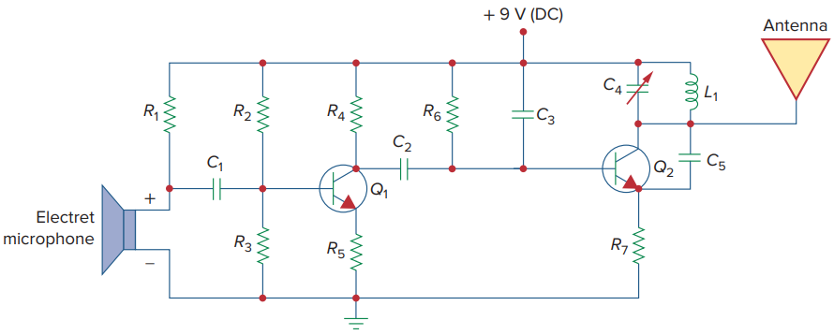
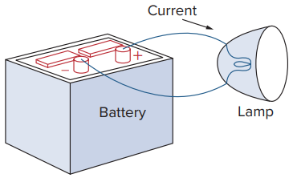
Introduction

Slide 3
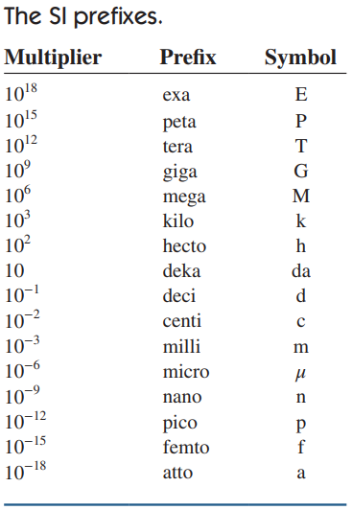
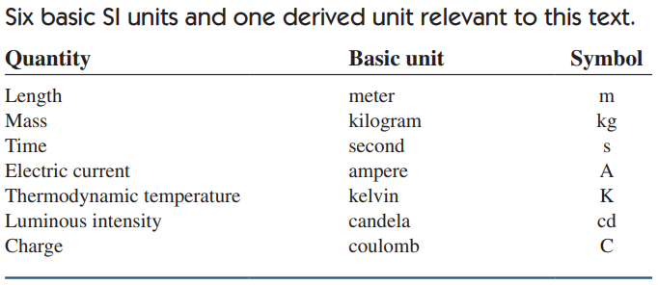
System of Units

Slide 4
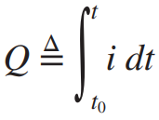

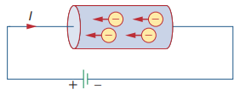
Charge and Current
Charge is an electrical property of the atomic particles of which matter consists, measured in coulombs (C).
Electric current is the time rate of change of charge, measured in amperes (A).

Slide 5
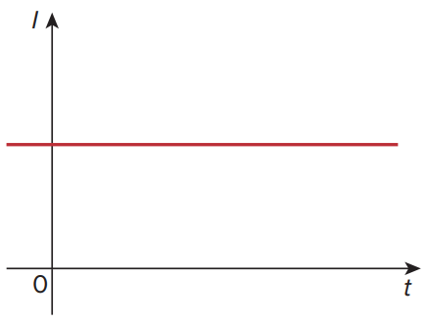
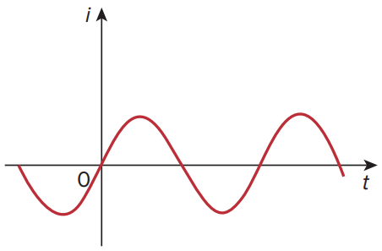
DC and AC
A direct current (dc) flows only in one direction and can be constant or time varying.
An alternating current (ac) is a current that changes direction with respect to time.

Slide 6
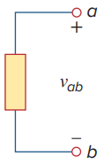


Voltage
Voltage (or potential difference) is the energy required to move a unit charge from a reference point (−) to another point (+), measured in volts (V).

Slide 7

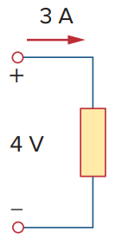
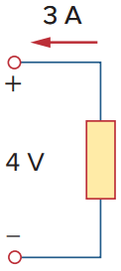
Power and Energy
Power is the time rate of expending or absorbing energy, measured in watts (W).
p = +vi or vi > 0 implies that the element is absorbing power. p = −vi or vi < 0 implies that the element is supplying power.

Slide 8

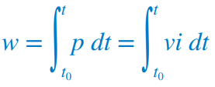
continued…
Total power supplied to the circuit must balance the total power absorbed.
Energy is the capacity to do work, measured in joules (J).

Slide 9
Circuit Element
Active Element
Passive Element
Capable of generating energy
Example:
generators
batteries
operational amplifiers
The most important active elements are voltage sources or current sources that generally deliver power to the circuit connected to them.
Not capable of generating energy
Example:
resistors
capacitors
inductors

Slide 10
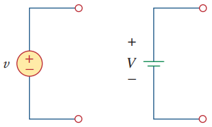
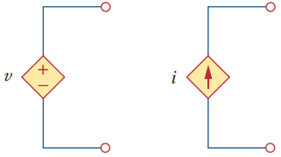
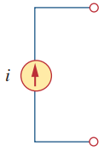
Voltage Source and Current Source
Ideal Independent Source: an active element that provides a specified voltage or current that is completely independent of other circuit elements
Ideal Dependent (or controlled) Source: an active element in which the source quantity is controlled by another voltage or current
voltage-controlled voltage source (VCVS)
current-controlled voltage source (CCVS)
voltage-controlled current source (VCCS)
current-controlled current source (CCCS)

Slide 11

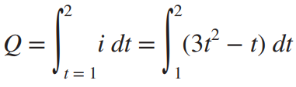

Example

Slide 12

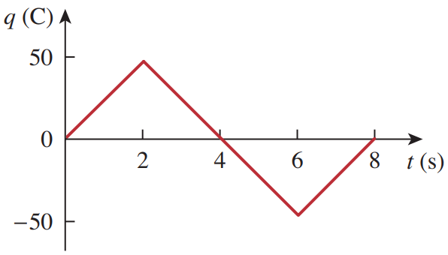
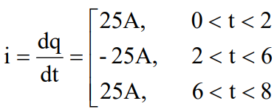
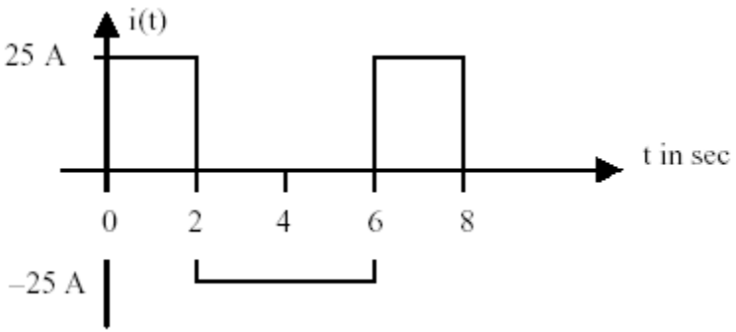
continued…

Slide 13

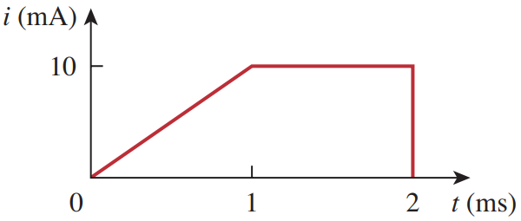





continued…

Slide 14
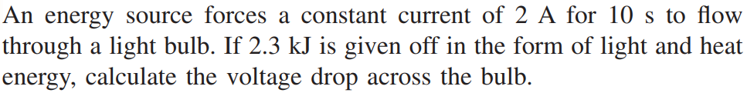


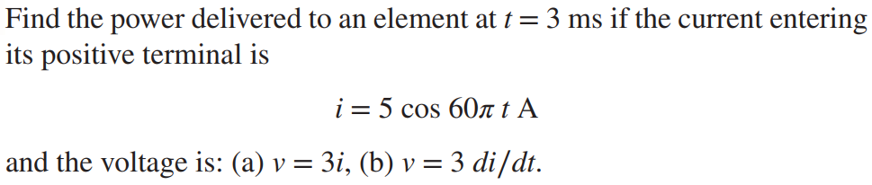



continued…
(a)

Slide 15
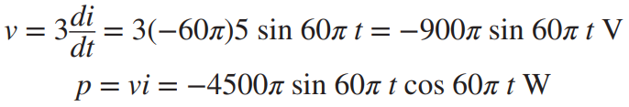




continued…
(b)
or,

Slide 16
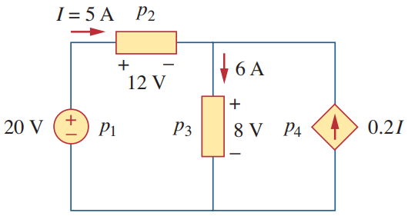










continued…

Slide 17
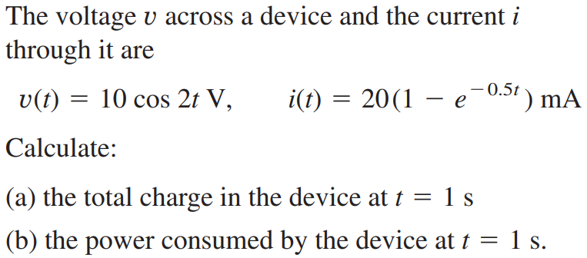







continued…

Slide 18
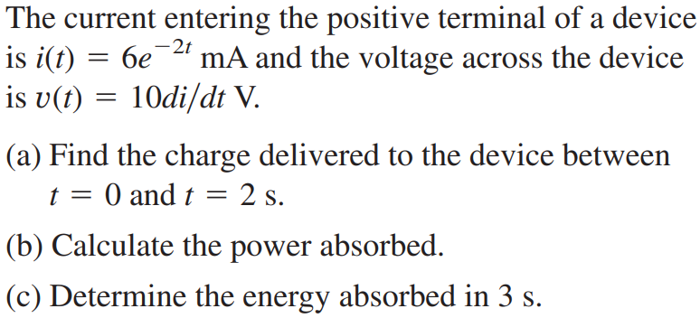



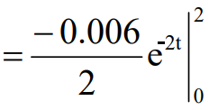






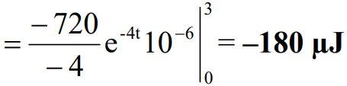

continued…

Slide 19


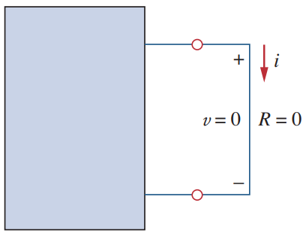
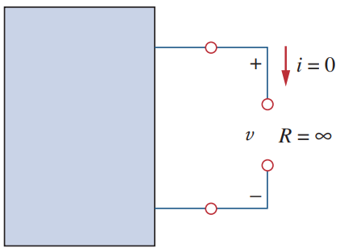

Ohm’s Law
The voltage (v) across a resistor is directly proportional to the current (i) flowing through the resistor.

Slide 20
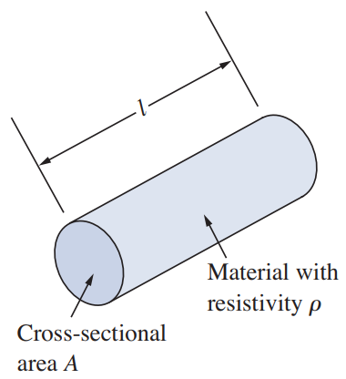
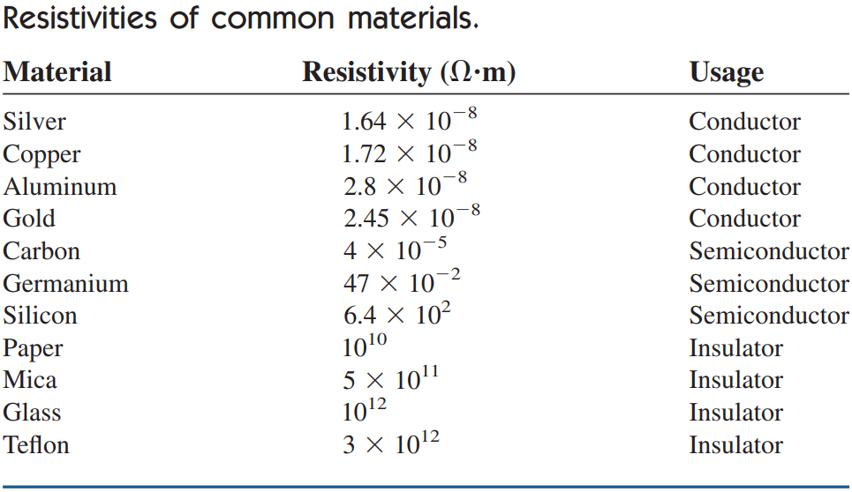

Resistivity

Slide 21
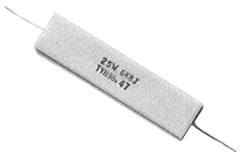
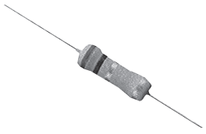
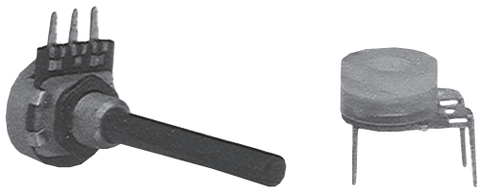

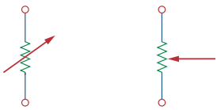



Some Terms
Resistance: Physical property of object
Resistivity: Physical property of material
Resistor or Conductor: Circuit Element (Object)
Conductance: 1 / Resistance
Conductivity: 1 / Resistivity

Slide 22
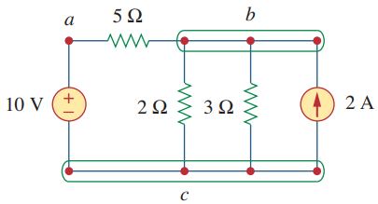
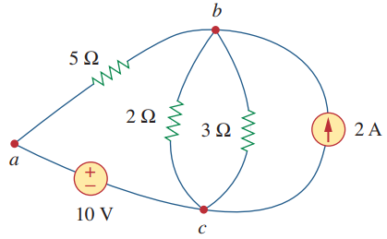

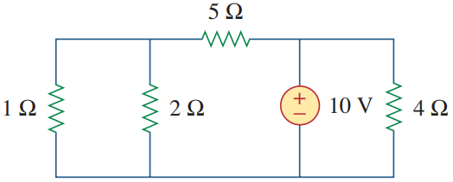
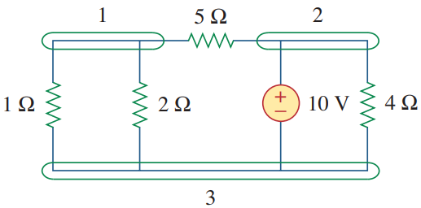
Nodes, Branches, and Loops

Slide 23
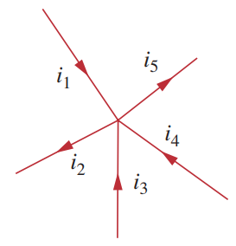
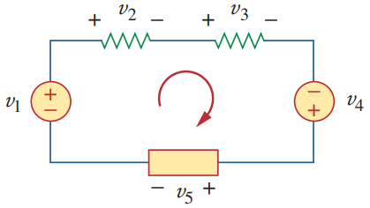


Kirchhoff’s Laws
KCL
KVL
Algebraic sum of all currents entering a node is zero.
Algebraic sum of all voltages around a closed path is zero.

Slide 24

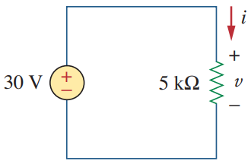




Example

Slide 25

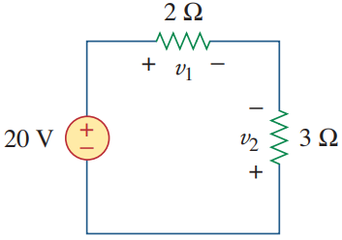
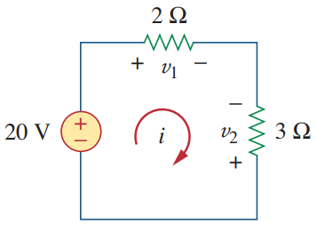






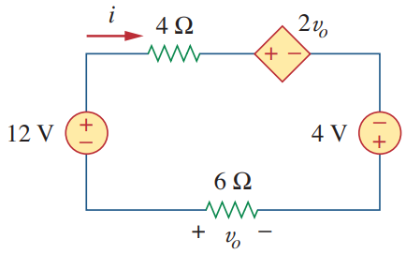




continued…

Slide 26
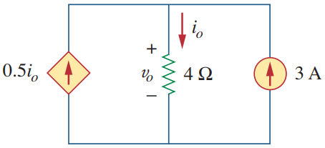




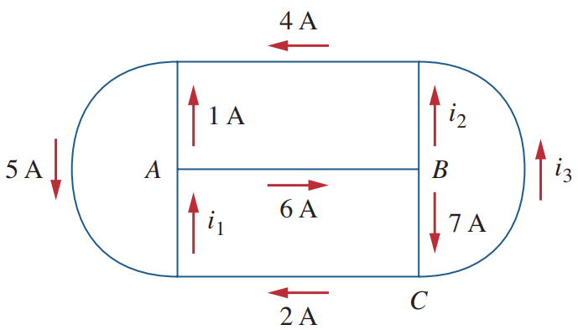






continued…

Slide 27
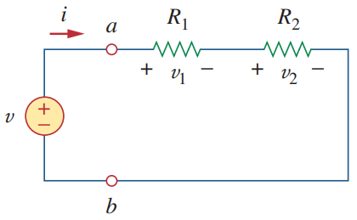



Series Resistors and Voltage Division

Slide 28
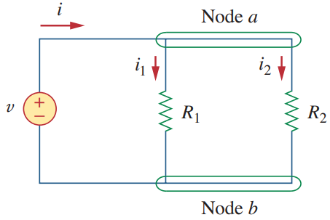



Parallel Resistors and Current Division

Slide 29








Example

Slide 30








continued…

Slide 31





continued…

Slide 32








continued…

Slide 33













continued…

Slide 34









Wye-Delta Transformations

Slide 35







Example

Slide 36








continued…

Slide 37







continued…

Slide 38
















continued…

Slide 39




continued…
[in this series combination]
B1 rated: 220 V – 60 W
B2 rated: 220 V – 100 W
$$P={V^{2}}/R$$
$$R_{60}={{220}^{2}}/{60}=807 Ω$$
$$R_{100}={{220}^{2}}/{100}=484 Ω$$
$$I=V/R={220}/{\left(807+484\right)}=0.17 A$$
Power dissipated in Bulb1, $P_{60}=I^{2}R_{60}={0.17}^{2}∙807=23.3 W$
Power dissipated in Bulb2, $P_{100}=I^{2}R_{100}={0.17}^{2}∙484=13.9 W$

Slide 40


Nodal Analysis

Slide 41











Example

Slide 42










continued…

Slide 43



Supernode
If the voltage source (dependent or independent) is connected between two nonreference nodes, the two nonreference nodes form a generalized node or Supernode.

Slide 44








Example

Slide 45






continued…
$$\frac{v−14}{4}+\frac{v−0}{3}+\frac{v_{1}−0}{2}+\frac{v_{1}−0}{6}=0$$
$$⟹3v−42+4v+6v_{1}+2v_{1}=0$$
$$⟹8v_{1}+7v=42$$
$$v_{1}−v=6$$
$$v_{1}=5.6V ;v=−0.4V$$
$$∴i={5.6}/2=2.8A$$

Slide 46





continued…

Slide 47














continued…

Slide 48






continued…
$$v_{1}−v_{2}=25$$
$$v_{3}−v_{2}=5i$$
But, $i={v_{1}}/2$
$$∴v_{3}−v_{2}={5v_{1}}/2$$
$$⟹−2.5v_{1}−v_{2}+v_{3}=0$$

Slide 49



Mesh Analysis
It is only applicable to a circuit that is planar. A planar circuit is one that can be drawn in a plane with no branches crossing one another; otherwise it is nonplanar.

Slide 50










Example

Slide 51






continued…

Slide 52




continued…

Slide 53












continued…
Find i₁ and i₂.

Slide 54





continued…
$$−6+{9i}_{1}−{3i}_{2}−{4i}_{3}=0$$
$$−4−{3i}_{1}+{8i}_{2}=0$$
$$−2−{4i}_{1}+{6i}_{3}−{1i}_{4}=0$$
$$+3−{1i}_{3}+{2i}_{4}=0$$

Slide 55

















continued…
$$∵i_{0}=i_{3}$$

Slide 56





Supermesh
Supermesh results when two meshes have a (dependent or independent) current source in common.

Slide 57








Example

Slide 58







continued…

Slide 59





continued…

Slide 60




continued…

Slide 61












continued…

Slide 62
Superposition
Voltage across (or current through) an element in a linear circuit is the algebraic sum of the voltages across (or currents through) that element due to each independent source acting alone.
Turn off all independent sources except one source. Find the output (voltage or current) due to that active source using the techniques previously covered.
Repeat previous step for each of the other independent sources.
Find the total contribution by adding algebraically all the contributions due to the independent sources.

Slide 63







Example
v₁ due to 6-V voltage source alone.
v₂ due to 3-A current source alone.

Slide 64







continued…
i_{o}’ due to 4-A current source alone.
i_{o}” due to 20-V voltage source alone.

Slide 65














continued…
$$6i_{2}−1i_{3}−5{i^{′}}_{o}=12$$
$$−1i_{2}+10i_{3}+5{i^{′}}_{o}=20$$
$$0i_{2}+1i_{3}+1{i^{′}}_{o}=4$$

Slide 66






continued…
i₁ due to 16-V voltage source alone.
i₂ due to 4-A current source alone.
i₃ due to 12-V voltage source alone.

Slide 67





continued…
v₁ due to 10-V voltage source alone.
v₂ due to 2-A current source alone.

Slide 68








continued…

Slide 69




continued…
i₁ due to 12-V voltage source alone.
i₂ due to 24-V voltage source alone.
i₃ due to 3-A current source alone.

Slide 70










continued…

Slide 71



Source Transformation

Slide 72






Example

Slide 73






continued…

Slide 74






continued…

Slide 75







continued…

Slide 76




continued…
$$20i+12−18−30−30=0$$
$$⟹i=3.3$$
$$∴v_{0}=−2i=−6.6 V$$

Slide 77

Thevenin’s Theorem

Slide 78




Example

Slide 79












continued…

Slide 80




continued…

Slide 81









continued…

Slide 82




continued…

Slide 83








continued…
$$3+(v_{1}−v_{2})/20=0$$
$$−60=v_{1}−v_{2}$$

Slide 84







continued…
To find $R_{Th}$, we set the independent source equal to zero but leave the dependent source alone.
Because of the presence of the dependent source, however, we excite the network with a voltage source $v_{o}$ connected to the terminals.

Slide 85













continued…

Slide 86










continued…

Slide 87




Norton’s Theorem

Slide 88









Example

Slide 89









continued…
Alternative via Thevenin Voltage:

Slide 90




Maximum Power Transfer

Slide 91




Example

Slide 92






continued…
$$\frac{V−12}{6}+\frac{V−0}{12}+\frac{V−V_{Th}}{3}=0$$
$$⟹7V−4V_{Th}=24$$
$$\frac{V_{Th}−V}{3}−2=0$$
$$⟹−V+V_{Th}=6$$

Slide 93
Electrical Technology (Part 2)
EEE 101

Slide 94



Capacitor

Slide 95








continued…
Unit of Capacitance: Farad (F)
1 Farad = 1 Coulomb / Volt

Slide 96



continued…
A capacitor is an open-circuit to DC.
If a battery (DC voltage) is connected across a capacitor, the capacitor charges.
The voltage across a capacitor cannot change abruptly.
Allowed Not allowed

Slide 97









Example

Slide 98




continued…

Slide 99






continued…

Slide 100



continued…

Slide 101








continued…

Slide 102



Series & Parallel Capacitors

Slide 103




Example

Slide 104




continued…

Slide 105






continued…

Slide 106









continued…

Slide 107



Inductor
L = Inductance
Unit of inductance: Henry (H)
1 Henry = 1 Volt-second per Ampere

Slide 108





continued…
An inductor acts like a short-circuit to DC.
The current through an inductor cannot change instantaneously.
Allowed Not allowed

Slide 109









Example

Slide 110









continued…
$$w=\frac{1}{2}Li^{2}\left(4\right)$$
$$=\frac{1}{2}∙2∙{\left(−18\right)}^{2}$$
$$=324 J$$
If the question was: Find the energy stored between t=0 and t=4 s.
$$w=\frac{1}{2}Li^{2}\left(4\right)−\frac{1}{2}Li^{2}(0)$$
$$=\frac{1}{2}∙2∙{\left(−18\right)}^{2}−\frac{1}{2}∙2∙{\left(2\right)}^{2}$$
$$=324−4=320 J$$

Slide 111






continued…
Find i, v_{C} , i_{L} , and the energy stored in the capacitor and inductor.

Slide 112



Series and Parallel Inductors

Slide 113




Example

Slide 114








continued…

Slide 115

1889 engraving by William Allen Rogers for Harper’s Weekly magazine. GRAND STREET, NEW YORK, AT NIGHT

Slide 116


October 11, 1889. The death of John Feeks. Manhattan, New York.
World's Columbian Exposition, 1893, Chicago

Slide 117
1st-order Circuits
RC and RL circuits: characterized by a 1st-order differential equation.
2 ways of excitation:
Energy is initially stored in capacitor or inductor; source-free circuit.
Circuit is excited by independent sources.

Slide 118













Source-Free RC Circuit

Slide 119


continued…
Time constant (τ) of a circuit is the time required for the response to decay to a factor of 1/e or 36.8 percent of its initial value.
The natural response depends on the nature of the circuit alone, with no external sources.
In fact, the circuit has a response only because of the energy initially stored in the capacitor.

Slide 120













Example
We have to find Thevenin resistance at the capacitor terminals.

Slide 121









continued…
We have to find Thevenin resistance at the capacitor terminals.

Slide 122








continued…

Slide 123












Source-Free RL Circuit

Slide 124






Example
We have to find Thevenin resistance at the inductor terminals.
Because of the dependent source, we insert a 1V voltage source at the inductor terminals a-b.

Slide 125














continued…

Slide 126







continued…

Slide 127





continued…
We have to find Thevenin resistance at the inductor terminals.

Slide 128





continued…

Slide 129







continued…
We have to find Thevenin resistance at the inductor terminals.

Slide 130




continued…

Slide 131

Singularity Functions
(also called switching functions): either are discontinuous or have discontinuous derivatives.
Unit Step | Unit Impulse | Unit Ramp
u(t) | δ(t) | r(t)
$$u\left(t\right)=\left\{\begin{aligned}0, t<0 \\ &1, t>0\end{aligned}\right.$$ | $$δ\left(t\right)=\left\{\begin{aligned}0, t<0 \\ &∞, t=0 \\ 0, t>0\end{aligned}\right.$$ | $$r\left(t\right)=\left\{\begin{aligned}0, t≤0 \\ &t, t≥0\end{aligned}\right.$$
$$u\left(t\right)=\int_{−∞}^{t}{δ\left(t\right)dt}$$ $$u(t)=\frac{d}{dt}r(t)$$ | $$δ\left(t\right)=\frac{d}{dt}u\left(t\right)$$ | $$r\left(t\right)=tu(t)$$

Slide 132






Step Function

Slide 133




Impulse Function
(also known as Dirac delta function): NOT physically realizable.
$$\int_{0^{−}}^{0^{+}}{δ\left(t\right)dt=1}$$
The unit area is known as the strength of the impulse function.
When an impulse function has a strength other than unity, the area of the impulse is equal to its strength.
$$δ\left(t\right)=\left\{\begin{aligned}0, t<0 \\ &∞, t=0 \\ 0, t>0\end{aligned}\right.$$

Slide 134






Ramp Function

Slide 135




Step Response of RC Circuit
The step response is the response of the circuit due to a sudden application of a dc voltage or current source.
Response of an RC circuit with initially charged capacitor

Slide 136



continued…
Transient response is the circuit’s temporary response that will die out with time.
Steady-state response is the behavior of the circuit a long time after an external excitation is applied.
Step response of an RC circuit with initially uncharged capacitor:
(left) voltage response, (right) current response
If the switch changes position at time $t=t_{0}$

Slide 137









Example

Slide 138








continued…

Slide 139











continued…
We have to find Thevenin resistance at the capacitor terminals.

Slide 140


continued…

Slide 141





Step Response of RL Circuit
The step response is the response of the circuit due to a sudden application of a dc voltage or current source.
Total response of an RL circuit with initial inductor current $I_{0}$

Slide 142



continued…
Step response of an RL circuit with no initial inductor current:
(left) current response, (right) voltage response
If the switch changes position at time $t=t_{0}$

Slide 143









Example
We have to find Thevenin resistance at the inductor terminals.

Slide 144








continued…

Slide 145












continued…

Slide 146



continued…

Slide 147

continued…

Slide 148
Electrical Technology (Part 3)
EEE 101

Slide 149




Basic: Magnetic Field
Flux Density
Relative Permeability
Magnetomotive Force
Reluctance

Slide 150





Ohm’s Law for Magnetic Circuits
Desired effect is the flux $Φ$.
The cause is the magnetomotive force (mmf) $ℱ$, which is the external force required to set up the flux lines within the magnetic material.
The opposition to the setting up of the flux is the reluctance $ℜ$.
$Φ$is established in the core through the alteration of the atomic structure of the core due to $ℱ$, and is not a measure of the flow of some charged particles through the core.

Slide 151



Magnetizing Force
mmf per unit length is called the magnetizing force (H).
H is independent of the type of core material.
For a particular H, the greater the µ, the greater is the induced flux density B.

Slide 152

continued…
Variation of µ with the H

Slide 153

Hysteresis

Slide 154

continued…
Normal magnetization curve

Slide 155

continued…
Expanded view of previous figure for the low H region (rotated counterclockwise)

Slide 156


Ampère’s Circuital Law
Algebraic sum of the rises and drops of the mmf around a closed loop of a magnetic circuit is equal to zero.
or
Sum of the rises in mmf equals the sum of the drops in mmf around a closed loop.

Slide 157




continued…

Slide 158



Flux: remember KCL?
$$\sum{\text{fluxes} \text{entering} \text{a} \text{junction}}=\sum{\text{fluxes} \text{leaving} \text{a} \text{junction}}$$

Slide 159











Example

Slide 160







continued…

Slide 161








continued…
Determine the current I required to establish the indicated flux in the core.

Slide 162









continued…

Slide 163







continued…
Determine the secondary current $I_{2}$ for the transformer if the resultant clockwise flux in the core is $1.5×{10}^{−5}$ Wb.
$$H \left(Sheet steel\right)≅30 At/m$$
$$N_{1}I_{1}=H_{abcda}l_{abcda}+N_{2}I_{2}$$
$$⟹\left(60 t\right)\left(2 A\right)=\left(30 {At}/m\right)\left(0.16 m\right)+(30 t)\left(I_{2}\right)$$

Slide 164


continued…
$$⟹120 At=4.8 At+(30 t)\left(I_{2}\right)$$
$$⟹\left(30 t\right)\left(I_{2}\right)=120 At−4.8 At$$
$$⟹I_{2}=\frac{115.2 At}{30 t}$$
$$⟹I_{2}=3.84 A$$
Note: Because of the nonlinearity of the B-H curve, it is not possible to apply superposition to magnetic circuits.

