Slide 1
EEE 103
(Part 1)
Electrical Circuits II
Dept. of EEE, BUBT

Slide 2

1889 engraving by William Allen Rogers for Harper’s Weekly magazine. GRAND STREET, NEW YORK, AT NIGHT

Slide 3
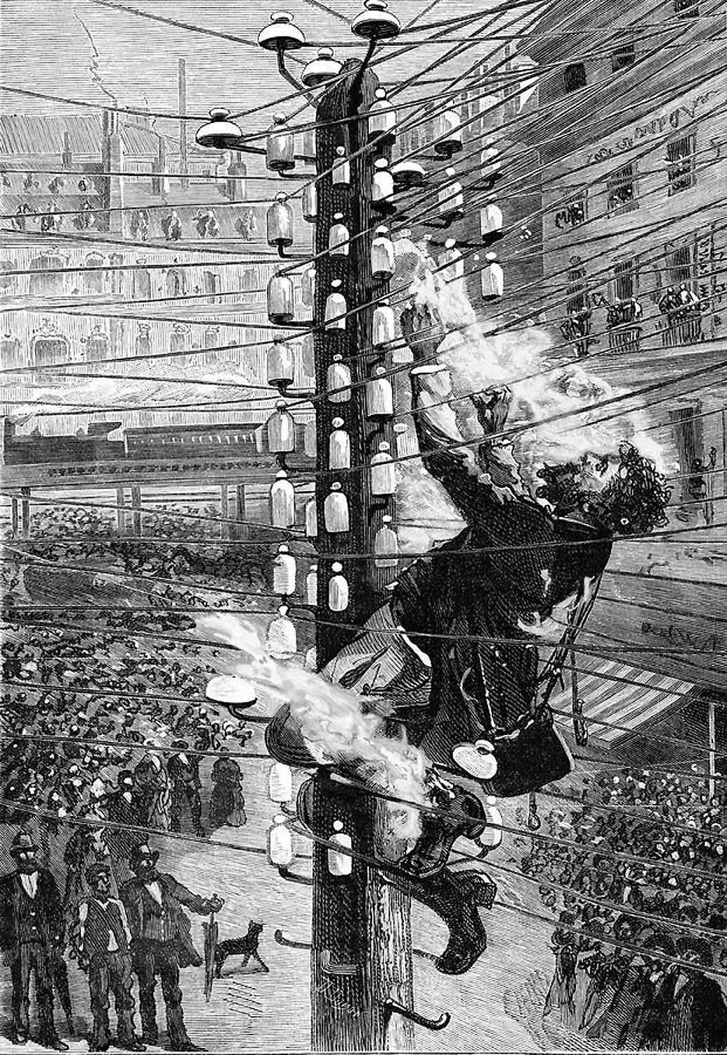
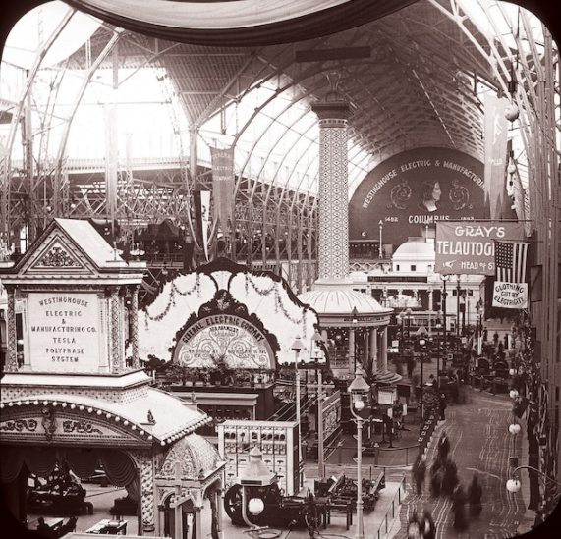
October 11, 1889. The death of John Feeks. Manhattan, New York.
World's Columbian Exposition, 1893, Chicago

Slide 4

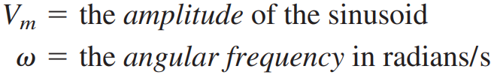

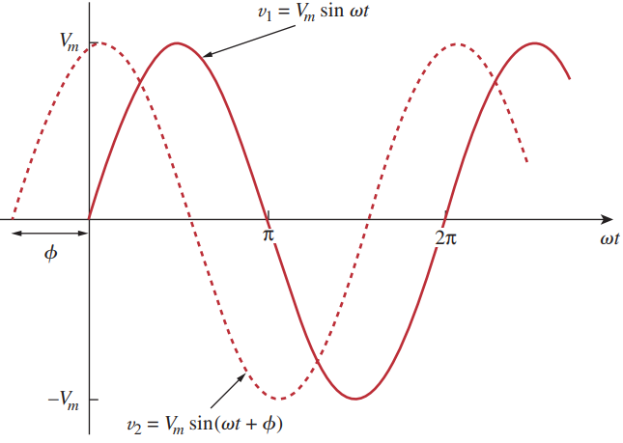



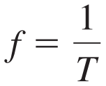

Sinusoids

Slide 5




Example

Slide 6
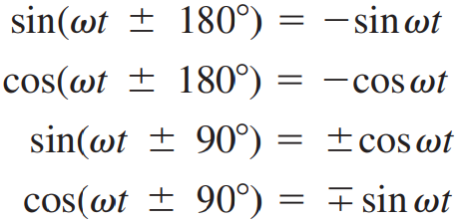



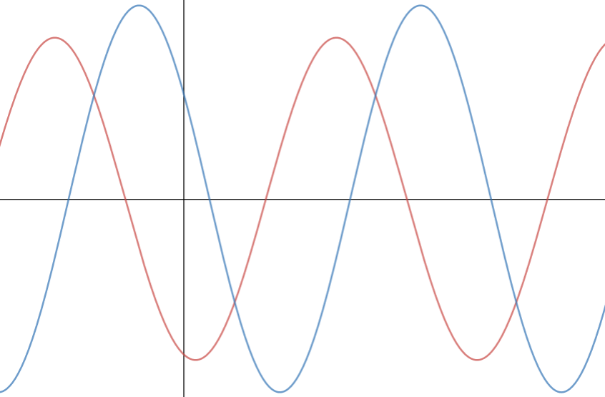

continued…
Red: v1
Blue: v2

Slide 7
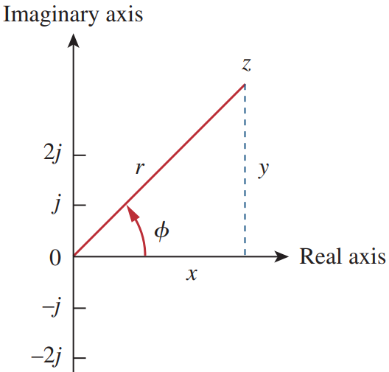
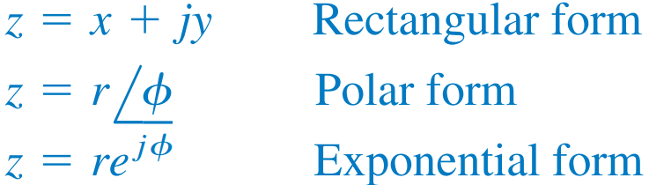
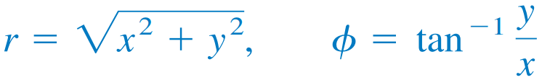
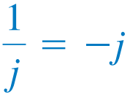
Phasors

Slide 8




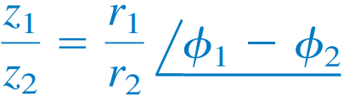
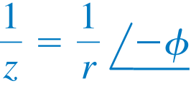


Some Basic Operations of Complex Number

Slide 9

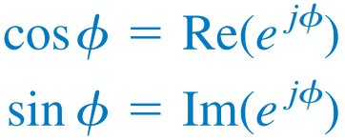
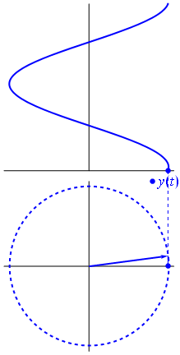



Euler’s Identity and Phasor Representation

Slide 10
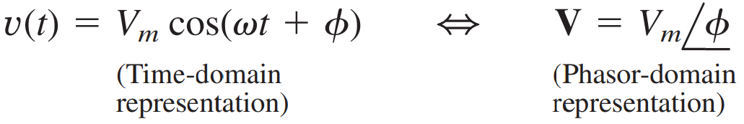
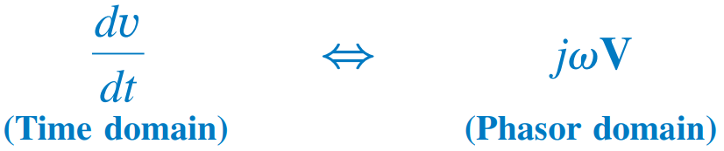
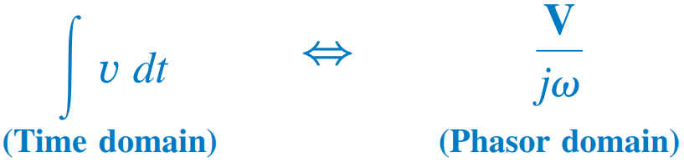
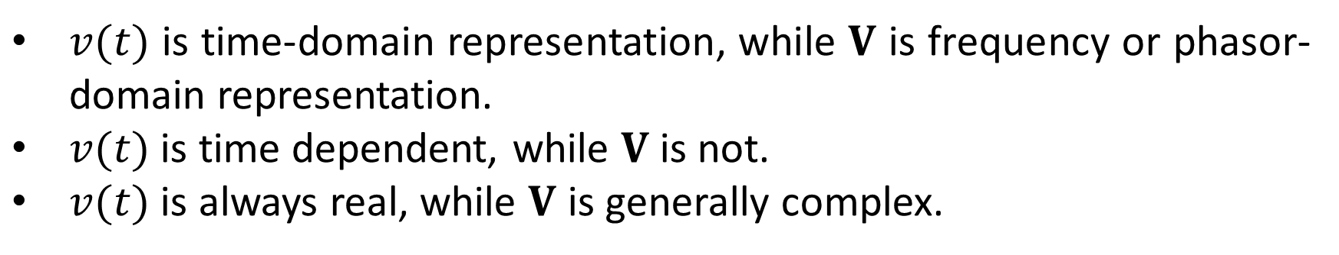
continued…
$v(t)$ is time-domain representation, while $V$ is frequency or phasor-domain representation.
$v(t)$ is time dependent, while $V$ is not.
$v(t)$ is always real, while $V$ is generally complex.

Slide 11
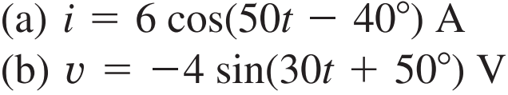






Example

Slide 12
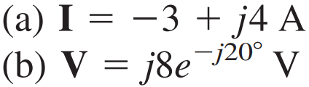







continued…

Slide 13
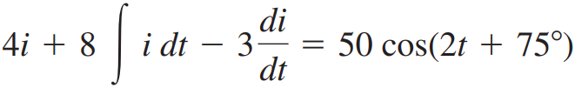
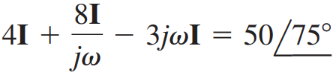


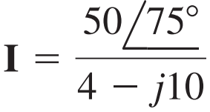
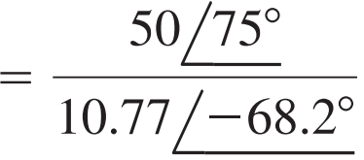

continued…

Slide 14
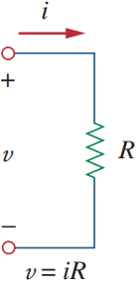





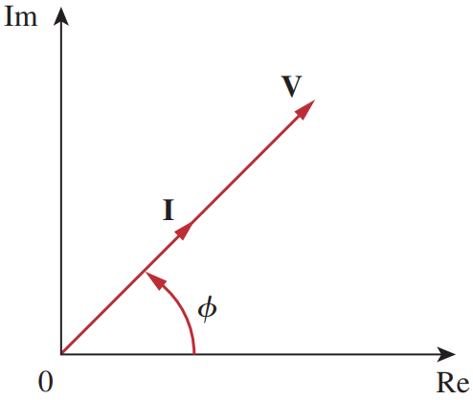

Phasor with Elements
(1) Resistor:
Current and Voltage are in phase.

Slide 15
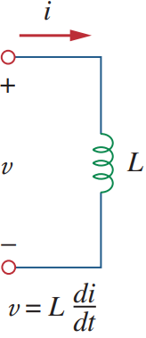
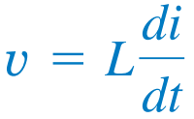

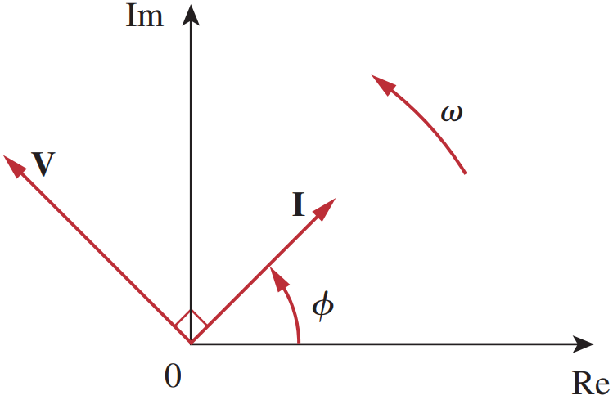


continued…
(2) Inductor:
Current lags Voltage by 90°

Slide 16
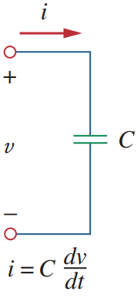

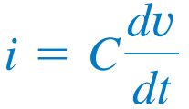

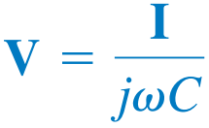

continued…
(3) Capacitor:
Current leads Voltage by 90°

Slide 17


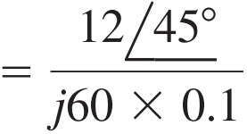
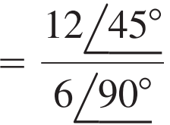
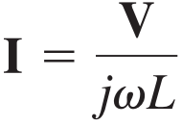


Example

Slide 18









continued…

Slide 19
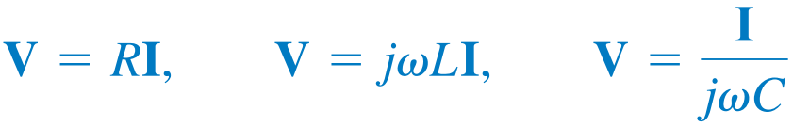
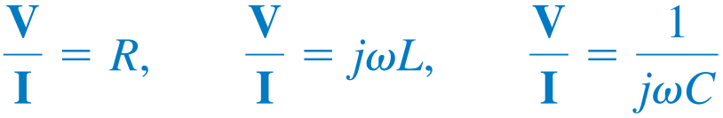
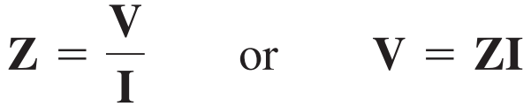
Impedance
Impedance (frequency-dependent)
Unit: Ohm

Slide 20


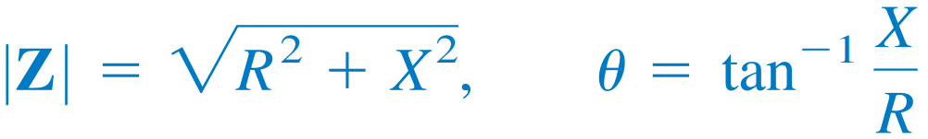

continued…
Impedance $Z$ is inductive (lagging) when $X$ is positive.
Impedance $Z$ is capacitive (leading) when $X$ is negative.
KCL, KVL, Voltage-division, Current-division – all hold in Phasor domain too.

Slide 21
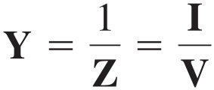






Admittance
Unit: Siemens (S) or Mho (℧)

Slide 22
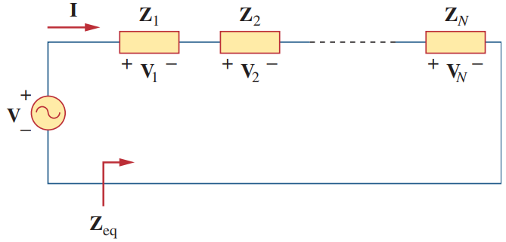

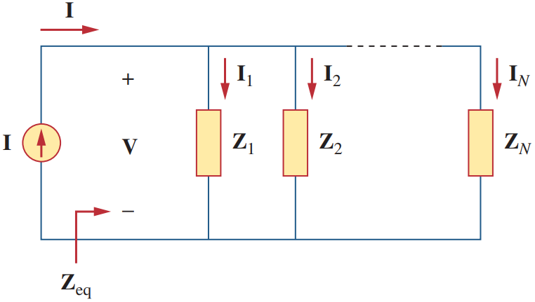



Series and Parallel Impedances

Slide 23
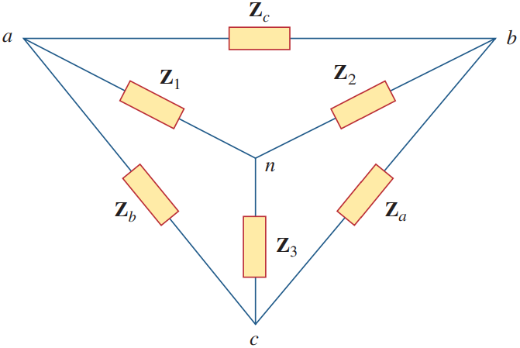


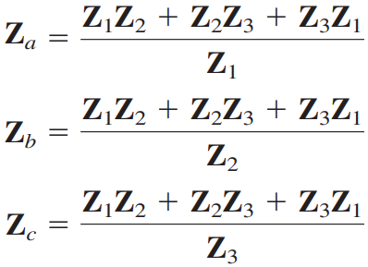
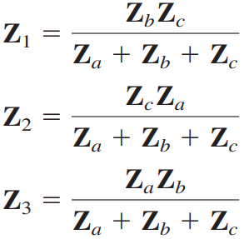
Y-Δ Transformations

Slide 24
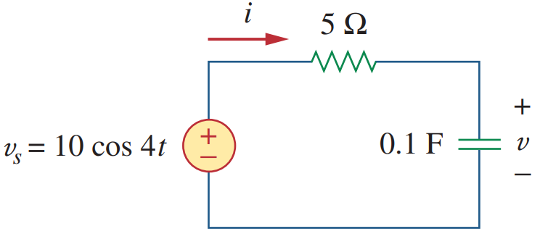


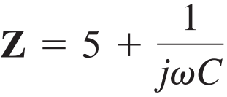
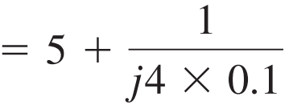

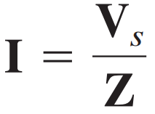



Example

Slide 25





continued…

Slide 26














continued…

Slide 27











continued…

Slide 28




continued…

Slide 29














continued…

Slide 30




continued…

Slide 31









continued…

Slide 32






continued…

Slide 33









continued…

Slide 34





continued…

Slide 35







Nodal Analysis Example

Slide 36













continued…
Nodal Equations
(to be solved)

Slide 37








continued…

Slide 38




continued…
After substituting,

Slide 39






Mesh Analysis Example

Slide 40





continued…
After substituting,

Slide 41








continued…

Slide 42






continued…
After solving those 4 equations,

Slide 43








continued…
N
At node N,
But, $I_{o}=I_{1}$
$⟹I_{o}=5.074 ∠5.94°$ A
After solving, $I_{1}=5.074 ∠5.94°$ A

Slide 44







Superposition Example

Slide 45












continued…
After solving,

Slide 46
















continued…

Slide 47













continued…

Slide 48


continued…
Source Transformation

Slide 49







Source Transformation Example

Slide 50






continued…

Slide 51





Thevenin and Norton Equivalent Circuits

Slide 52







Example

Slide 53










continued…

Slide 54








continued…
Finding Z_{Th}:
Due to the presence of the dependent source, we connect a 3-A current source (or voltage source if you want).
3 is an arbitrary value chosen for convenience here.

Slide 55










continued…

Slide 56








continued…
Finding Z_{Th}:
Due to the presence of the dependent source, we connect a 1-V voltage source (or current source if you want).

Slide 57










continued…

Slide 58






continued…
Substituting this V₁ into node equation 1:

Slide 59







continued…
Obtain the Norton equivalent at terminals a-b

Slide 60









continued…
After solving,
$=8.54 ∠69.44°$ A

Slide 61






continued…

Slide 62








continued…
At node N,
$$I_{2}=I_{1}+(−j4)$$
N
After solving,

Slide 63





continued…

Slide 64









continued…
Finding Z_{Th}:
Due to the presence of the dependent source, we connect a 1-A current source (or voltage source if you want).

Slide 65








continued…
$$=−0.42+0.51j Ω$$
Finding V_{Th}

Slide 66











continued…

Slide 67




Instantaneous Power
The instantaneous power (in watts) is the power at any instant of time.

Slide 68

continued…
The first part is constant (time independent). Its value depends on the phase difference between voltage & current.
The second part is a sinusoidal function whose frequency is 2ω.

Slide 69






Average Power
The average power (in watts) is the average of the instantaneous power over one period.
We know,
Thus,

Slide 70



continued…
For purely resistive circuit, current & voltage are in phase.
For purely reactive circuit, current & voltage are out of phase (±90°).
waveform on next page
A resistive load (R) absorbs power at all times, while a reactive load (L or C) absorbs zero average power.

Slide 71


continued…
Pure Inductor
Pure Capacitor

Slide 72




Example
You can use this too:

Slide 73






continued…

Slide 74










continued…

Slide 75







continued…

Slide 76







continued…
The circuit is delivering average power to the voltage source.
The current source is delivering average power to the circuit.
This average power is absorbed by the resistor.

Slide 77












continued…
voltage across it is
$$current through it is \left(I_{1}−I_{2}\right)=4−10.58∠79.1°$$
$$=10.58∠−79.1° A$$
voltage across it is
$$=\left(10∠90°\right)\left(10.58∠−79.1°\right)$$
$=105.8∠10.9°$ V

Slide 78




Maximum Average Power Transfer
For maximum average power transfer, the load impedance Z_{L} must be equal to the complex conjugate of the Thevenin impedance Z_{Th}.

Slide 79

continued…
In a special situation in which the load is purely real:
The load $R_{L}$ must be chosen such that
$$R_{L}=\sqrt{{R_{Th}}^{2}+{X_{Th}}^{2}}=\left|Z_{Th}\right|$$
Then,
$$P_{max}=\frac{1}{2}{\left|I\right|}^{2}R_{L}$$
where $I$ is the current phasor flowing through load $R_{L}$.

Slide 80






Example

Slide 81








continued…

Slide 82









continued…

Slide 83







continued…

Slide 84





Effective or RMS Value
The effective value of a periodic current is the dc current that delivers the same average power to a resistor as the periodic current.

Slide 85






continued…

Slide 86




Apparent Power and Power Factor
The apparent power, S (in VA) is the product of the rms values of voltage and current.
Power Factor, pf (dimensionless) is the ratio of the average power to the apparent power.

Slide 87





continued…
Power Factor (pf) is the cosine of phase difference between voltage and current. It is also the cosine of the angle of the load impedance.
Value of pf ranges between zero and unity.
For a purely resistive load, the voltage and current are in phase, that means $θ_{v}=θ_{i}$ ; thus, pf = 1.
  apparent power (S) = average power (P)
For a purely reactive load, $θ_{v}−θ_{i}=±90°$. Thus, pf = 0.
  average power (P) is zero.
Leading pf means: current leads voltage → capacitive load (negative pf angle)
Lagging pf means: current lags voltage → inductive load (positive pf angle)

Slide 88
EEE 103
(Part 2)
Electrical Circuits II

Slide 89
Apparent Power and Power Factor
The apparent power, S (in VA) is the product of the rms values of voltage and current.
Power Factor, pf (dimensionless) is the ratio of the average power to the apparent power.

Slide 90
continued…
Power Factor (pf) is the cosine of phase difference between voltage and current. It is also the cosine of the angle of the load impedance.
Value of pf ranges between zero and unity.
For a purely resistive load, the voltage and current are in phase, that means $θ_{v}=θ_{i}$ ; thus, pf = 1.
  apparent power (S) = average power (P)
For a purely reactive load, $θ_{v}−θ_{i}=±90°$. Thus, pf = 0.
  average power (P) is zero.
Leading pf means: current leads voltage → capacitive load (negative pf angle)
Lagging pf means: current lags voltage → inductive load (positive pf angle)

Slide 91
















Example
Load impedance Z can be modeled by a 25.98 Ω resistor in series with a capacitor.

Slide 92













continued…

Slide 93









Complex Power
Complex power S absorbed by the ac load is the product of the voltage and the complex conjugate of the current.

Slide 94



continued…
Total complex power in a network is the sum of complex powers of individual components.

Slide 95


Power Triangle

Slide 96


















Example
$$={60∠−10°}/{1.5∠50°}=20−j34.64 Ω$$

Slide 97















continued…
Since pf is lagging, reactive power (Q) is positive.
kVAR

Slide 98













continued…
$$=1.027+j0.62 Ω$$

Slide 99











continued…

Slide 100












continued…

Slide 101












continued…
$$S_{1}=\left(V_{rms}\right)\left({I_{1,rms}}^{∗}\right)=\left(120∠10°\right)\left(2∠−40°\right)=240∠−30°$$
$$=207.85−j120 VA$$
$$S_{2}=\left(V_{rms}\right)\left({I_{2,rms}}^{∗}\right)=\left(120∠10°\right)\left(3∠35°\right)=360∠45°$$
$$=254.6+j254.6 VA$$

Slide 102











continued…

Slide 103






Power Factor Correction
The process of increasing the power factor without altering the voltage or current to the original load is known as power factor correction.
With the same supplied voltage, the original circuit (on left) draws larger current than the improved circuit (on right). $\left|I_{L}\right|>\left|I\right|$
Power companies charge more for larger currents, because they result in increased power losses.
Therefore, it is beneficial to both the power company and the consumer to keep the power factor as close to unity as possible.

Slide 104










continued…
If the original inductive load has apparent power S₁ , then
If we desire to increase the power factor from $\cos{θ_{1}}$ to $\cos{θ_{2}}$ without altering the real power, then the new reactive power is
The reduction in reactive power is caused by the shunt capacitor:

Slide 105






continued…
Rare case: Load may be capacitive (pf is leading).
An inductor (L) should be connected across the load for pf correction.
(the difference between the new and old reactive powers)

Slide 106









Example
$$=\frac{4000\left(\tan{36.87°}−\tan{18.19°}\right)}{2π×60×{120}^{2}}$$

Slide 107





continued…
$$\cos{θ_{1}}=0.85$$
$$⟹θ_{1}=31.79°$$
Now,
$$P=S\cos{θ_{1}}$$
$$⟹P=\frac{Q}{\sin{θ_{1}}}\cos{θ_{1}}$$
$$⟹P=\frac{140×{10}^{3}}{\sin{31.79°}}×0.85=225.93 kW$$
$$\cos{θ_{2}}=1$$
$$⟹θ_{2}=0°$$
$$=\frac{225.93×{10}^{3}\left(\tan{31.79°}−\tan{0°}\right)}{2π×60×{110}^{2}}$$

Slide 108




Three-Phase Circuits
Circuits or systems in which the ac sources operate at same frequency but different phases are known as polyphase.
(covered in previous chapter)

Slide 109


Slide 110
continued…
Why are 3-phase systems important?
Nearly all electric power is generated and distributed in 3-phase, at the operating frequency of 60 Hz or 50 Hz.
  When 1-phase or 2-phase inputs are required, they are taken from the 3-phase system rather than generated independently.
The instantaneous power in a 3-phase system can be constant.
  This results in uniform power transmission and less vibration.
The amount of wire required for a 3-phase system is less than that required for an equivalent 1-phase system to deliver same power.
  The 3-phase system is more economical than 1-phase (33% more material).

Slide 111

continued…

Slide 112

Balanced 3-Ø Voltage Source
3-Ø current source is very scarce.

Slide 113



continued…

Slide 114




continued (Star Connection)…
Positive (abc) Sequence
Negative (acb) Sequence

Slide 115


continued (Star Connection)…
Positive (abc) Sequence
Negative (acb) Sequence

Slide 116






Balanced 3-Ø Load
Y-connected Load
Δ-connected Load

Slide 117








Example

Slide 118








Balanced Y-Y Connection
Assuming the positive sequence,
the phase voltages (or line-to-neutral voltages):
The line-to-line voltages or simply line voltages:

Slide 119











continued…
The Line Currents

Slide 120


continued…
Thus, voltage across the neutral wire is zero. The neutral line can thus be removed without affecting the system.
In Y-Y system, the line current is the same as the phase current.

Slide 121









Example
Since the source voltages are in positive sequence, the line currents are also in positive sequence.

Slide 122










continued…

Slide 123








continued…

Slide 124






Balanced Y-Δ Connection
Assuming the positive sequence, the phase voltages are:
The line voltages are:
The phase currents are:

Slide 125








continued…
The line currents are:
$$=I_{AB}−I_{AB}∠−240°$$

Slide 126







continued…
Alternatively, we can transform Y-Δ system to a Y-Y system.
Then solve the line current using 1-Ø equivalent circuit.
Then the phase currents are solved using:

Slide 127










Example

Slide 128




continued…
The phase currents are:
$$I_{AB}=\frac{I_{a}}{\sqrt{3}∠−30°}$$

Slide 129






Balanced Δ-Δ Connection
Assuming a positive sequence, the phase voltages are:
Line voltages = Phase voltages
The line currents are:
The phase currents are:

Slide 130








Example

Slide 131




continued…

Slide 132




Balanced Δ-Y Connection
The line voltages as well as the phase voltages:
Replace the Δ-connected source with its equivalent Y-connected source.
Now we find a Y-Y connection.
Then solve using equivalent 1-Ø circuit.
Equivalent Y-connected source has the phase voltages:

Slide 133




continued…
The line currents are:
Phase currents = Line currents

Slide 134









Example

Slide 135

Summary
Δ-connected load is more desirable than the Y-connected load:
It is easier to alter the loads in any one phase of the Δ-connected loads, as the individual loads are connected directly across the lines.
The Δ-connected source is hardly used in practice:
Any slight imbalance in the phase voltages will result in unwanted circulating currents.
Positive or abc sequence is assumed.

Slide 136

Power in a Balanced System
Total instantaneous power, $p\left(t\right)=3V_{p}I_{p}\cos{θ}$
Total average power, $P=3V_{p}I_{p}\cos{θ}=\sqrt{3}V_{L}I_{L}\cos{θ}$
Total reactive power, $Q=3V_{p}I_{p}\sin{θ}=\sqrt{3}V_{L}I_{L}\sin{θ}$
Total complex power, $S=3V_{p}{\left(I_{p}\right)}^{∗}=3{I_{p}}^{2}Z_{p}=\sqrt{3}V_{L}I_{L}∠θ$
Average power per phase, $P_{p}=V_{p}I_{p}\cos{θ}$
Reactive power per phase, $Q_{p}=V_{p}I_{p}\sin{θ}$
Apparent power per phase, $S_{p}=V_{p}I_{p}$
Complex power per phase, $S_{p}=P_{p}+jQ_{p}=V_{p}{\left(I_{p}\right)}^{∗}$
Remember that $V_{p}$, $I_{p}$, $V_{L}$, $I_{L}$ are rms values.

Slide 137








Example

Slide 138












Mutual Inductance
Self-inductance (L)

Slide 139







continued…
M₂₁ : mutual inductance of coil 2 with respect to coil 1.
M₁₂ : mutual inductance of coil 1 with respect to coil 2.
Mutual inductance is the ability of one inductor to induce a voltage across a neighboring inductor, measured in henrys (H).

Slide 140




Dot Convention: Magnetically Coupled Circuit
If a current enters the dotted terminal of one coil, the reference polarity of the mutual voltage in the second coil is positive at the dotted terminal of the second coil.
If a current leaves the dotted terminal of one coil, the reference polarity of the mutual voltage in the second coil is negative at the dotted terminal of the second coil.

Slide 141




continued…
I₁ enters L₁ at the dotted end, it induces a voltage in L₂ that tries to force a current out of the dotted end of L₂.
I₂ leaves L₂ at the dotted end, it induces a voltage in L₁ that tries to force a current into the dotted end of L₁.

Slide 142



Example

Slide 143








continued…
After solving,

Slide 144


continued…
For mesh 1, $−6j+\left(4+j8\right)I_{1}+j1I_{2}=0$
For mesh 2, $j1I_{1}+\left(j5+10\right)I_{2}=0$
After solving, $I_{2}=−j0.06$
$$∴V_{o}=10I_{2}$$
$$⟹V_{o}=−j0.6=0.6∠−90° V$$

Slide 145






continued…
For mesh 1,
$$−100+\left(4−j3+j6\right)I_{1}−j6I_{2}−j2I_{2}=0$$
$$⟹\left(4+j3\right)I_{1}−j8I_{2}=100$$
For mesh 2,
$$j2I_{2}+\left(j6+j8+5\right)I_{2}−j6I_{1}−j2\left(I_{1}−I_{2}\right)=0$$
$$⟹−j8I_{1}+\left(5+j18\right)I_{2}=0$$

Slide 146






continued…
For mesh 1,
$$−\left(12∠60°\right)+\left(5+j2+j3\right)I_{1}−j6I_{2}+j3(I_{2}−I_{1})=0$$
$$⟹\left(5+j2\right)I_{1}−j3I_{2}=6+j6\sqrt{3}$$
For mesh 2,
$$j3I_{1}+\left(j6−j4\right)I_{2}−j6I_{1}=0$$
$$⟹−1.5I_{1}+I_{2}=0$$

