Slide 1

Control System
EEE 401 (Part 1)
Dept. of EEE, BUBT

Slide 2
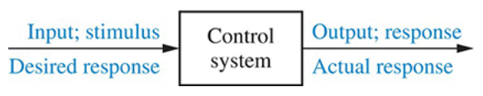
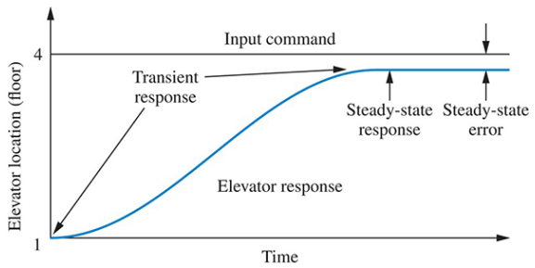
Introduction
A control system consists of subsystems and processes (or plants) assembled for the purpose of obtaining a desired output with desired performance, given a specified input.

Slide 3
Why do we build control systems?
Power amplification
Example: rotation of radar antenna
Remote control
Example: robot in radioactive environment
Convenience of input form
Example: temperature control by thermostat
Compensation for disturbances
Example: cancellation of wind-force on antenna

Slide 4
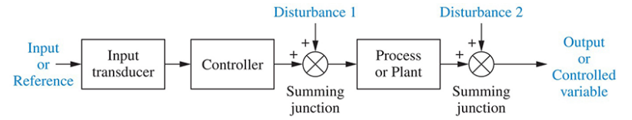
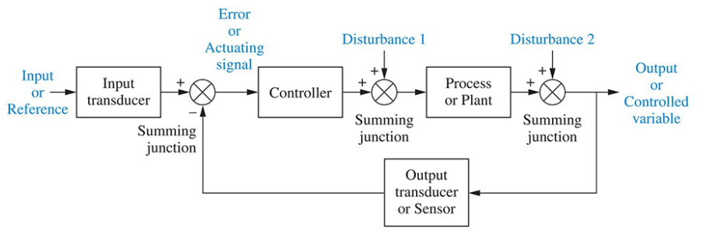
System Configuration
Open-Loop
Closed-Loop

Slide 5

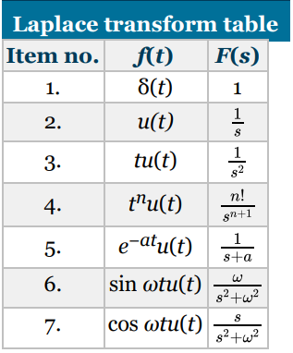

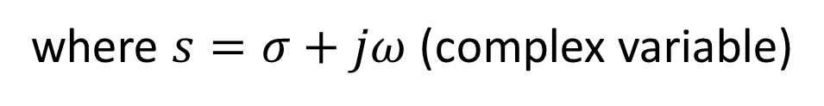
Laplace Transform Review
where $s=σ+jω$ (complex variable)

Slide 6
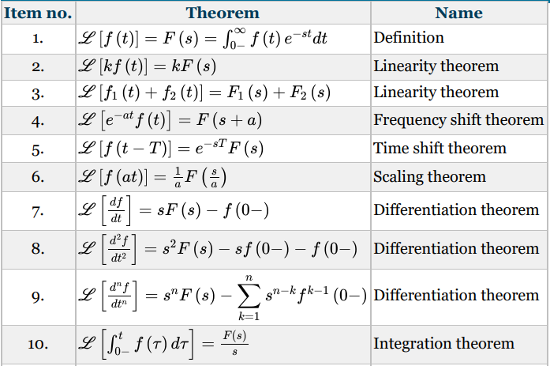
Laplace Transform Theorems

Slide 7
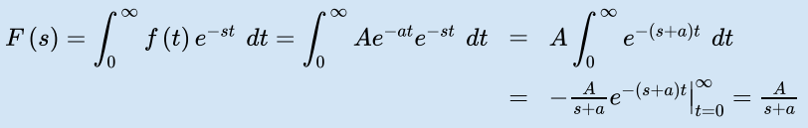


Example

Slide 8
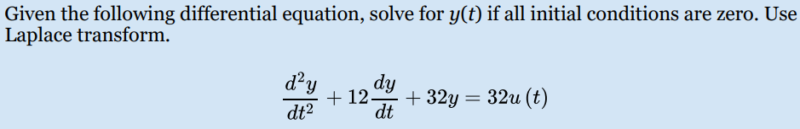


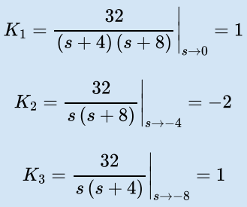


continued…

Slide 9




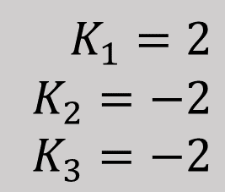
continued…
$$K_{1}=2 \\ K_{2}=−2 \\ K_{3}=−2$$

Slide 10






continued…

Slide 11











continued…

Slide 12
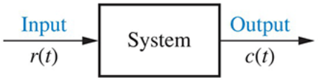



Transfer Function

Slide 13







Example

Slide 14





continued…

Slide 15
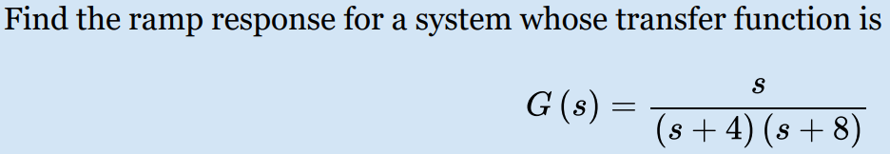






continued…

Slide 16
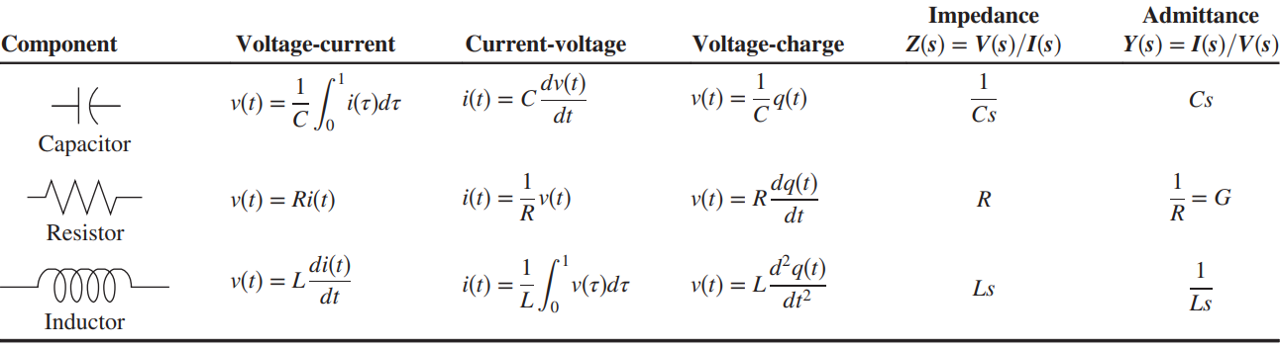
Electrical Network Transfer Functions

Slide 17
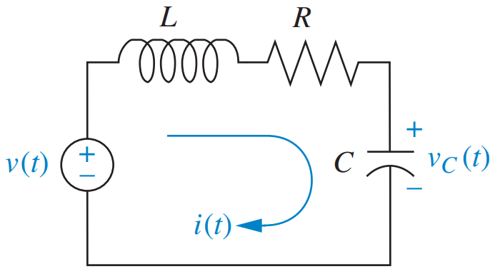






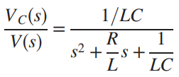
Example

Slide 18
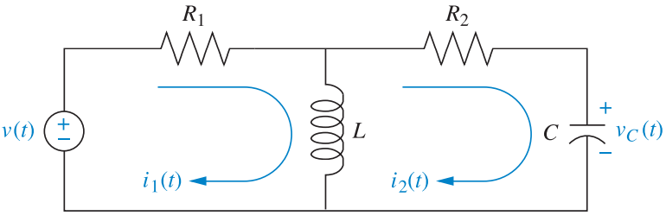


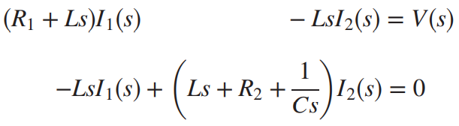
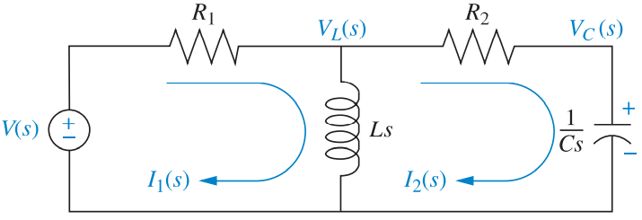
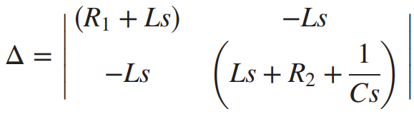
continued…

Slide 19
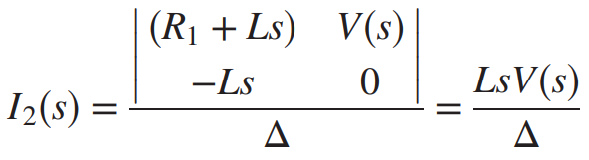
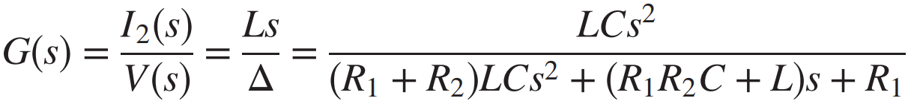
continued…

Slide 20
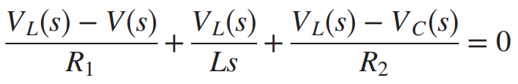

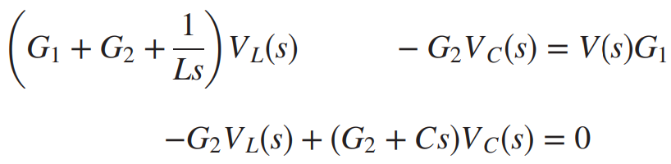
continued…

Slide 21
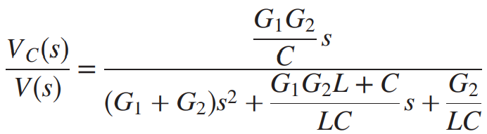
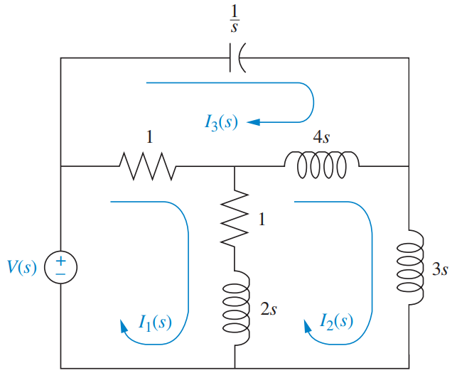
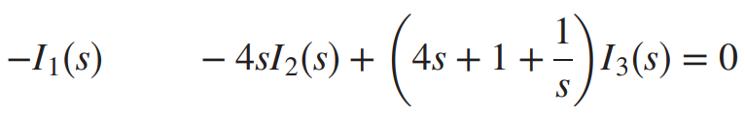
continued…

Slide 22
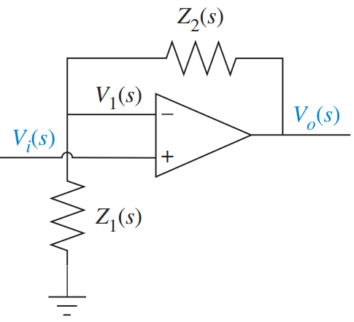
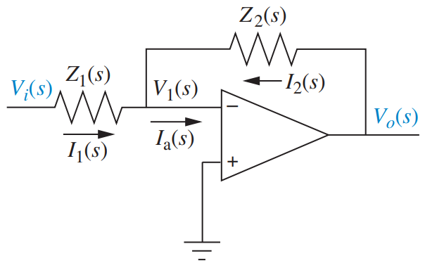
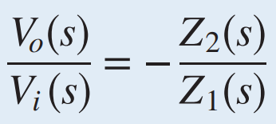
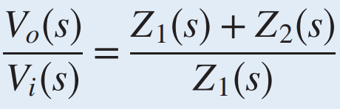
continued…
Op-Amp

Slide 23
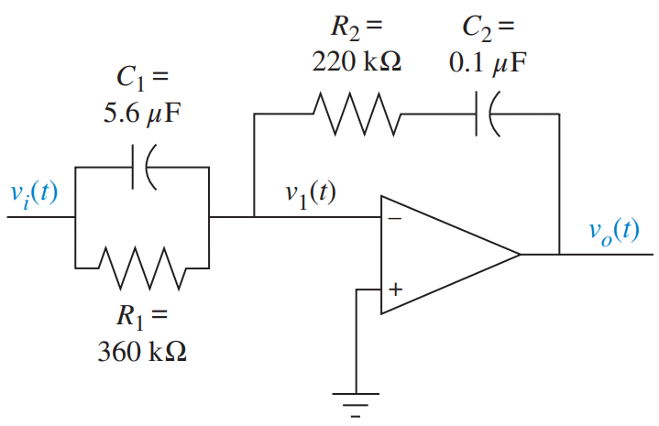
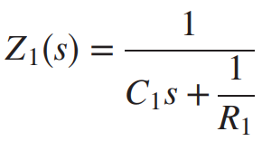
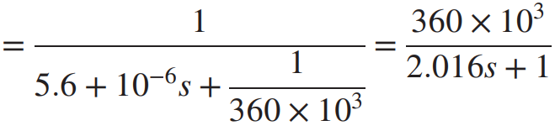
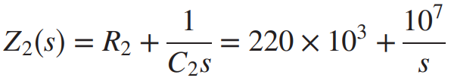
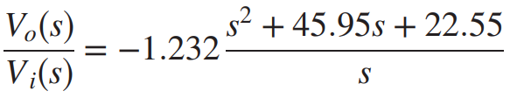
continued…

Slide 24
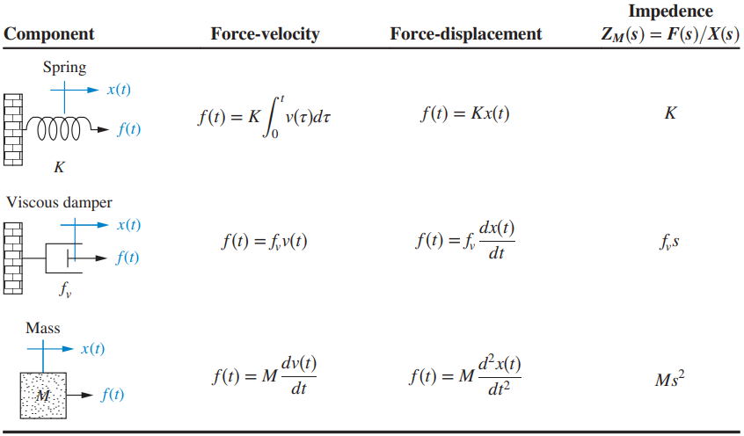
Translational Mechanical System

Slide 25
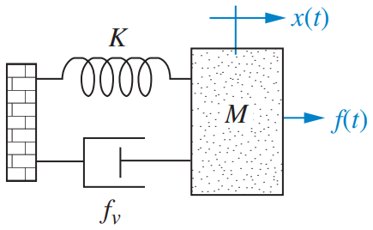
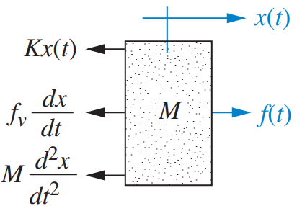
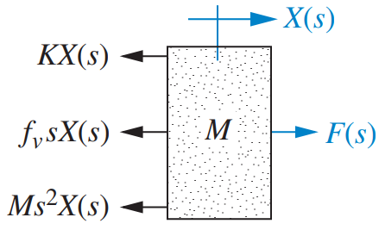


Example

Slide 26
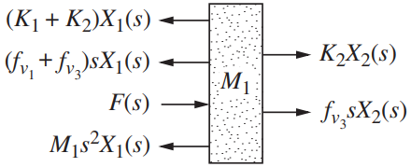
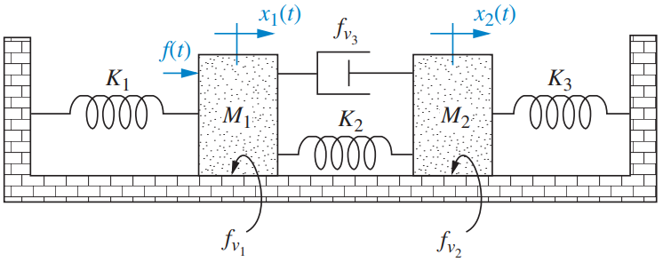
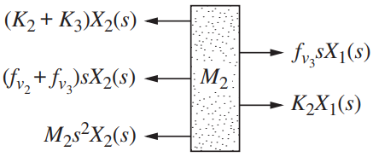
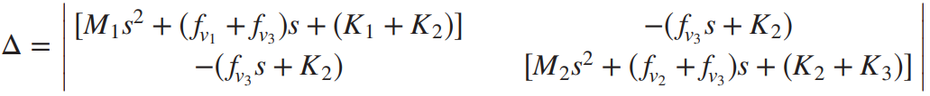

continued…

Slide 27
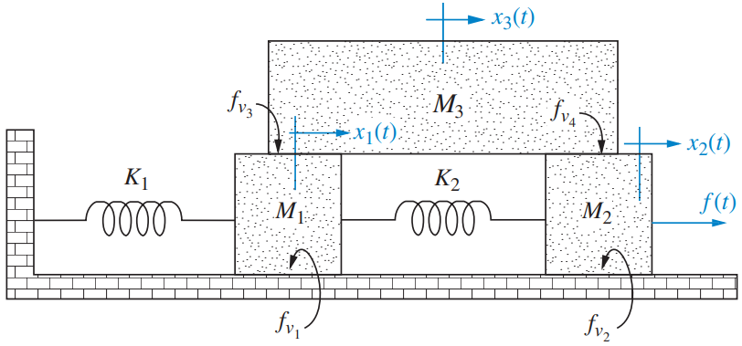
continued…

Slide 28
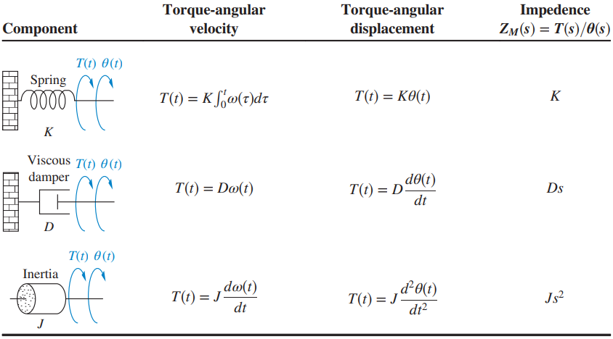
Rotational Mechanical System

Slide 29
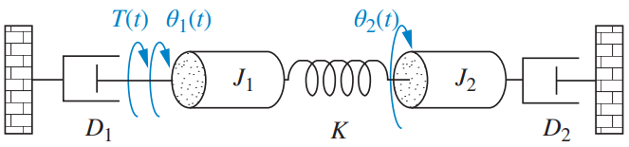
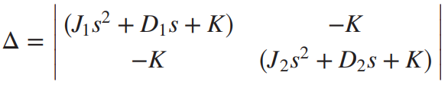

Example

Slide 30
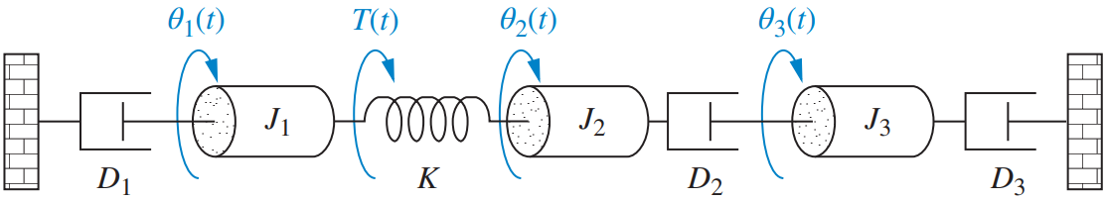
continued…

Slide 31
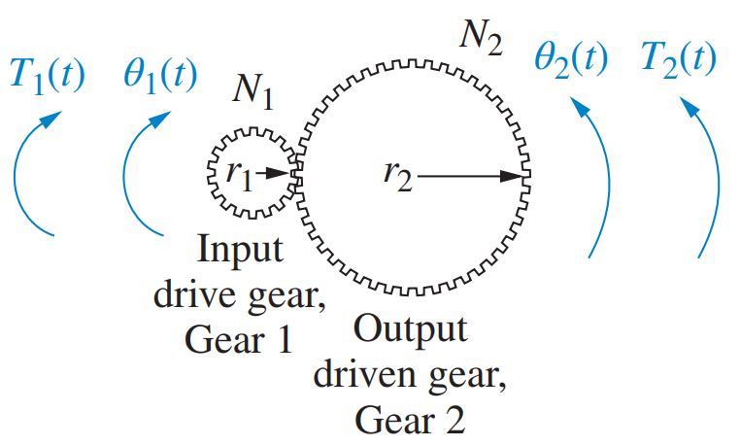




System with Gears

Slide 32







continued…
We want an equivalent system at $θ_{1}$ without gears.
For impedance reflection, use

Slide 33







Example

Slide 34





continued…
Find $G\left(s\right)={θ_{2}(s)}/{T(s)}$
$$J_{e}=J_{2}+J_{1}{\left(\frac{N_{2}}{N_{1}}\right)}^{2}+J_{3}{\left(\frac{N_{3}}{N_{4}}\right)}^{2}$$
$$=1+2×{\left(\frac{12}{4}\right)}^{2}+16×{\left(\frac{4}{16}\right)}^{2}=20$$
$$D_{e}=D_{2}+D_{1}{\left(\frac{N_{2}}{N_{1}}\right)}^{2}+D_{3}{\left(\frac{N_{3}}{N_{4}}\right)}^{2}$$
$$=2+1×{\left(\frac{12}{4}\right)}^{2}+32×{\left(\frac{4}{16}\right)}^{2}=13$$
$$K_{e}=K{\left(\frac{N_{3}}{N_{4}}\right)}^{2}=64×{\left(\frac{4}{16}\right)}^{2}=4$$

Slide 35

continued…
$$∴\left(J_{e}s^{2}+D_{e}s+K_{e}\right)θ_{2}\left(s\right)=T(s)∙\frac{N_{2}}{N_{1}}$$
$$⟹\left(20s^{2}+13s+4\right)θ_{2}\left(s\right)=T(s)∙3$$
$$⟹\frac{θ_{2}\left(s\right)}{T\left(s\right)}=\frac{3}{20s^{2}+13s+4}$$
$$⟹G\left(s\right)=\frac{3}{20s^{2}+13s+4}$$

Slide 36




State-Space Representation

Slide 37









Example

Slide 38



continued…

Slide 39










continued…

Slide 40

continued…

Slide 41





continued…

Slide 42






continued…

Slide 43

continued…

Slide 44













continued…

Slide 45






State-Space Representation to Transfer Function

Slide 46




Example

Slide 47






continued…

Slide 48
Time Response
Output response = Forced response + Natural response
Forced response = Steady-state response or Particular solution
Natural response = Homogeneous solution
Poles: Values of the Laplace transform variable, s, that cause the transfer function to become infinite
Zeros: Values of the Laplace transform variable, s, that cause the transfer function to become zero

Slide 49







continued…
Pole-Zero plot of System

Slide 50

continued…

Slide 51




1st-order System
Laplace transform of the step response,
$$=\frac{1}{s}−\frac{1}{s+a}$$

Slide 52



continued…
$$Rise Time, T_{r}=\frac{2.2}{a}$$
[time for the waveform to go from 0.1 to 0.9 of its final value]
$$Settling Time, T_{s}=\frac{4}{a}$$
[time for the response to reach, and stay within, 2% of its final value]

Slide 53




continued…
Laplace transform of the step response,
$$DC Gain,K=\frac{b}{a}$$
(also known as “Steady-state Value”)
Step Response

Slide 54


1st-order System with Zero
$$G\left(s\right)=\frac{\frac{20}{3}\left(s+\frac{1}{2}\right)}{s+\frac{1}{3}}$$
If input is step, $R\left(s\right)=1/s$
$$∴C\left(s\right)=R\left(s\right)∙G(s)=\frac{\frac{20}{3}\left(s+\frac{1}{2}\right)}{s\left(s+\frac{1}{3}\right)}$$
$$⟹C(s)=\frac{10}{s}−\frac{{10}/3}{s+\frac{1}{3}}$$
$$∴c\left(t\right)=10−\frac{10}{3}e^{{−t}/3}$$
Case 1: Pole is nearer to imaginary axis

Slide 55


continued…
$$G\left(s\right)=\frac{\frac{40}{3}\left(s+\frac{1}{2}\right)}{s+\frac{2}{3}}$$
If input is step, $R\left(s\right)=1/s$
$$∴C\left(s\right)=R\left(s\right)∙G(s)=\frac{\frac{40}{3}\left(s+\frac{1}{2}\right)}{s\left(s+\frac{2}{3}\right)}$$
$$⟹C\left(s\right)=\frac{10}{s}+\frac{{10}/3}{s+\frac{2}{3}}$$
$$∴c\left(t\right)=10+\frac{10}{3}e^{{−2t}/3}$$
Case 2: Zero is nearer to imaginary axis

Slide 56


2nd-order System
$Natural Frequency, ω_{n}=$ frequency of oscillation without damping
$Damping Ratio, ζ=$ exponential decay frequency / natural frequency
Pole Location:

Slide 57





continued…
ζ | Pole Location | Step Response
$$ζ=0$$
$$0<ζ<1$$

Slide 58





continued…
ζ | Pole Location | Step Response
$$ζ=1$$
$$ζ>1$$

Slide 59









Example

Slide 60





Underdamped 2nd-order System
Laplace transform of the step response,
2nd-order (underdamped) step responses for damping ratio values

Slide 61



continued…
$$Rise Time, T_{r}$$
[time for the waveform to go from 0.1 to 0.9 of its final value]
$$Peak Time, T_{p}=\frac{π}{ω_{n}\sqrt{1−ζ^{2}}}$$
[time to reach the first, or maximum, peak]

Slide 62




continued…
$$Percent Overshoot, \%OS=e^{−\left({ζπ}/{\sqrt{1−ζ^{2}}}\right)}×100$$
$$Settling Time, T_{s}=\frac{4}{ζω_{n}}$$
$$Evaluation of T_{r}$$
[time for transient’s damped oscillations to reach and stay within ±2% of the steady-state value]

Slide 63






continued…
$ω_{d}=$ damped frequency of oscillation
$σ_{d}=$ exponential damping frequency
$$ζ=\cos{θ}$$

Slide 64







continued…
$ω_{d}=$ damped frequency of oscillation
(imaginary part)
$σ_{d}=$ exponential damping frequency
(real part)

Slide 65




continued…
$$1⟶2⟶3$$
Settling time is same.
Peak time decreases.
Overshoot increases.
Rise time decreases.
Settling time decreases.
Peak time is same.
Overshoot decreases.
Rise time increases.
Settling time decreases.
Peak time decreases.
Overshoot is same.
Rise time decreases.

Slide 66



Example
$$ω_{n}=10$$
$$ζ=0.75$$
$$T_{p}=\frac{π}{ω_{n}\sqrt{1−ζ^{2}}}=0.48$$
$$\%OS=e^{−\left({ζπ}/{\sqrt{1−ζ^{2}}}\right)}×100=2.83$$
$$T_{s}=\frac{4}{ζω_{n}}=0.53$$
Normalized $T_{r}=2.3$ (from Table)
$Actual T_{r}=\frac{Normalized T_{r}}{ω_{n}}=0.23$

Slide 67


continued…
Find damping ratio, natural frequency, peak time, overshoot and settling time for an underdamped 2nd-order system, if the poles are at $−3±j7$.
$$ζ=\cos{θ=\cos\left(\tan^{−1}{\frac{7}{3}}\right)}=0.394$$
$$ω_{n}=\sqrt{7^{2}+3^{2}}=7.616$$
$$T_{p}=\frac{π}{ω_{d}}=\frac{π}{7}=0.449$$
$$Overshoot=e^{−\left({ζπ}/{\sqrt{1−ζ^{2}}}\right)}×100=26\%$$
$$T_{s}=\frac{4}{σ_{d}}=\frac{4}{3}=1.333$$

Slide 68



2nd-order Approximation from 3rd-order System
Complex pole at: $−ζω_{n}±jω_{n}\sqrt{1−ζ^{2}}$
Real pole at: $−α_{r}$
Laplace transform of the step response,

Slide 69

continued…
Rule of thumb: if the real pole is five times farther to the left than the dominant poles

Slide 70



Example
Determine the validity of a 2nd-order approximation for each of these two transfer functions:
a. Complex poles at $−2±j9.8$
Real pole at $−15$
More than five-times further.
So, approximation will be valid.
b. Complex poles at $−1±j9.4$
Real pole at $−4$
Not more than five-times further.
So, approximation will be invalid.

Slide 71



Effect of Adding a Zero
If ‘a’ is very large, the Laplace transform of the response is approximately $aC(s)$, or a scaled version of the original response.
If ‘a’ becomes smaller, the derivative term contributes more to the response and has a greater effect.
Effect of adding a zero to a 2-pole system

Slide 72

continued…
What if ‘a’ is negative?
The zero is in the right half-plane.
Nonminimum-phase system: response begins to turn toward the opposite direction of the final value.

Slide 73







Pole-Zero Cancellation

Slide 74



continued…

Slide 75



continued…

Slide 76



Example
Determine the validity of a 2nd-order step-response approximation for each transfer function shown below:
a.
b.

Slide 77
Control System
EEE 401 (Part 2)
Dept. of EEE, BUBT

Slide 78



Block Diagram Topologies
(1) Cascade Form

Slide 79



continued…
(2) Parallel Form

Slide 80



continued…
(3) Feedback Form

Slide 81




Example

Slide 82



continued…

Slide 83



continued…

Slide 84


continued…
$$T\left(s\right)=\frac{\left(s^{2}+\frac{1}{s}\right)\frac{1}{s}}{1+\left(\left(s^{2}+\frac{1}{s}\right)\frac{1}{s}\right)2s}$$
$$=\frac{\frac{s^{3}+1}{s^{2}}}{1+\frac{s^{3}+1}{s^{2}}∙2s}$$
$$=\frac{s^{3}+1}{2s^{4}+s^{2}+2s}$$

Slide 85







continued…

Slide 86






continued…

Slide 87


Signal-Flow Graphs
Alternative to block diagrams

Slide 88

Example

Slide 89

continued…

Slide 90


Mason’s Rule

Slide 91



Example

Slide 92



continued…
Non-touching loops are those not sharing any common node or branch.

Slide 93




continued…

Slide 94



continued…

Slide 95


continued…
$$=\frac{T_{1}∆_{1}+T_{2}∆_{2}}{∆}$$
$$=\frac{G_{1}G_{2}G_{3}∙1+G_{1}G_{3}∙1}{∆}$$
$$=\frac{G_{1}G_{2}G_{3}+G_{1}G_{3}}{1+G_{1}G_{2}H_{1}+G_{2}H_{2}+G_{3}H_{3}+G_{1}G_{2}G_{3}H_{1}H_{3}+G_{2}G_{3}H_{2}H_{3}}$$

Slide 96


Signal-Flow Graphs of State Equations

Slide 97



continued…

Slide 98



continued…

Slide 99



Example

Slide 100





Alternate Representation
[1] Cascade Form

Slide 101





Alternate Representation
[2] Parallel Form

Slide 102




Alternate Representation
[3] Controller Canonical Form
Renumbering in Reverse Order
Phase Variable Form
Reordering in Ascending Order

Slide 103


continued…
Phase Variable Form
Controller Canonical Form

Slide 104



Alternate Representation
[4] Observer Canonical Form

Slide 105




continued…

Slide 106

Stability
In terms of natural response:
A system is stable if the natural response approaches zero as time approaches infinity.
A system is unstable if the natural response approaches infinity as time approaches infinity.
A system is marginally stable if the natural response neither decays nor grows but remains constant or oscillates.
In terms of total response:
A system is stable if every bounded input yields a bounded output.
A system is unstable if any bounded input yields an unbounded output.

Slide 107


continued…
Stable systems have CLTF with poles only in the LHP.
Unstable systems have CLTF with at least one pole in the RHP and/or poles of multiplicity greater than 1 on the imaginary axis.
Marginally stable systems have CLTF with only imaginary axis poles of multiplicity 1 and poles in the LHP.

Slide 108





Routh-Hurwitz Criterion

Slide 109


Example

Slide 110





continued…
(# Roots in the RHP) = (# Sign changes in 1st column)
So, the previous system is unstable (two sign changes in 1st column).
This system is unstable (two sign changes).

Slide 111



continued…
Differentiation
This system is stable (no sign change).

Slide 112

continued…
Even polynomial: has only even powers of s (e.g. $s^{4}+2s^{2}+2$).
Even polynomial causes the row of zeros to appear.
  The roots are symmetrical and real
  The roots are symmetrical and imaginary
  The roots are quadrantal
If we do not have a row of zeros, we cannot possibly have jω roots.

Slide 113



continued…

Slide 114

continued…

Slide 115



continued…
RHP poles: 2
LHP poles: 2
jω poles: 0
This system is unstable.

Slide 116



continued…
+
+
+
‒
+
+
RHP poles: 2
LHP poles: 3
jω poles: 0
This system is unstable.

Slide 117




continued…

Slide 118

continued…

Slide 119



continued…
Find the range of gain, K, that will cause the system to be stable and unstable. Assume K > 0.
If K < 1386, all terms in the 1st column is positive. The system is stable.
If K > 1386, the $s^{1}$ term in the 1st column is negative. The system is unstable.

Slide 120


Steady-State Error
Step Input Response
Ramp Input Response
Steady-state error (SSE) is the difference between the input and the output for a prescribed test input as $t→∞$.

Slide 121


Test Waveform Example

Slide 122









SSE for Unity Negative Feedback System
In terms of T(s)
In terms of G(s)

Slide 123






continued…
Step Input
Ramp Input
Parabolic Input

Slide 124







Example

Slide 125















continued…

Slide 126







continued…

Slide 127









Static Error Constant

Slide 128

















Example

Slide 129




continued…

Slide 130




continued…

Slide 131

System Type
Number of pure integrations in the forward path

Slide 132

Example
The system is stable.
The system is of Type 1.
A ramp input is the test signal.
The SSE is $1/K_{v}$ per unit ramp.
The system is stable.
The system is of Type 0.
A step input is the test signal.
The SSE is $1/\left(1+K_{p}\right)$ per unit step.

Slide 133







continued…
Find the value of K so that there is 10% error in the steady state.

Slide 134




SSE for Non-unity Negative Feedback System

Slide 135









Example
For the system shown, find the system type, the appropriate error constant associated with the system type, and the steady-state error for a unit step input.
The negative value for SSE implies that the output step is larger than the input step.

Slide 136





Root Locus

Slide 137




continued…
It is this representation of the paths of the closed-loop poles (as the gain is varied) that we call a root locus.

Slide 138



Sketching the Root Locus
The number of branches equals the number of closed-loop poles.
The root locus is symmetrical about the real axis.
On the real axis, for $K>0$, the root locus exists to the left of an odd number of real-axis, finite open-loop poles and/or finite open-loop zeros.
The root locus begins at the finite and infinite poles of $G(s)H(s)$ and ends at the finite and infinite zeros of $G(s)H(s)$.

Slide 139





Root Locus: Behavior at Infinity
A function can also have poles and/or zeros at $∞$.
If the function approaches $∞$ as s approaches $∞$, then the function has a pole at $∞$.
If the function approaches $0$ as s approaches $∞$, then the function has a zero at $∞$.
Example: $G(s)=s$ has a pole at $∞$ ; $G\left(s\right)=1/s$ has a zero at $∞$.
The root locus approaches straight lines (as asymptotes) as the locus approaches $∞$.

Slide 140









Example
Sketch the root locus for the system shown

Slide 141





continued…
Sketch the root locus and its asymptotes for a unity negative feedback system that has the forward transfer function:

Slide 142


Refining the Root Locus
Using Routh-Hurwitz criterion: Forcing a row of zeros in the Routh table will yield the gain; going back one row to the even polynomial equation and solving for the roots yields the frequency at the jω-axis crossing.
Assuming a point (on root locus) close to a complex pole or zero: The sum of angles drawn from all finite poles and zeros to this point is an odd multiple of 180°.

Slide 143






Example

Slide 144










continued…
For the system, find the frequency and gain, K, for which the root locus crosses the imaginary axis. For what range of K is the system stable?
Forming the even polynomial by using the s² row with $K=9.65$,
In this table, for positive values of gain, only the s¹ row can yield a row of zeros.
Thus the root locus crosses the jω-axis at $±j1.59$ at a gain of $9.65$.
The system is stable for $0≤K<9.65$.

Slide 145







continued…
Find the angle of departure from the complex poles and sketch the root locus.
Complex poles at $−1±j1$
We take $−1+j1$

Slide 146







continued…
[Given a unity feedback system that has this forward transfer function]
Poles at $2±j3$
Zeros at $−2$ and $∞$

Slide 147




continued…
$$s^{2}+21=0$$
$$⟹s=±j4.58$$
$$\frac{1}{σ+2}=\frac{1}{σ−2−j3}+\frac{1}{σ−2+j3}$$
$$⟹\frac{1}{σ+2}=\frac{2σ−4}{σ^{2}−4σ+13}$$
$$⟹{2σ}^{2}−8=σ^{2}−4σ+13$$
$$⟹σ^{2}+4σ−21=0$$
$$⟹σ=−7,3$$
But, $3$ is unacceptable.

Slide 148


continued…
$${−θ}_{1}+θ_{2}−θ_{3}=180°$$
$$⟹−θ_{1}+\tan^{−1}\left(\frac{3}{4}\right)−90°=180°$$
$$⟹θ_{1}=−233.1°=126.9°$$

Slide 149

continued…
Sketch the root locus for the system shown. Find the exact point and gain where the locus crosses the jω-axis. Find the breakaway point on the real axis. Find the angle of arrival. Find the range of K within which the system is stable.
Poles at $−2$ and $−4$.
Zeros at $2±j4$.
$$T\left(s\right)=\frac{K\left(s^{2}−4s+20\right)}{\left(1+K\right)s^{2}+\left(6−4K\right)s+8+20K}$$
Routh Table:
$$\begin{matrix}s^{2} & 1+K & 8+20K \\ s^{1} & 6−4K & 0 \\ s^{0} & \frac{−80K^{2}+88K+48}{6−4K} & 0\end{matrix}$$
We get row of zeros for $K=\frac{6}{4}=1.5$.
Now, from the $s^{2}$ row with $K=1.5$,
$$\left(1+1.5\right)s^{2}+\left(8+20×1.5\right)=0$$
$$⟹2.5s^{2}+38=0$$
$⟹s=±j3.89$ [jω-axis crossing]
Now, for breakaway point,
$$\frac{1}{σ+2}+\frac{1}{σ+4}=\frac{1}{σ−2−j4}+\frac{1}{σ−2+j4}$$
$$⟹\frac{2σ+6}{σ^{2}+6σ+8}=\frac{2σ−4}{σ^{2}−4σ+20}$$

Slide 150

continued…
$$⟹\left(2σ+6\right)\left(σ^{2}−4σ+20\right)=(2σ−4)(σ^{2}+6σ+8)$$
$$⟹10σ^{2}−24σ−152=0$$
$$⟹σ=−2.87,5.27$$
But $5.27$ is unacceptable.
So, the breakaway point is at $−2.87$.
For angle of arrival,
$$θ_{1}−θ_{2}−θ_{3}+θ_{4}=180°$$
$$⟹θ_{1}−\tan^{−1}\left(\frac{4}{6}\right)−\tan^{−1}\left(\frac{4}{4}\right)+90°=180°$$
$$⟹θ_{1}=168.7°$$

Slide 151

continued…
This system is stable for $0≤K<1.5$.

Slide 152



continued…
Sketch the root locus for a unity negative feedback system having the following forward transfer function:
$$G\left(s\right)=\frac{K\left(s+\frac{2}{3}\right)}{s^{2}(s+6)}$$
Now, for breakaway and break-in point,
$$\frac{1}{σ+0}+\frac{1}{σ+0}+\frac{1}{σ+6}=\frac{1}{σ+\frac{2}{3}}$$
$$⟹\frac{3σ+12}{σ^{2}+6σ}=\frac{1}{σ+\frac{2}{3}}$$
$$⟹2σ^{2}+8σ+8=0$$
$$⟹σ=−2,−2$$

Slide 153

continued…

