Slide 1

Digital Signal Processing I
EEE 313
Dept. of EEE, BUBT

Slide 2
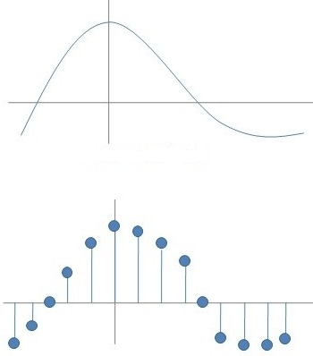
Signal
“Stream of information that varies with some variables”
Continuous Signal:
sin(Ωt)
Discrete Signal:
sin(ωn)
Types by dimension:
1D: Audio, ECG
2D: Photograph
3D: Video
All natural signals are analog.
When an analog signal is sampled, quantized and coded, it becomes a digital signal.

Slide 3
Sampling
x(t) = A cos(Ωt)
After sampling with T_{s} interval,
x(nT_{s}) = A cos(ΩnT_{s})
= A cos(2πFnT_{s})
= A cos(2πnF/F_{s})
= A cos(2πfn)
Ω = Analog Angular Frequency (rad/second) = 2πF
F = Analog Frequency (cycle/second)
F_{s} = Sampling Frequency (sample/second) = 1 / T_{s}
f = Discrete Time Frequency (cycle/sample) = F / F_{s}
Example: f = 1/70 means “70 samples are collected in 1 cycle”.

Slide 4
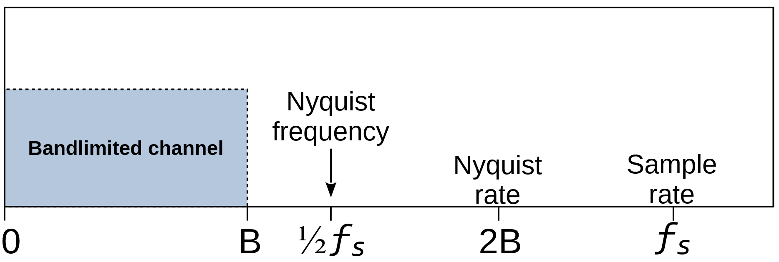
Nyquist's Sampling Theorem
For lossless reconstruction,
F_{s} ≥ 2F
or, F / F_{s} ≤ 1 / 2
or, f ≤ 1 / 2
So, f_{max} can be 1 / 2.
Note: Smaller f is better. Because smaller f means: more samples are taken in each cycle.
“A bandlimited continuous-time signal can be perfectly reconstructed from its samples if the waveform is sampled over twice as fast as its highest frequency component.”

Slide 5
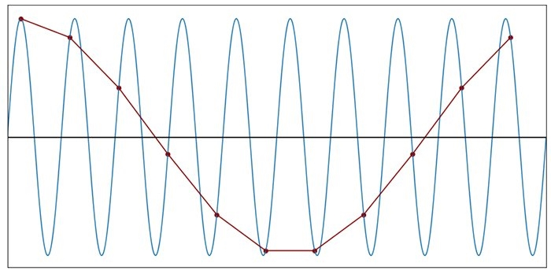
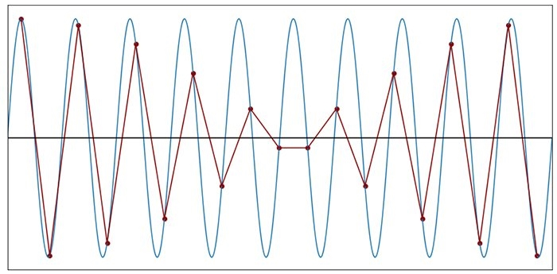
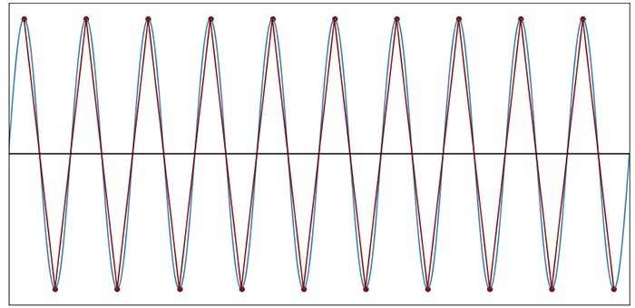
Nyquist (continued)…
F_{s} = 1.1 F
F_{s} = 1.9 F
F_{s} = 2 F

Slide 6
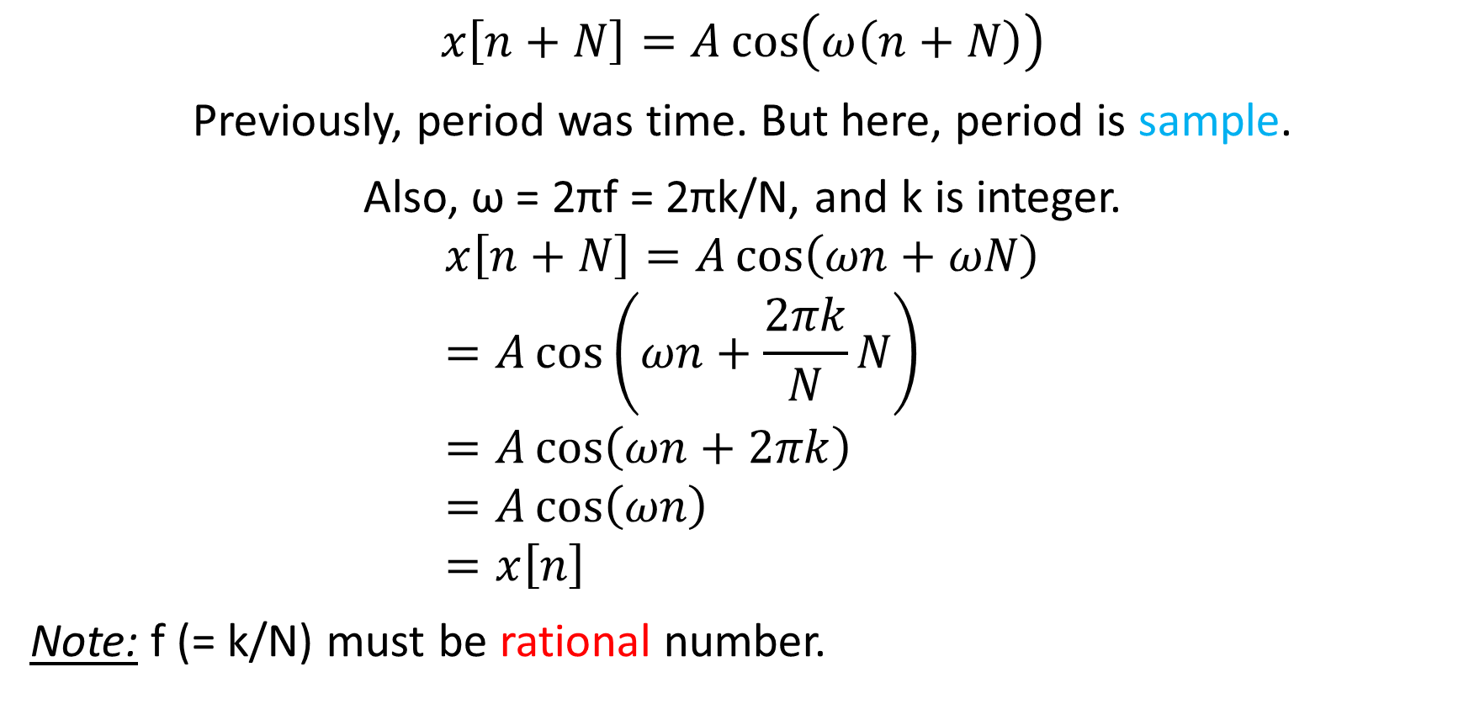
Periodicity
$$x\left[n+N\right]=A\cos\left(ω\left(n+N\right)\right)$$
Previously, period was time. But here, period is sample.
Also, ω = 2πf = 2πk/N, and k is integer.
$$x\left[n+N\right]=A\cos\left(ωn+ωN\right) \\ =A\cos\left(ωn+\frac{2πk}{N}N\right) \\ =A\cos\left(ωn+2πk\right) \\ =A\cos\left(ωn\right) \\ =x\left[n\right]$$
Note: f (= k/N) must be rational number.

Slide 7
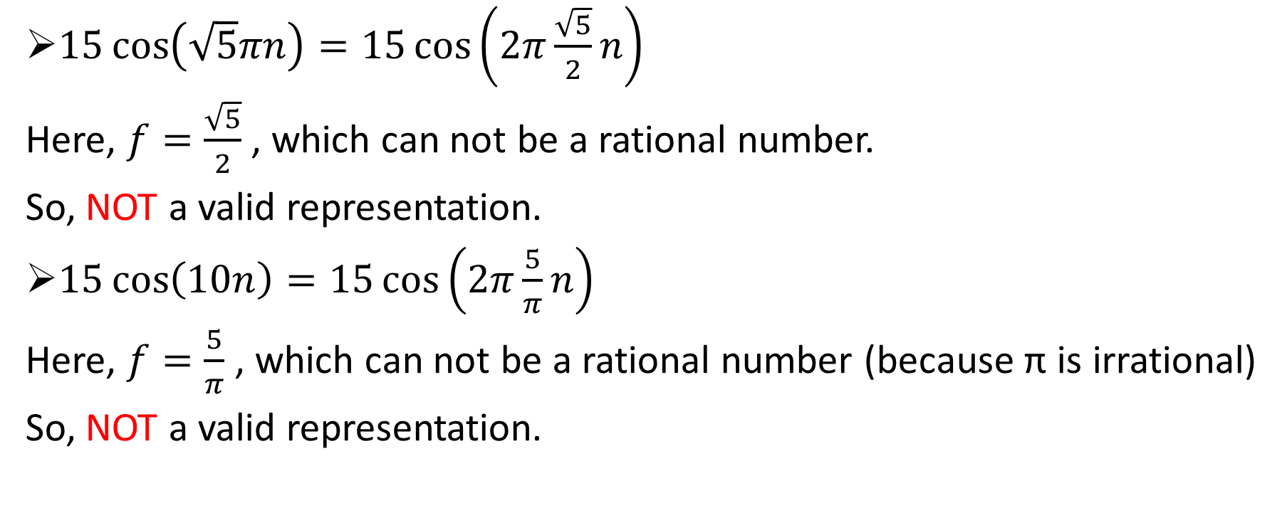

Question: Is “$15\cos\left(\sqrt{5}πn\right)$” a valid representation of discrete-time signal? Also find for “$15\cos\left(10n\right)$”.
$15\cos\left(\sqrt{5}πn\right)=15\cos\left(2π\frac{\sqrt{5}}{2}n\right)$
Here, $f=\frac{\sqrt{5}}{2}$ , which can not be a rational number.
So, NOT a valid representation.
$15\cos\left(10n\right)=15\cos\left(2π\frac{5}{π}n\right)$
Here, $f=\frac{5}{π}$ , which can not be a rational number (because π is irrational)
So, NOT a valid representation.

Slide 8
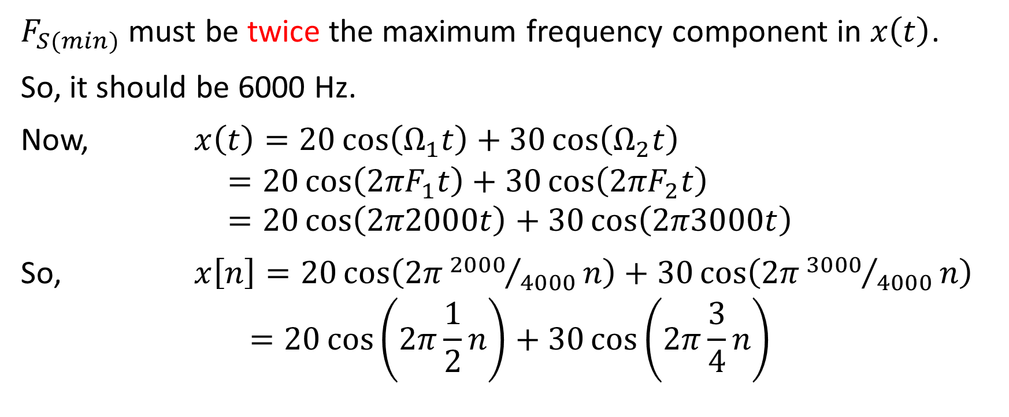
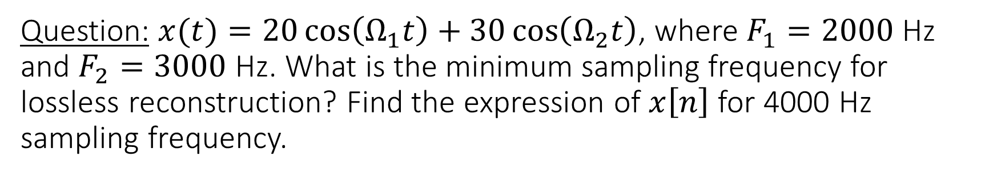
Question: $x(t)=20\cos\left(Ω_{1}t\right)+30\cos\left(Ω_{2}t\right)$, where $F_{1}=2000$ Hz and $F_{2}=3000$ Hz. What is the minimum sampling frequency for lossless reconstruction? Find the expression of $x\left[n\right]$ for 4000 Hz sampling frequency.
$F_{S(min)}$ must be twice the maximum frequency component in $x\left(t\right)$.
So, it should be 6000 Hz.
Now, $x\left(t\right)=20\cos\left(Ω_{1}t\right)+30\cos\left(Ω_{2}t\right)$
$$=20\cos\left({2πF}_{1}t\right)+30\cos\left({2πF}_{2}t\right) \\ =20\cos\left(2π2000t\right)+30\cos\left(2π3000t\right)$$
So, $x\left[n\right]=20\cos\left(2π{2000}/{4000}n\right)+30\cos\left(2π{3000}/{4000}n\right)$
$$=20\cos\left(2π\frac{1}{2}n\right)+30\cos\left(2π\frac{3}{4}n\right)$$

Slide 9
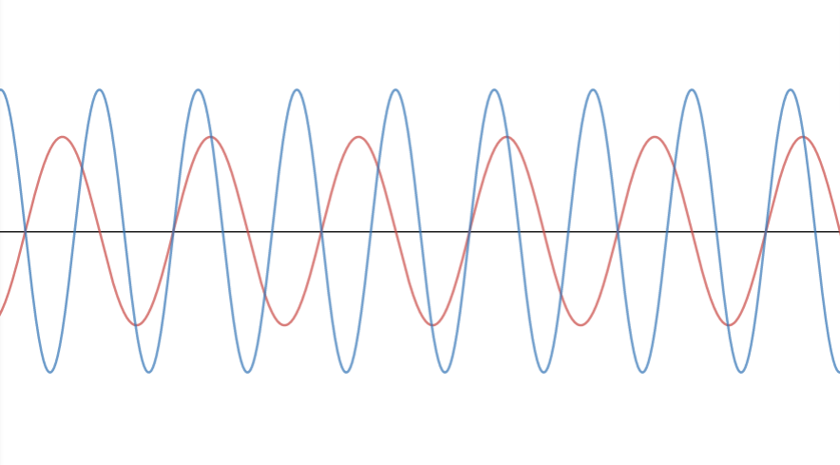
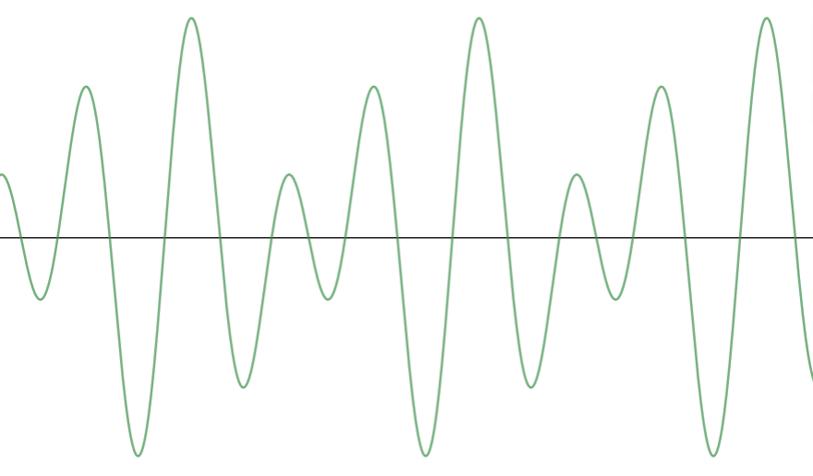
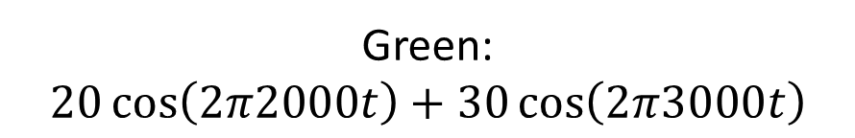

continued…
Red: $20\cos\left(2π2000t\right)$
Blue: $30\cos\left(2π3000t\right)$
Green: $20\cos\left(2π2000t\right)+30\cos\left(2π3000t\right)$

Slide 10
Time-Shifting of DT Sequence
Delay
Advance
y[n] = x[n - d], where d is integer.
Let, x[n] = [… 2 5 7 6 9 1 …]
y[n] = x[n-1]
y[-1] = x[-1-1] = x[-2] = 2
y[0] = x[0-1] = x[-1] = 5
y[1] = x[1-1] = x[0] = 7
y[2] = x[2-1] = x[1] = 6 and so on.
So, y[n] = [… 2 5 7 6 9 1 …]
y[n] = x[n + a], where a is integer.
Let, x[n] = [… 2 5 7 6 9 1 …]
y[n] = x[n+1]
y[-1] = x[-1+1] = x[0] = 7
y[0] = x[0+1] = x[1] = 6
y[1] = x[1+1] = x[2] = 9
y[2] = x[2+1] = x[3] = 1 and so on.
So, y[n] = [… 2 5 7 6 9 1 …]

Slide 11
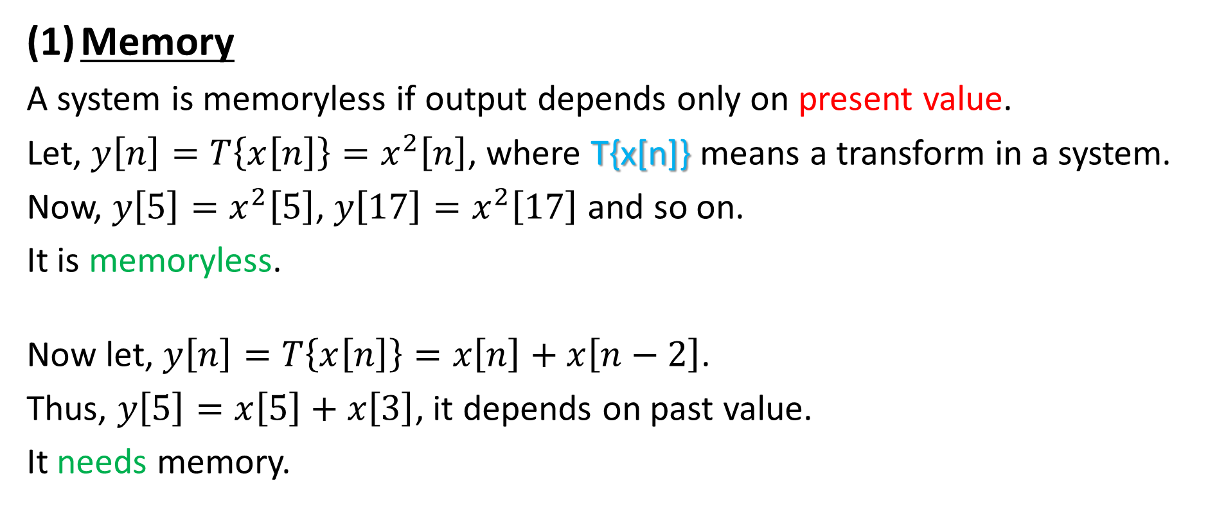
Basic Properties of Discrete-Time System
Memory
A system is memoryless if output depends only on present value.
Let, $y\left[n\right]=T\left\{x\left[n\right]\right\}=x^{2}\left[n\right]$, where T{x[n]} means a transform in a system.
Now, $y\left[5\right]=x^{2}\left[5\right]$, $y\left[17\right]=x^{2}\left[17\right]$ and so on.
It is memoryless.
Now let, $y\left[n\right]=T\left\{x\left[n\right]\right\}=x\left[n\right]+x\left[n−2\right]$.
Thus, $y\left[5\right]=x\left[5\right]+x\left[3\right]$, it depends on past value.
It needs memory.

Slide 12
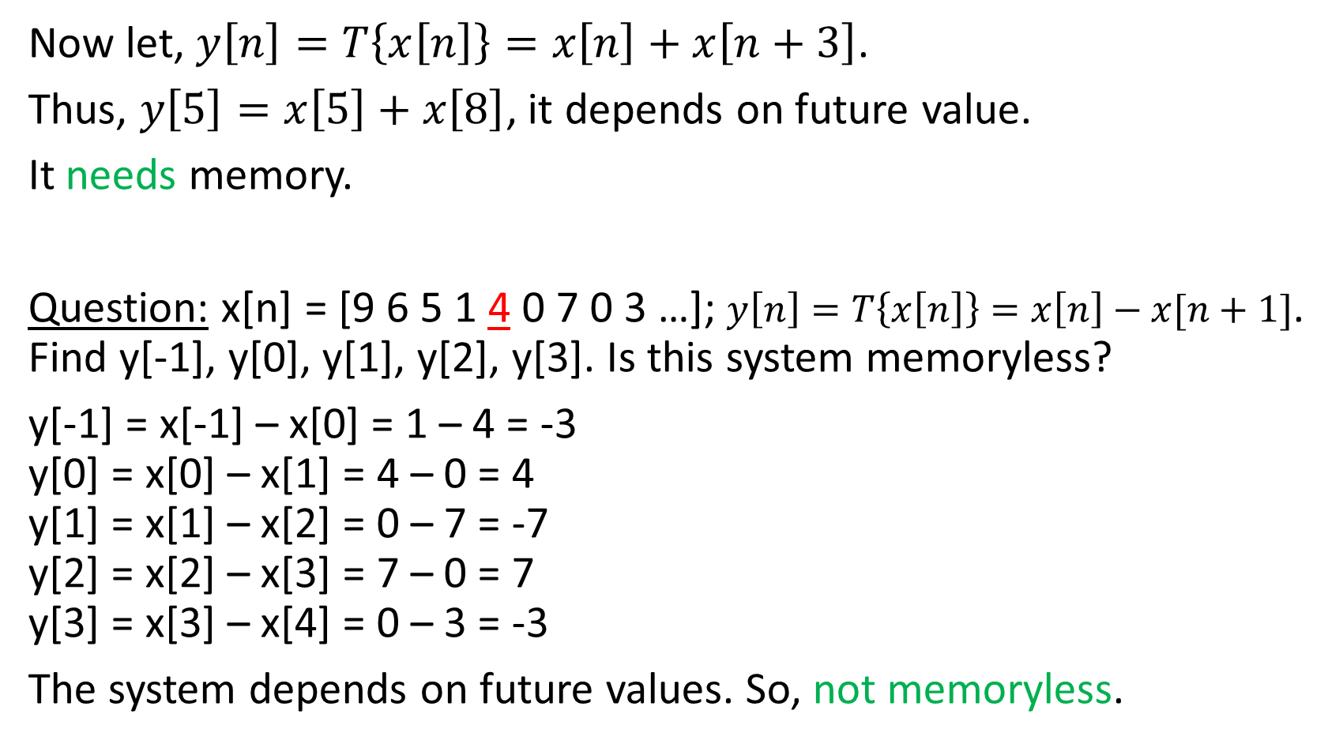
continued…
Now let, $y\left[n\right]=T\left\{x\left[n\right]\right\}=x\left[n\right]+x\left[n+3\right]$.
Thus, $y\left[5\right]=x\left[5\right]+x\left[8\right]$, it depends on future value.
It needs memory.
Question: x[n] = [9 6 5 1 4 0 7 0 3 …]; $y\left[n\right]=T\left\{x\left[n\right]\right\}=x\left[n\right]−x[n+1]$. Find y[-1], y[0], y[1], y[2], y[3]. Is this system memoryless?
y[-1] = x[-1] – x[0] = 1 – 4 = -3
y[0] = x[0] – x[1] = 4 – 0 = 4
y[1] = x[1] – x[2] = 0 – 7 = -7
y[2] = x[2] – x[3] = 7 – 0 = 7
y[3] = x[3] – x[4] = 0 – 3 = -3
The system depends on future values. So, not memoryless.

Slide 13
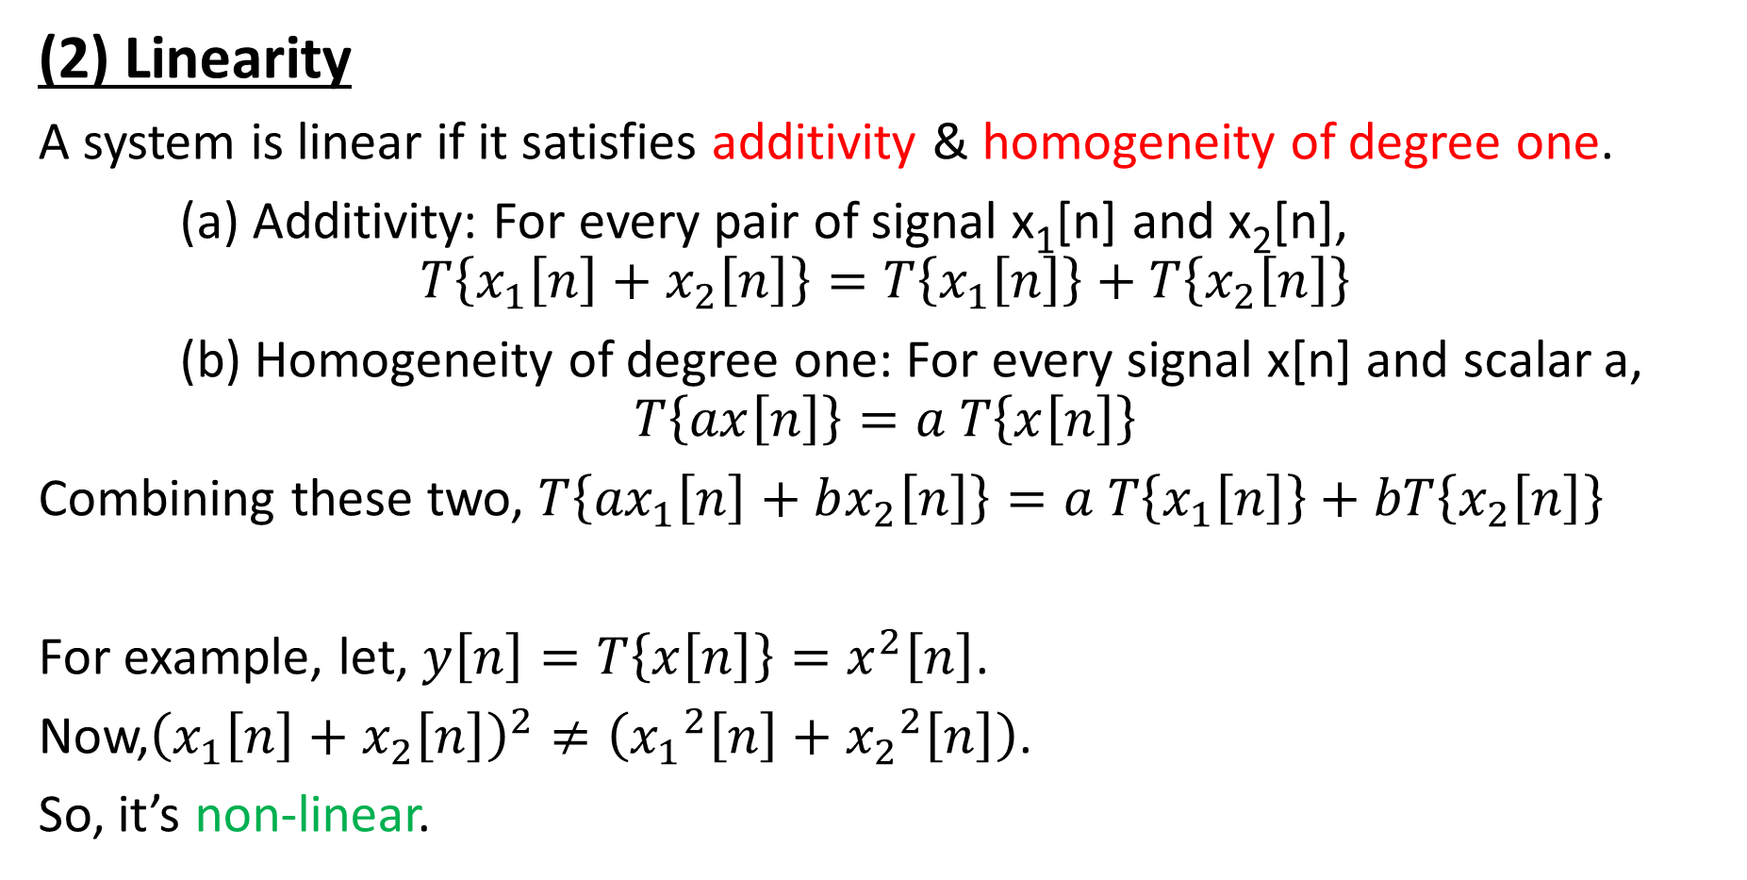
continued…
(2) Linearity
A system is linear if it satisfies additivity & homogeneity of degree one.
(a) Additivity: For every pair of signal x₁[n] and x₂[n],
$$T\left\{x_{1}\left[n\right]+x_{2}\left[n\right]\right\}=T\left\{x_{1}\left[n\right]\right\}+T\left\{x_{2}\left[n\right]\right\}$$
(b) Homogeneity of degree one: For every signal x[n] and scalar a,
$$T\left\{ax\left[n\right]\right\}=a T\left\{x\left[n\right]\right\}$$
Combining these two, $T\left\{{ax}_{1}\left[n\right]+bx_{2}\left[n\right]\right\}=a T\left\{x_{1}\left[n\right]\right\}+bT\left\{x_{2}\left[n\right]\right\}$
For example, let, $y\left[n\right]=T\left\{x\left[n\right]\right\}=x^{2}\left[n\right]$.
Now,${\left(x_{1}\left[n\right]+x_{2}\left[n\right]\right)}^{2}≠\left({x_{1}}^{2}\left[n\right]+{x_{2}}^{2}\left[n\right]\right)$.
So, it’s non-linear.

Slide 14
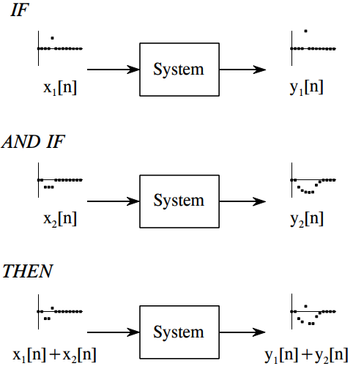
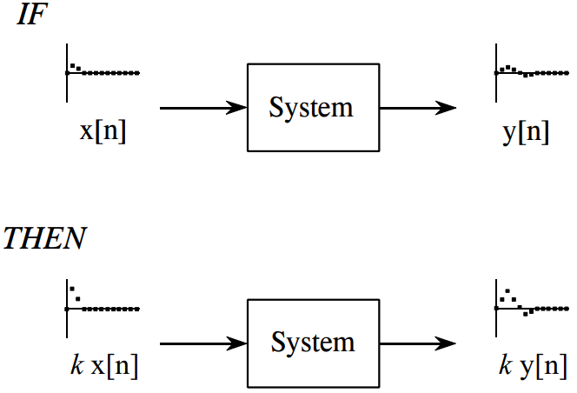
continued…
Additivity
Homogeneity

Slide 15
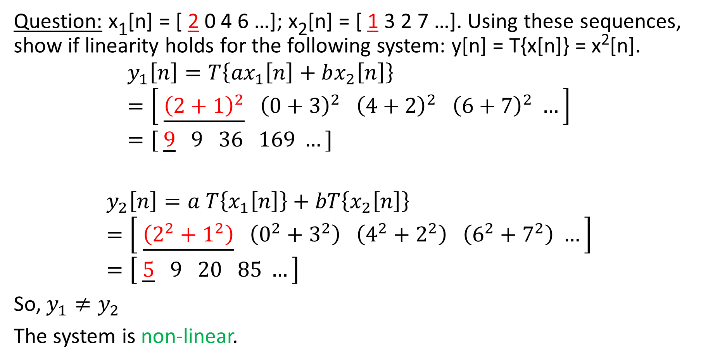
continued…
Question: x₁[n] = [ 2 0 4 6 …]; x₂[n] = [ 1 3 2 7 …]. Using these sequences, show if linearity holds for the following system: y[n] = T{x[n]} = x²[n].
$$y_{1}\left[n\right]=T\left\{{ax}_{1}\left[n\right]+bx_{2}\left[n\right]\right\}=\left[ \underline{{\left(2+1\right)}^{2}} {\left(0+3\right)}^{2} {\left(4+2\right)}^{2} {\left(6+7\right)}^{2} …\right] \\ =[ \underline{9} 9 36 169 …]$$
$$y_{2}\left[n\right]=a T\left\{x_{1}\left[n\right]\right\}+bT\left\{x_{2}\left[n\right]\right\} \\ =\left[ \underline{\left(2^{2}+1^{2}\right)} \left(0^{2}+3^{2}\right) \left(4^{2}+2^{2}\right) \left(6^{2}+7^{2}\right) …\right] \\ =\left[ \underline{5} 9 20 85 …\right]$$
So, $y_{1}≠y_{2}$
The system is non-linear.

Slide 16
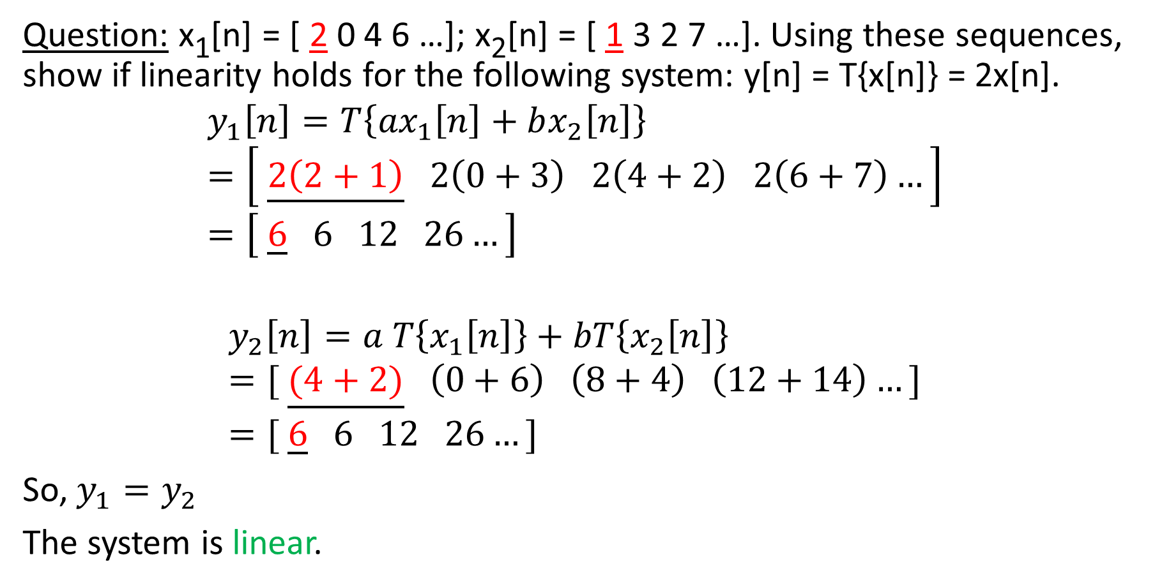
continued…
Question: x₁[n] = [ 2 0 4 6 …]; x₂[n] = [ 1 3 2 7 …]. Using these sequences, show if linearity holds for the following system: y[n] = T{x[n]} = 2x[n].
$$y_{1}\left[n\right]=T\left\{{ax}_{1}\left[n\right]+bx_{2}\left[n\right]\right\} \\ =\left[ \underline{2\left(2+1\right)} 2\left(0+3\right) 2\left(4+2\right) 2\left(6+7\right)…\right] \\ =\left[ \underline{6} 6 12 26…\right]$$
$$y_{2}\left[n\right]=a T\left\{x_{1}\left[n\right]\right\}+bT\left\{x_{2}\left[n\right]\right\} \\ =[ \underline{(4+2)} \left(0+6\right) \left(8+4\right) \left(12+14\right)…] \\ =[ \underline{6} 6 12 26…]$$
So, $y_{1}=y_{2}$
The system is linear.

Slide 17
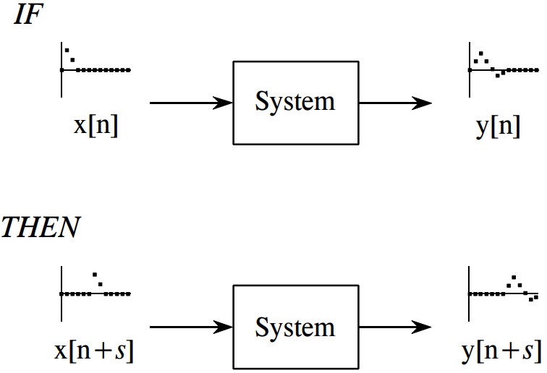
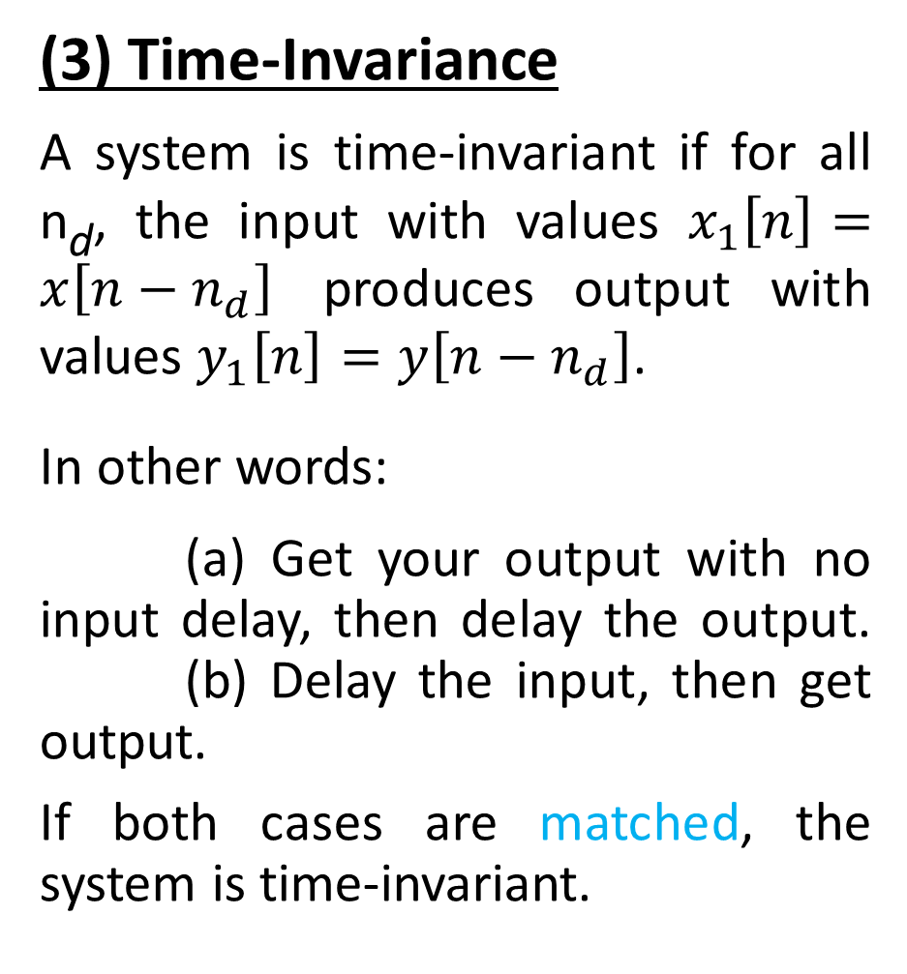
continued…
(3) Time-Invariance
A system is time-invariant if for all n_{d}, the input with values $x_{1}\left[n\right]=x\left[n−n_{d}\right]$ produces output with values $y_{1}\left[n\right]=y\left[n−n_{d}\right]$.
In other words:
(a) Get your output with no input delay, then delay the output.
(b) Delay the input, then get output.
If both cases are matched, the system is time-invariant.

Slide 18
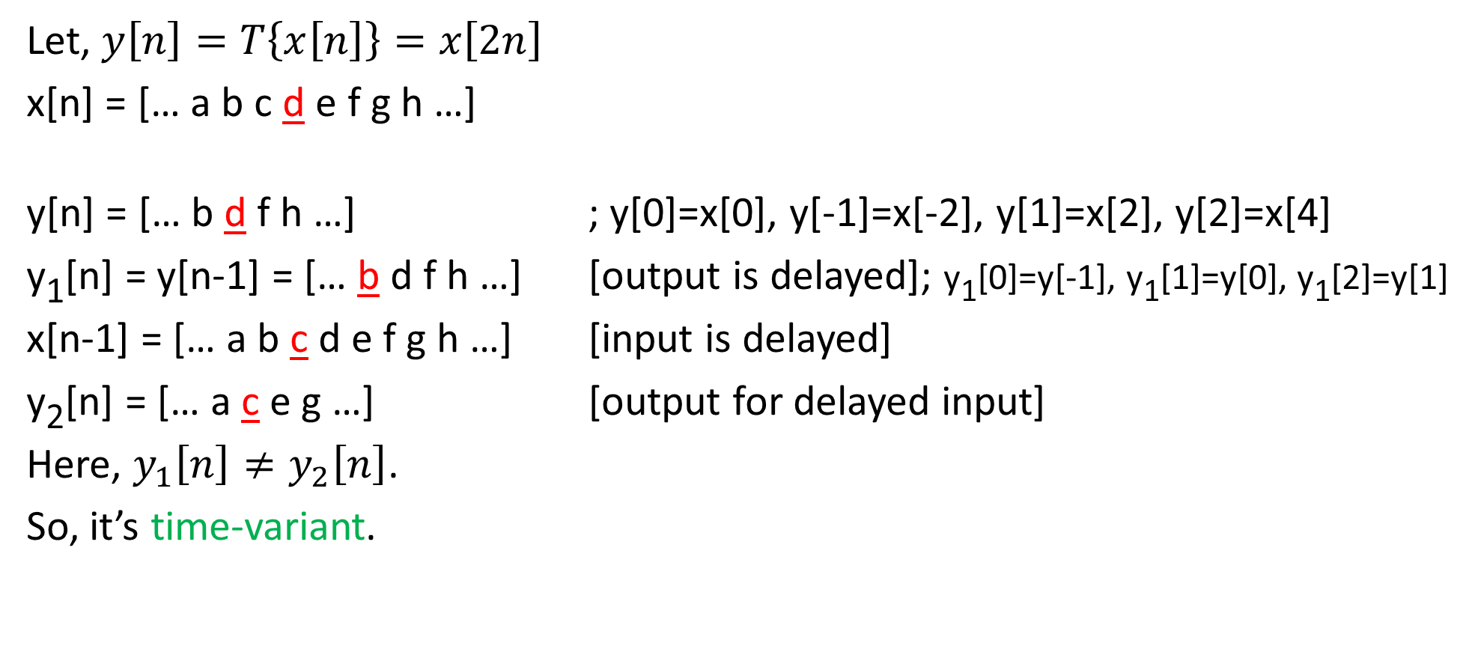
continued…
Let, $y\left[n\right]=T\left\{x\left[n\right]\right\}=x\left[2n\right]$
x[n] = [… a b c d e f g h …]
y[n] = [… b d f h …] ; y[0]=x[0], y[-1]=x[-2], y[1]=x[2], y[2]=x[4]
y₁[n] = y[n-1] = [… b d f h …] [output is delayed]; y₁[0]=y[-1], y₁[1]=y[0], y₁[2]=y[1]
x[n-1] = [… a b c d e f g h …] [input is delayed]
y₂[n] = [… a c e g …] [output for delayed input]
Here, $y_{1}\left[n\right]≠y_{2}\left[n\right]$.
So, it’s time-variant.

Slide 19
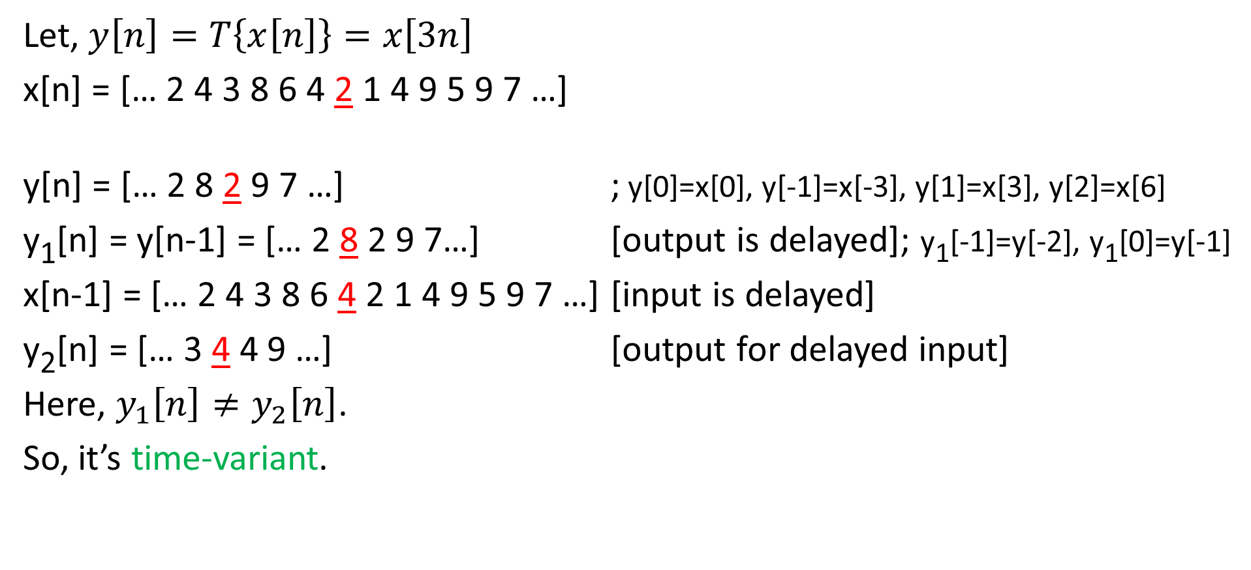
continued…
Let, $y\left[n\right]=T\left\{x\left[n\right]\right\}=x\left[3n\right]$
x[n] = [… 2 4 3 8 6 4 2 1 4 9 5 9 7 …]
y[n] = [… 2 8 2 9 7 …] ; y[0]=x[0], y[-1]=x[-3], y[1]=x[3], y[2]=x[6]
y₁[n] = y[n-1] = [… 2 8 2 9 7…] [output is delayed]; y₁[-1]=y[-2], y₁[0]=y[-1]
x[n-1] = [… 2 4 3 8 6 4 2 1 4 9 5 9 7 …] [input is delayed]
y₂[n] = [… 3 4 4 9 …] [output for delayed input]
Here, $y_{1}\left[n\right]≠y_{2}\left[n\right]$.
So, it’s time-variant.

Slide 20
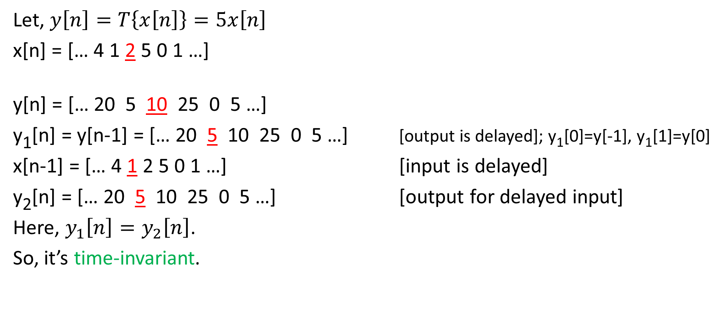
continued…
Let, $y\left[n\right]=T\left\{x\left[n\right]\right\}=5x\left[n\right]$
x[n] = [… 4 1 2 5 0 1 …]
y[n] = [… 20 5 10 25 0 5 …]
y₁[n] = y[n-1] = [… 20 5 10 25 0 5 …] [output is delayed]; y₁[0]=y[-1], y₁[1]=y[0]
x[n-1] = [… 4 1 2 5 0 1 …] [input is delayed]
y₂[n] = [… 20 5 10 25 0 5 …] [output for delayed input]
Here, $y_{1}\left[n\right]=y_{2}\left[n\right]$.
So, it’s time-invariant.

Slide 21
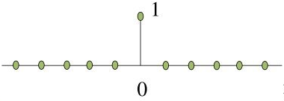
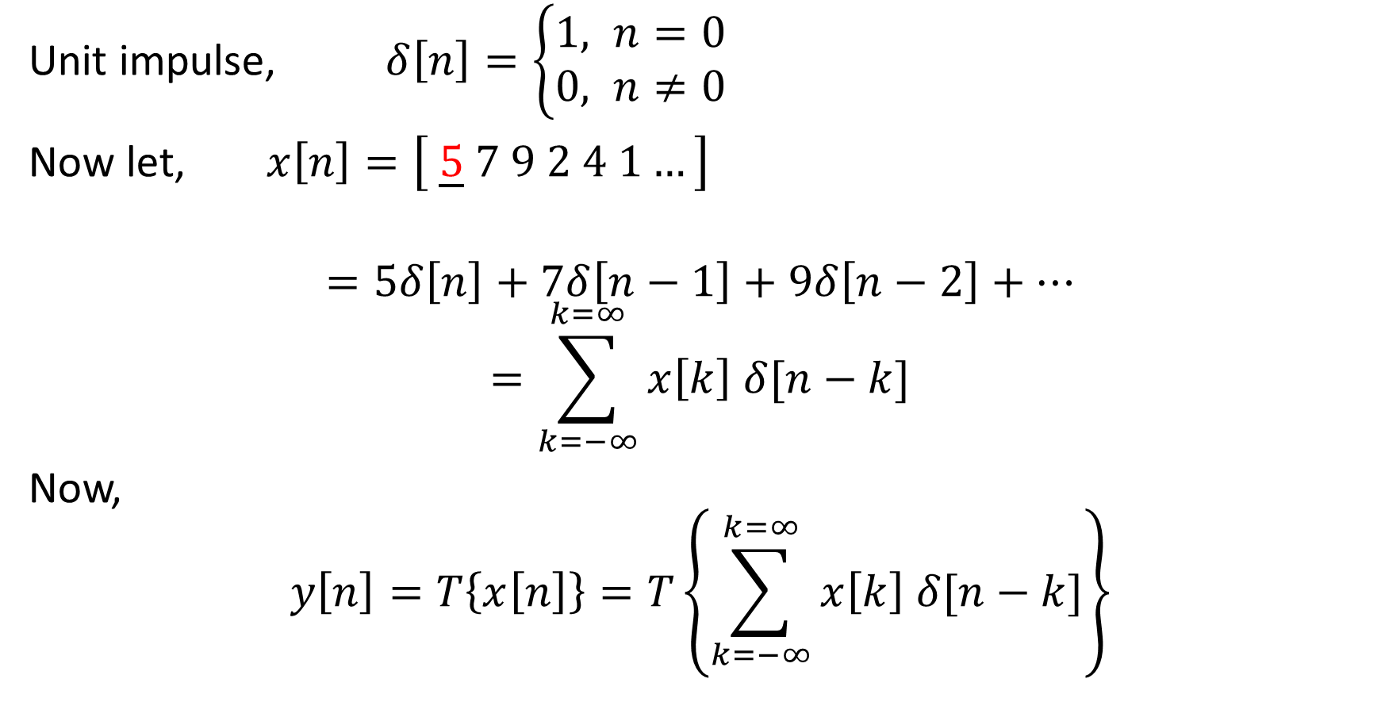
Linear Time-Invariant (LTI) System
Unit impulse, $δ\left[n\right]=\left\{\begin{aligned}1, n=0 \\ &0, n≠0\end{aligned}\right.$
Now let, $x\left[n\right]=\left[ \underline{5} 7 9 2 4 1…\right]$
$$=5δ\left[n\right]+7δ\left[n−1\right]+9δ\left[n−2\right]+…$$
$$=\sum_{k=−∞}^{k=∞}{x\left[k\right] δ[n−k]}$$
Now,
$$y\left[n\right]=T\left\{x\left[n\right]\right\}=T\left\{\sum_{k=−∞}^{k=∞}{x\left[k\right] δ[n−k]}\right\}$$

Slide 22
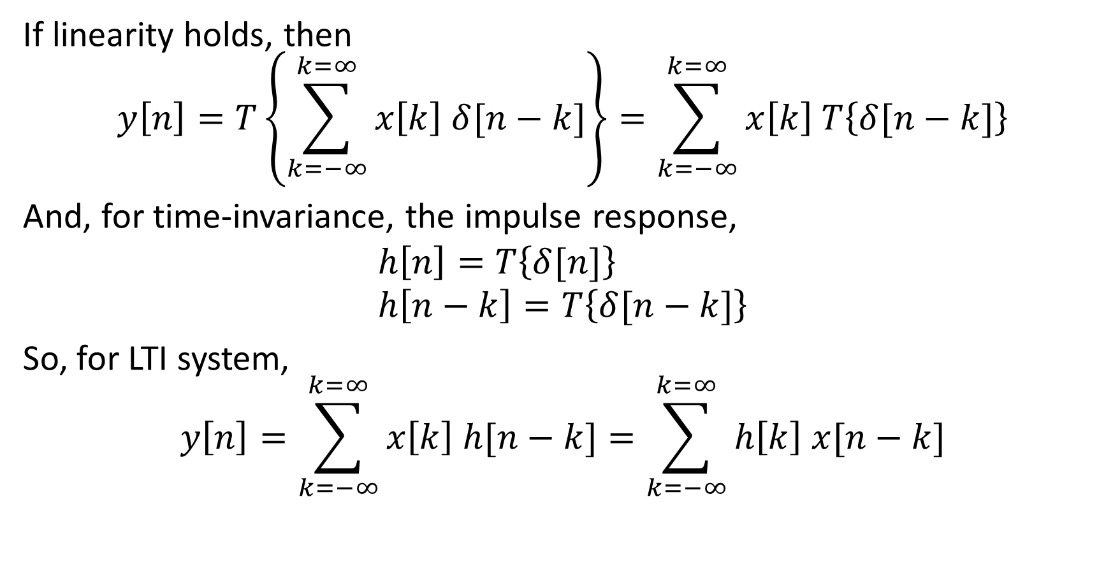
continued…
If linearity holds, then
$$y\left[n\right]=T\left\{\sum_{k=−∞}^{k=∞}{x\left[k\right] δ[n−k]}\right\}=\sum_{k=−∞}^{k=∞}{x\left[k\right] T\left\{δ[n−k]\right\}}$$
And, for time-invariance, the impulse response,
$$h\left[n\right]=T\left\{δ[n]\right\} \\ h\left[n−k\right]=T\left\{δ[n−k]\right\}$$
So, for LTI system,
$$y\left[n\right]=\sum_{k=−∞}^{k=∞}{x\left[k\right] h[n−k]}=\sum_{k=−∞}^{k=∞}{h\left[k\right] x[n−k]}$$

Slide 23
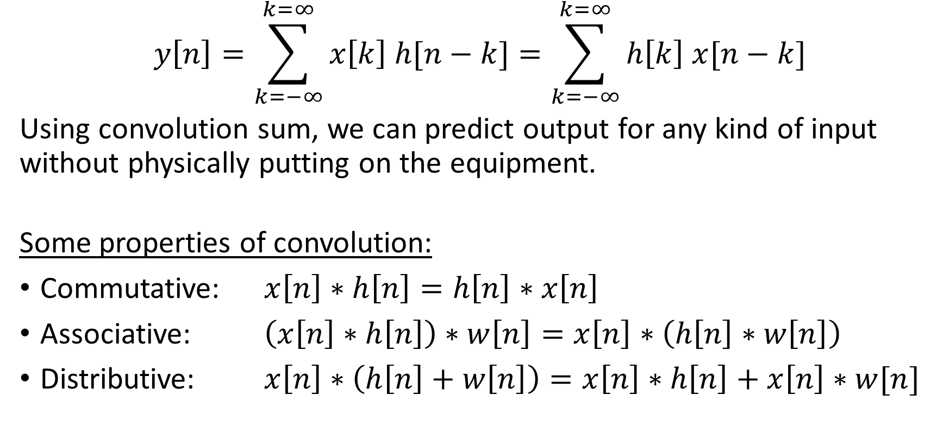
Convolution Sum Formula
$$y\left[n\right]=\sum_{k=−∞}^{k=∞}{x\left[k\right] h[n−k]}=\sum_{k=−∞}^{k=∞}{h\left[k\right] x[n−k]}$$
Using convolution sum, we can predict output for any kind of input without physically putting on the equipment.
Some properties of convolution:
Commutative: $x\left[n\right]∗h\left[n\right]=h\left[n\right]∗x\left[n\right]$
Associative: $\left(x\left[n\right]∗h\left[n\right]\right)∗w\left[n\right]=x\left[n\right]∗\left(h\left[n\right]∗w\left[n\right]\right)$
Distributive: $x\left[n\right]∗\left(h\left[n\right]+w\left[n\right]\right)=x\left[n\right]∗h\left[n\right]+x\left[n\right]∗w[n]$

Slide 24
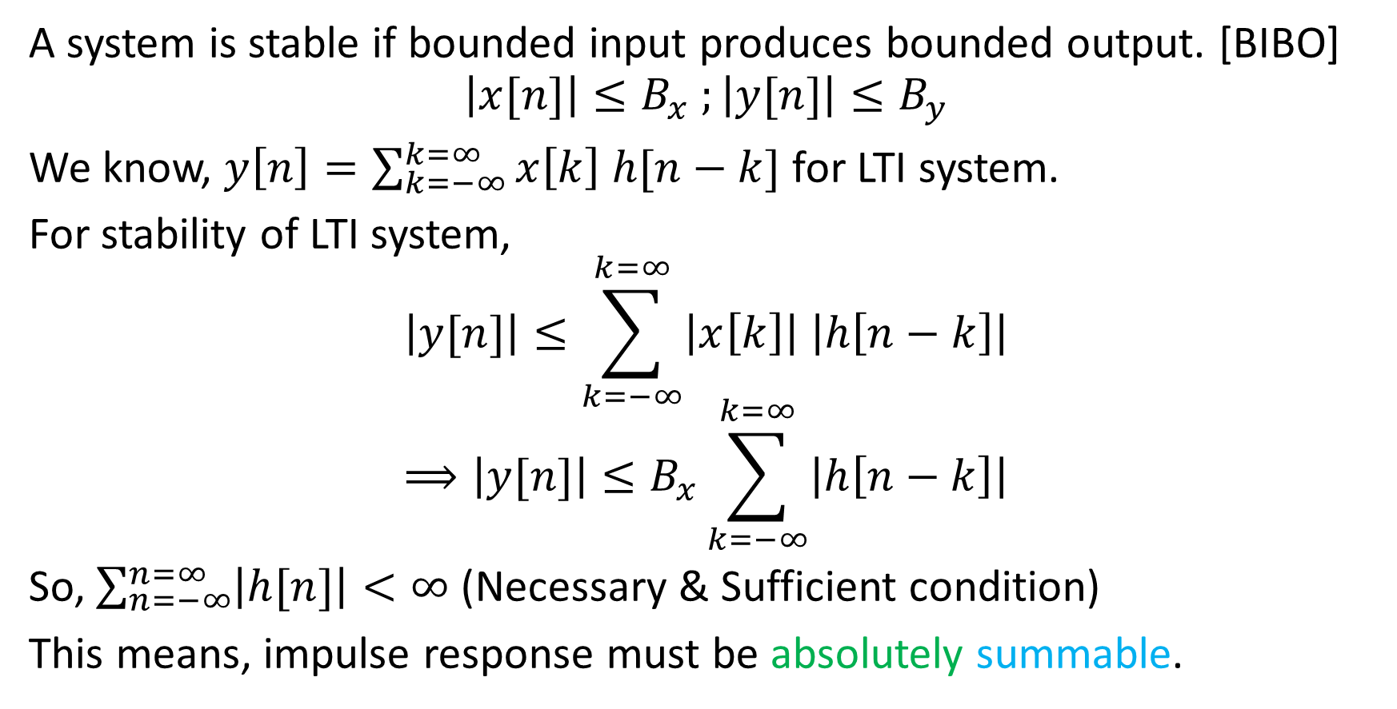
(4) Stability
A system is stable if bounded input produces bounded output. [BIBO]
$$\left|x[n]\right|≤B_{x} ;\left|y[n]\right|≤B_{y}$$
We know, $y\left[n\right]=\sum_{k=−∞}^{k=∞}{x\left[k\right] h[n−k]}$ for LTI system.
For stability of LTI system,
$$\left|y[n]\right|≤\sum_{k=−∞}^{k=∞}{\left|x\left[k\right]\right| \left|h\left[n−k\right]\right|}$$
$$⟹\left|y[n]\right|≤B_{x}\sum_{k=−∞}^{k=∞}{\left|h\left[n−k\right]\right|}$$
So, $\sum_{n=−∞}^{n=∞}{\left|h[n]\right|<∞}$ (Necessary & Sufficient condition)
This means, impulse response must be absolutely summable.

Slide 25
Question: Find if the following systems are stable or not:
y[n] = x[n] – x[n+1]
If input is bounded, then difference between bounded values will also be bounded. So, the system is stable.
y[n] = x[n] + 7
If input is bounded, then addition of bounded values will also be bounded. So, the system is stable.
y[n] = log (x[n])
If 0 is found anywhere in the sequence x[n], then output becomes log(0) = – ∞. So, the system is unstable.
y[n] = n x[n]
Even if input is bounded, we don’t know the boundary of n. So, the system is unstable.

Slide 26
(5) Causality
A system is causal if output depends on present and/or past input.
y[n] = 4x[n] System is causal.
y[n] = 2x[n-1] System is causal.
y[n] = 7x[n] + 5x[n-1] System is causal.
y[n] = 7x[n] + 5x[n+1] System is non-causal.
y[n] = 5x[n+1] System is anti-causal & non-causal.
Note:
1. All anti-causal systems are non-causal, but not the opposite.
2. All memoryless systems are causal.
3. Real-time system can not be non-causal.

Slide 27
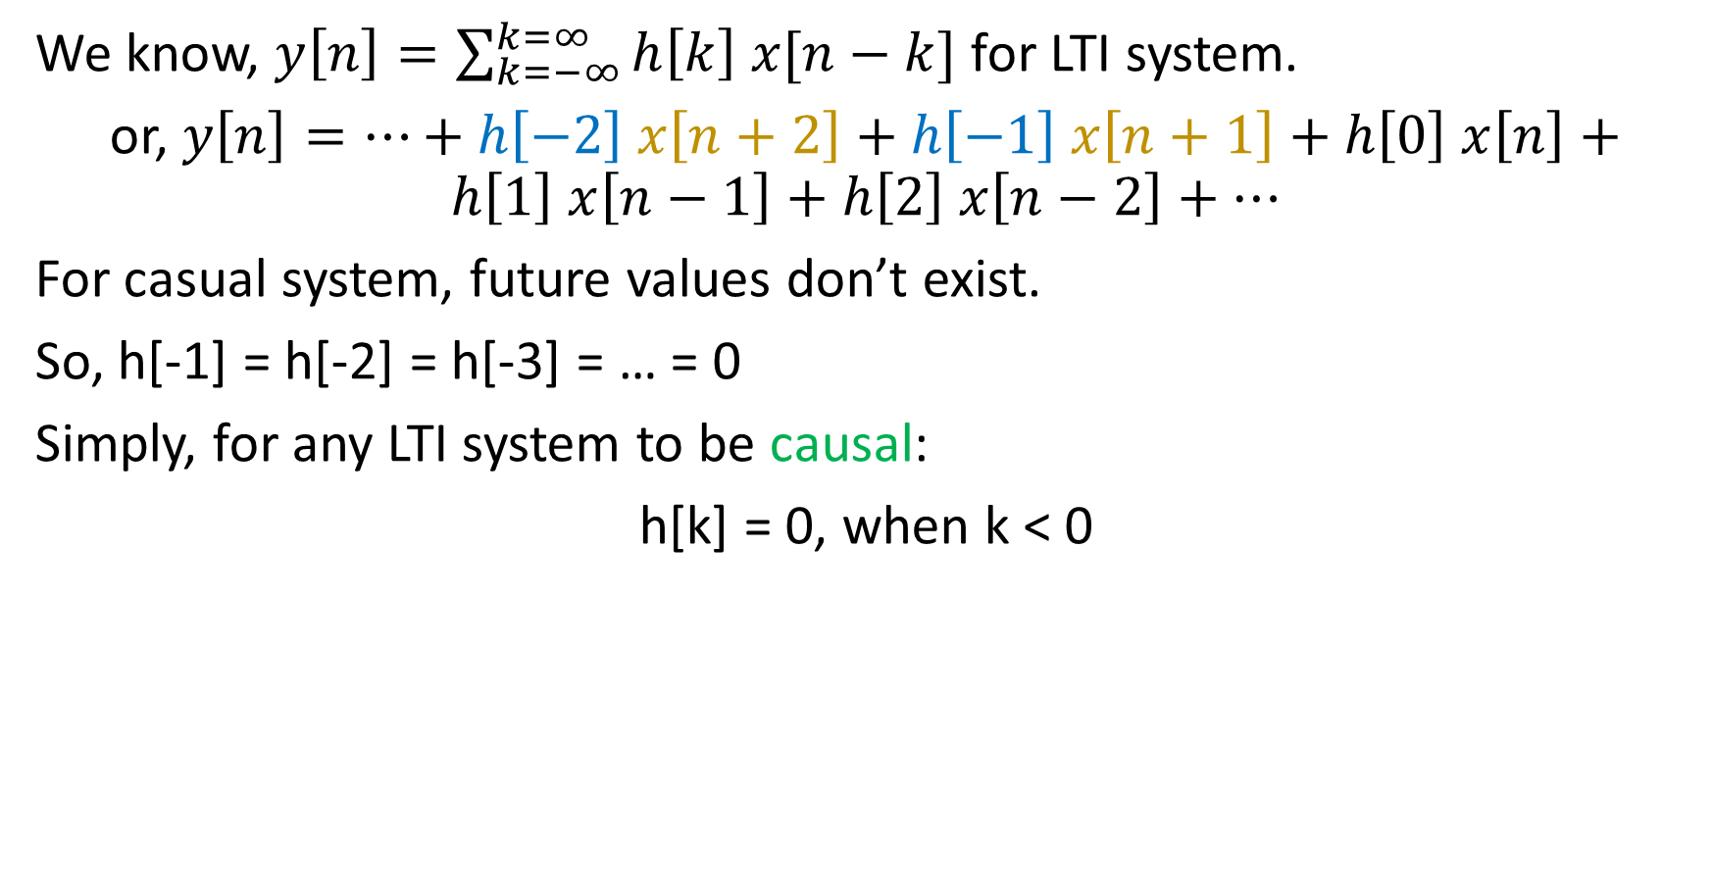
continued…
We know, $y\left[n\right]=\sum_{k=−∞}^{k=∞}{h\left[k\right] x[n−k]}$ for LTI system.
or, $y\left[n\right]=…+h\left[−2\right] x\left[n+2\right]+h\left[−1\right] x\left[n+1\right]+h\left[0\right] x\left[n\right]+h\left[1\right] x\left[n−1\right]+h\left[2\right] x\left[n−2\right]+…$
For casual system, future values don’t exist.
So, h[-1] = h[-2] = h[-3] = … = 0
Simply, for any LTI system to be causal:
h[k] = 0, when k < 0

Slide 28
Question: x[n]=[ 1 2 3 ], h[n]=[ 4 5 6 ]. Find the convolution.
 |  | 1 | 2 | 3
6 | 5 | 4
 |  | 1 | 2 | 3
 | 6 | 5 | 4
 |  | 1 | 2 | 3
 |  | 6 | 5 | 4
 |  | 1 | 2 | 3
 |  |  | 6 | 5 | 4
 |  | 1 | 2 | 3
 |  |  |  | 6 | 5 | 4
y[0] = 4
y[1] = 5+8 = 13
y[2] = 6+10+12 = 28
y[3] = 12+15 = 27
y[4] = 18
So, y[n] = [ 4 13 28 27 18 ]

Slide 29
Question: x[n]=[ 1 2 3 4 5 ], h[n]=[ 4 5 6 ]. Find the convolution.
y[0] = 12+15+16 = 43
y[1] = 18+20+20 = 58
y[2] = 24+25 = 49
y[3] = 30
y[-1] = 6+10+12 = 28
y[-2] = 5+8 = 13
y[-3] = 4
So, y[n] = [4 13 28 43 58 49 30]
1 | 2 | 3 | 4 | 5 |  |  |  |  |  |  | 1 | 2 | 3 | 4 | 5
 | 6 | 5 | 4 |  |  |  |  |  |  |  | 6 | 5 | 4
1 | 2 | 3 | 4 | 5 |  |  |  |  |  |  | 1 | 2 | 3 | 4 | 5
 |  | 6 | 5 | 4 |  |  |  |  |  | 6 | 5 | 4
1 | 2 | 3 | 4 | 5 |  |  |  |  |  |  | 1 | 2 | 3 | 4 | 5
 |  |  | 6 | 5 | 4 |  |  |  | 6 | 5 | 4
1 | 2 | 3 | 4 | 5
 |  |  |  | 6 | 5 | 4

Slide 30
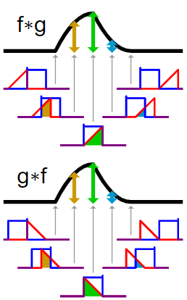
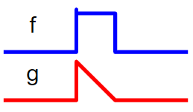
Convolution (graph)

Slide 31
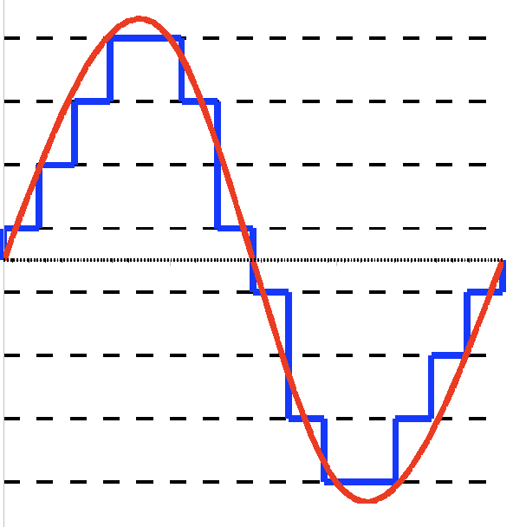
Quantization
“Process of mapping continuous infinite values to a smaller set of discrete finite values”

Slide 32
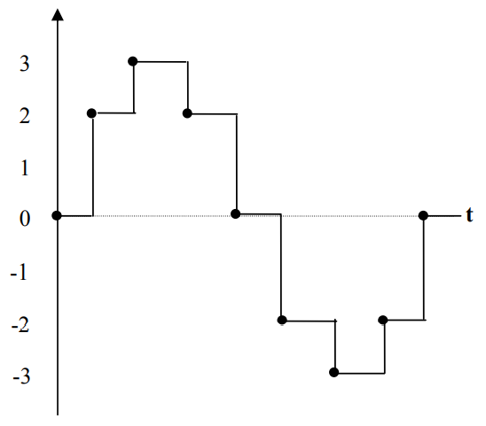
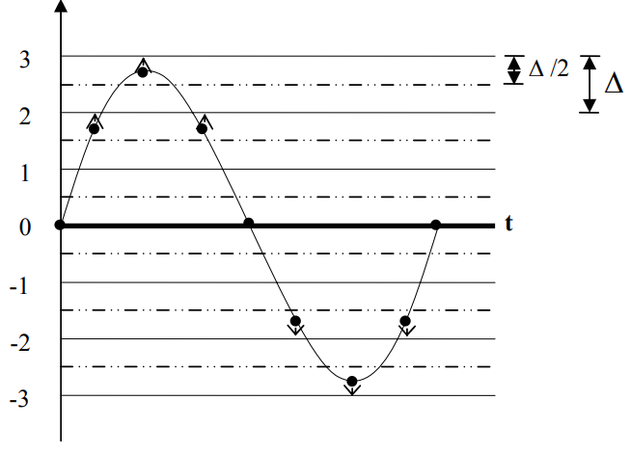
Quantization by Rounding

Slide 33
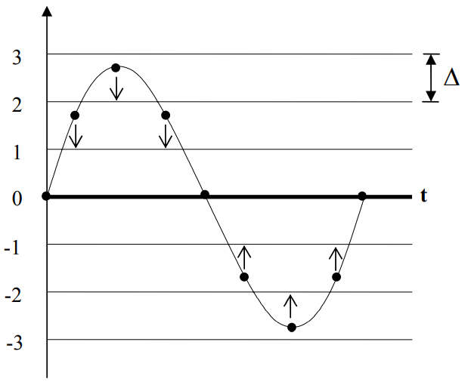
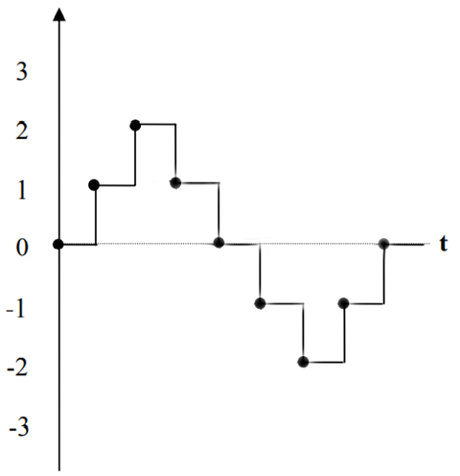
Quantization by Truncation

Slide 34
Question: Quantize the sequence using integer rounding and truncation: x[n]= [ 7.4 2.3 6.5 5.7 9.2 -0.6 -1.9 0.5 -9.6 -2 -0.5 ].
Also find the error sequence.
Rounding: x_{q}[n]= [ 7 2 7 6 9 -1 -2 1 -10 -2 -1 ]
Error: e[n] = [ -0.4 -0.3 0.5 0.3 -0.2 -0.4 -0.1 0.5 -0.4 0 -0.5 ]
Truncation: x_{q}[n] = [ 7 2 6 5 9 0 -1 0 -9 -2 0 ]
  Error: e[n] = [ -0.4 -0.3 -0.5 -0.7 -0.2 0.6 0.9 -0.5 0.6 0 0.5 ]

Slide 35
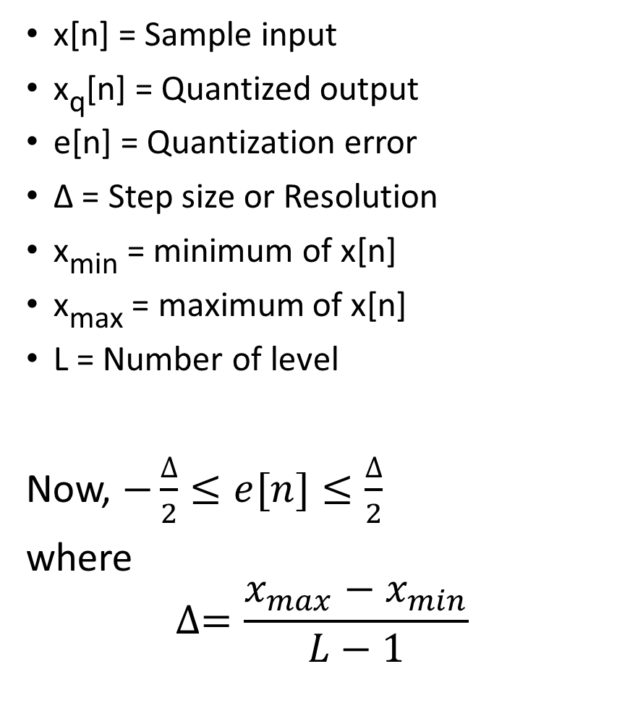
SQNR for Rounding
x[n] = Sample input
x_{q}[n] = Quantized output
e[n] = Quantization error
Δ = Step size or Resolution
x_{min} = minimum of x[n]
x_{max} = maximum of x[n]
L = Number of level
Now, $−\frac{∆}{2}≤e[n]≤\frac{∆}{2}$
where
$$∆=\frac{x_{max}−x_{min}}{L−1}$$
SQNR: Signal to Quantization Noise Ratio

Slide 36
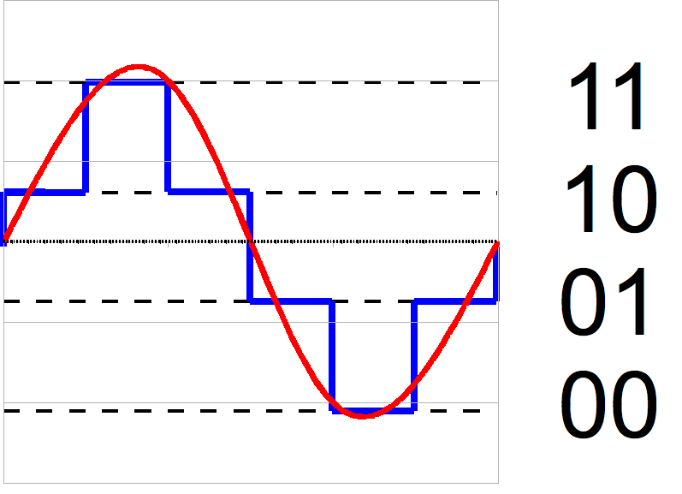
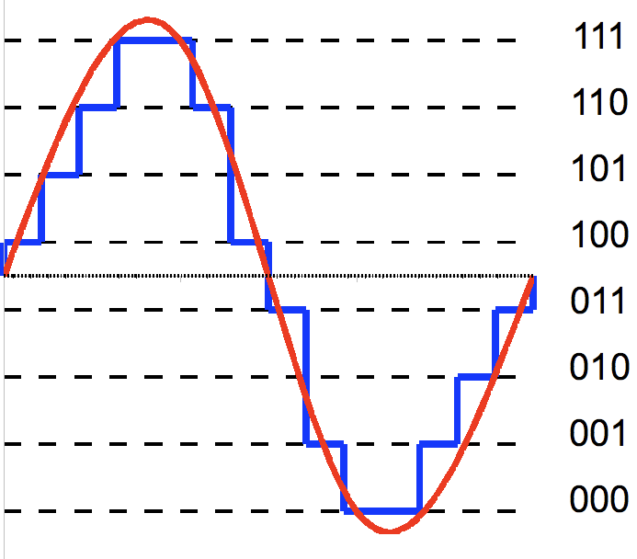
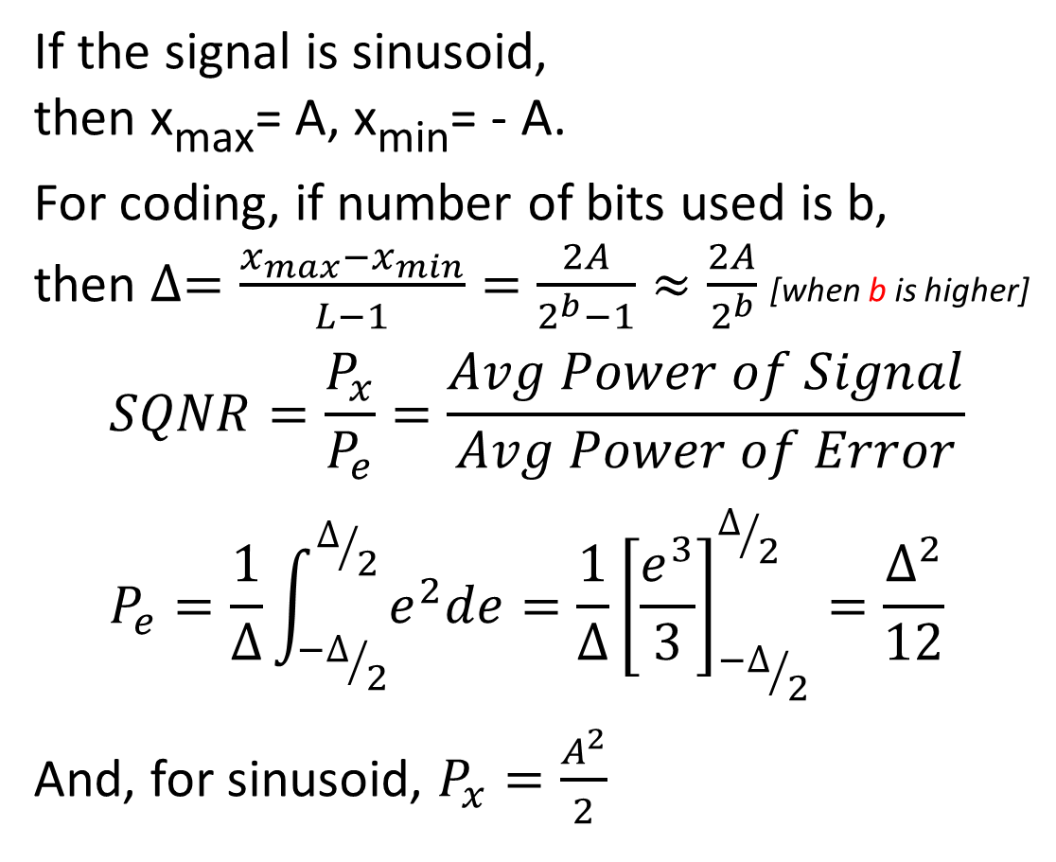
continued…
If the signal is sinusoid,
then x_{max}= A, x_{min}= - A.
For coding, if number of bits used is b,
then $∆=\frac{x_{max}−x_{min}}{L−1}=\frac{2A}{2^{b}−1}≈\frac{2A}{2^{b}}$ [when b is higher]
$$SQNR=\frac{P_{x}}{P_{e}}=\frac{Avg Power of Signal}{Avg Power of Error} \\ P_{e}=\frac{1}{∆}\int_{{−∆}/2}^{∆/2}{e^{2}de}=\frac{1}{∆}{\left[\frac{e^{3}}{3}\right]}_{{−∆}/2}^{∆/2}=\frac{∆^{2}}{12}$$
And, for sinusoid, $P_{x}=\frac{A^{2}}{2}$

Slide 37
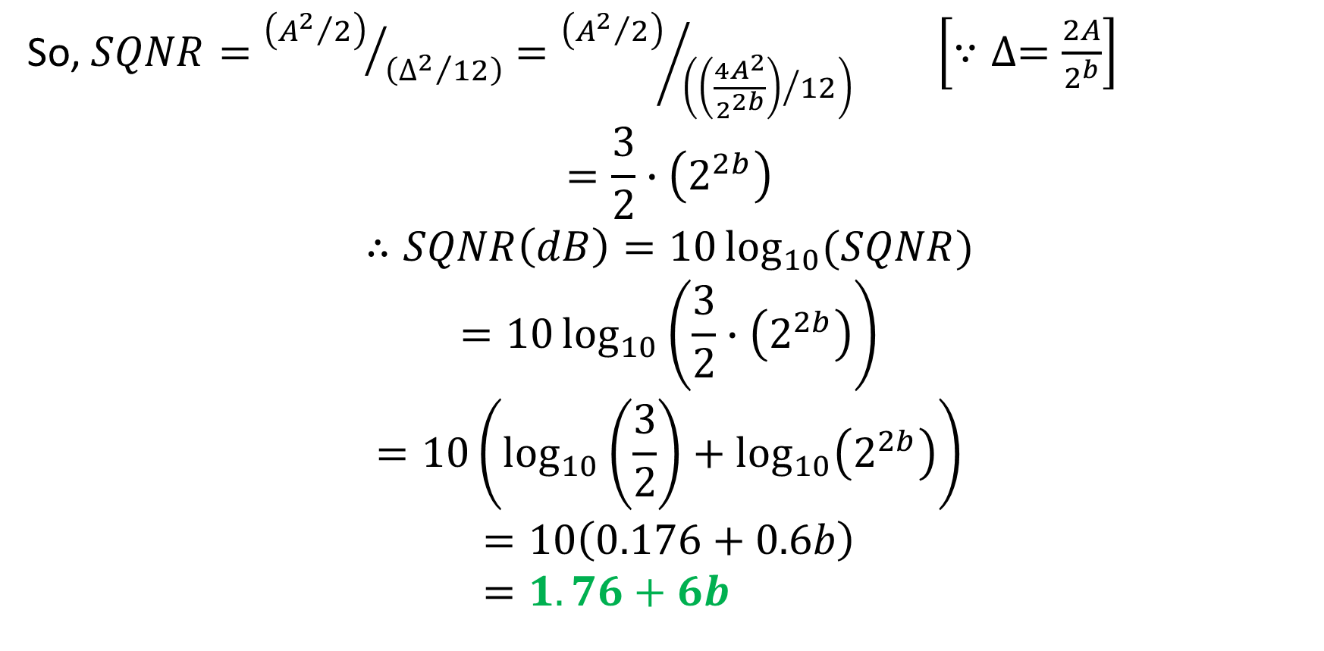
continued…
So, $SQNR={\left({A^{2}}/2\right)}/{\left({∆^{2}}/{12}\right)}={\left({A^{2}}/2\right)}/{\left({\left(\frac{4A^{2}}{2^{2b}}\right)}/{12}\right)}$ $\left[∵∆=\frac{2A}{2^{b}}\right]$
$$=\frac{3}{2}∙\left(2^{2b}\right)$$
$$∴SQNR\left(dB\right)=10\log_{10}{(SQNR)}$$
$$=10\log_{10}\left(\frac{3}{2}∙\left(2^{2b}\right)\right)$$
$$=10\left(\log_{10}\left(\frac{3}{2}\right)+\log_{10}\left(2^{2b}\right)\right)$$
$$=10\left(0.176+0.6b\right) \\ =1.76+6b$$
log(ab) = log(a) + log(b)

Slide 38
Question: An A/D converter uses 7-bit uniform rounding quantization for a sinusoidal signal. Find the SQNR(dB). If 8-bit was used, what would be the improvement in SQNR(dB)? If the sinusoid’s amplitude is 17, find resolution in both cases.
For 7-bit, SQNR(dB) = (1.76 + 6 x 7) dB = 43.76 dB
For 8-bit, SQNR(dB) = (1.76 + 6 x 8) dB = 49.76 dB
So, the improvement is (49.76 – 43.76) dB, or, 6 dB
Resolution for 7-bit, Δ₁ = (2 x 17) / (2⁷) = 0.2656
Resolution for 8-bit, Δ₂ = (2 x 17) / (2⁸) = 0.1328

Slide 39
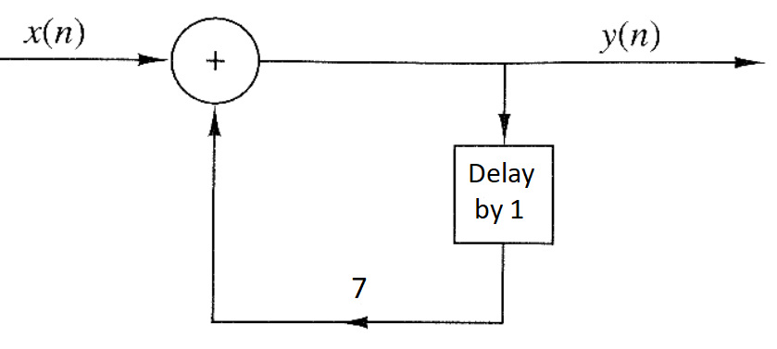
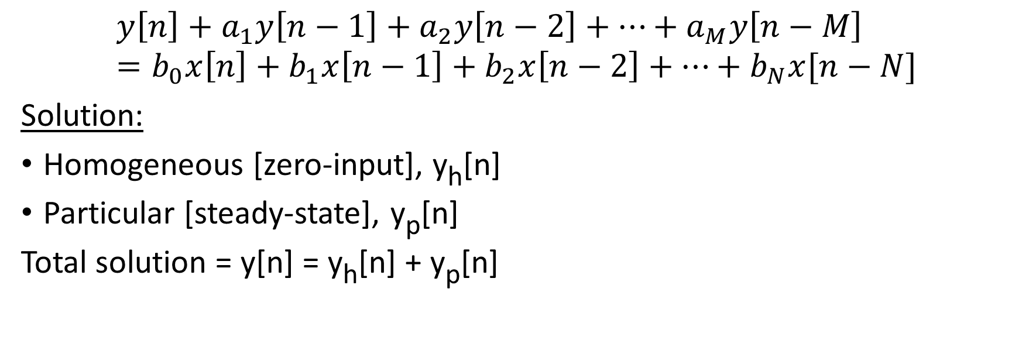
Linear Constant-Coefficient Difference Equation (LCCDE)
$$y\left[n\right]+a_{1}y\left[n−1\right]+a_{2}y\left[n−2\right]+…+a_{M}y\left[n−M\right]=b_{0}x\left[n\right]+b_{1}x\left[n−1\right]+b_{2}x\left[n−2\right]+…+b_{N}x[n−N]$$
Solution:
Homogeneous [zero-input], y_{h}[n]
Particular [steady-state], y_{p}[n]
Total solution = y[n] = y_{h}[n] + y_{p}[n]
y[n] = x[n] + 7 y[n-1]
or, y[n] – 7 y[n-1] = x[n]

Slide 40
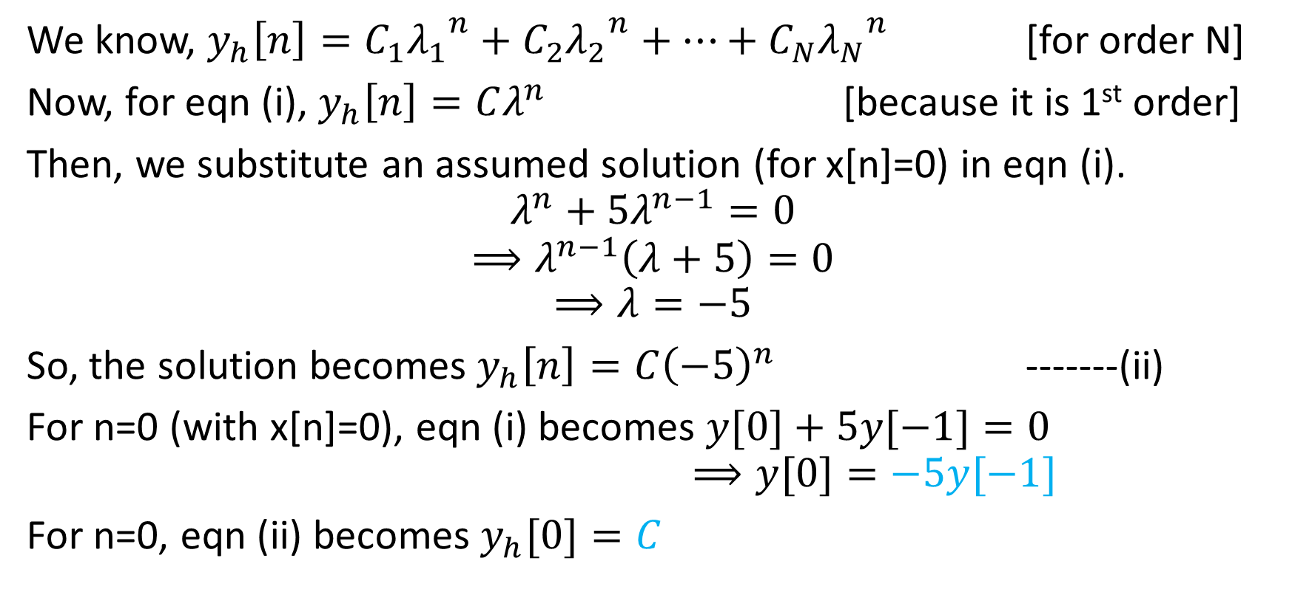
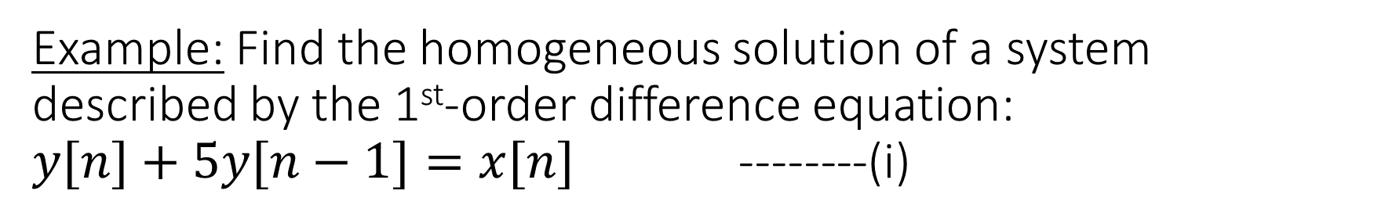
Example: Find the homogeneous solution of a system described by the 1st-order difference equation:
$y[n]+5y[n−1]=x[n]$ --------(i)
We know, $y_{h}\left[n\right]=C_{1}{λ_{1}}^{n}+C_{2}{λ_{2}}^{n}+…+C_{N}{λ_{N}}^{n}$ [for order N]
Now, for eqn (i), $y_{h}\left[n\right]=Cλ^{n}$ [because it is 1st order]
Then, we substitute an assumed solution (for x[n]=0) in eqn (i).
$$λ^{n}+5λ^{n−1}=0$$
$$⟹λ^{n−1}\left(λ+5\right)=0$$
$$⟹λ=−5$$
So, the solution becomes $y_{h}\left[n\right]=C{\left(−5\right)}^{n}$ -------(ii)
For n=0 (with x[n]=0), eqn (i) becomes $y[0]+5y[−1]=0$
$⟹y[0]=−5y[−1]$
For n=0, eqn (ii) becomes $y_{h}[0]=C$

Slide 41
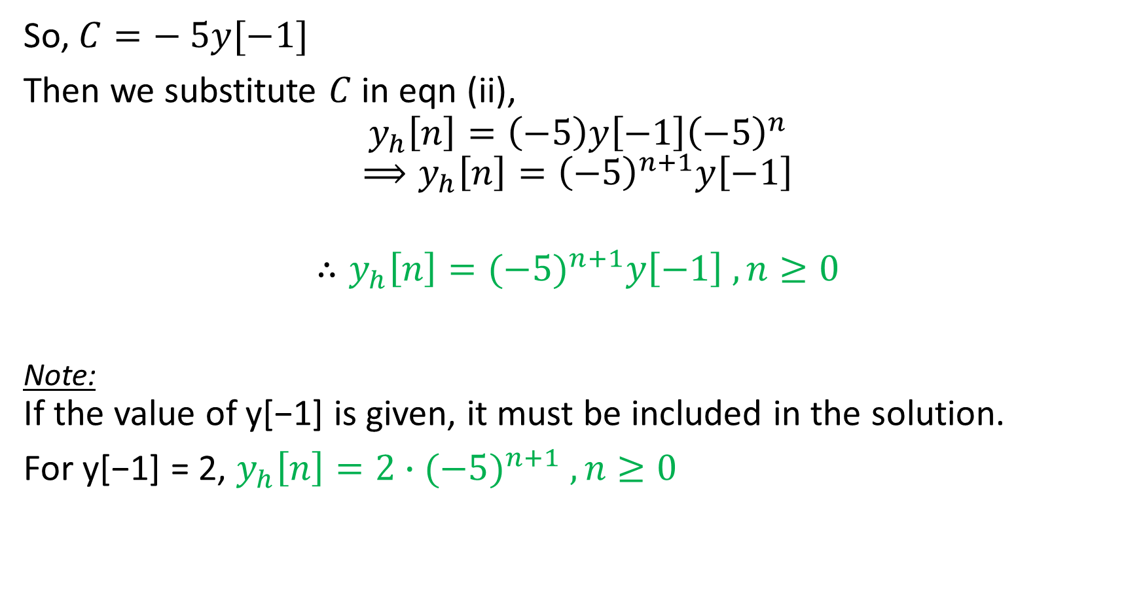
continued…
So, $C=− 5y[−1]$
Then we substitute $C$ in eqn (ii),
$$y_{h}\left[n\right]=\left(−5\right)y\left[−1\right]{\left(−5\right)}^{n}$$
$$⟹y_{h}\left[n\right]={\left(−5\right)}^{n+1}y\left[−1\right]$$
$$∴y_{h}\left[n\right]={(−5)}^{n+1}y\left[−1\right] , n≥0$$
Note:
If the value of y[−1] is given, it must be included in the solution.
For y[−1] = 2, $y_{h}\left[n\right]=2∙{(−5)}^{n+1} , n≥0$

Slide 42
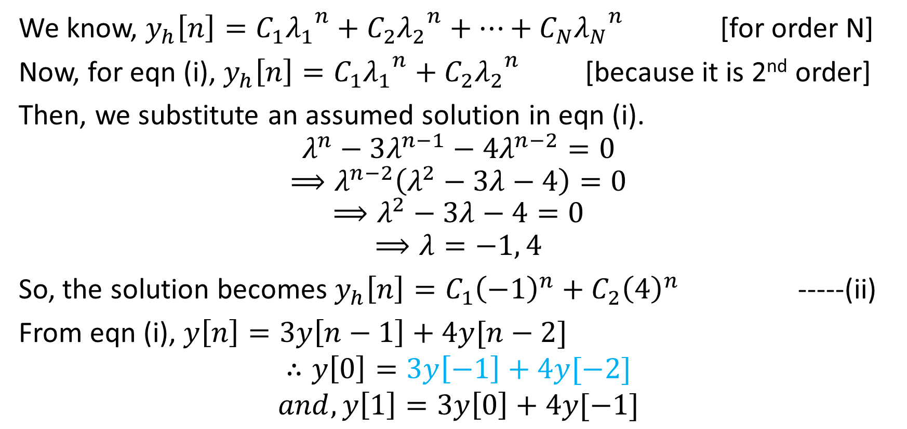
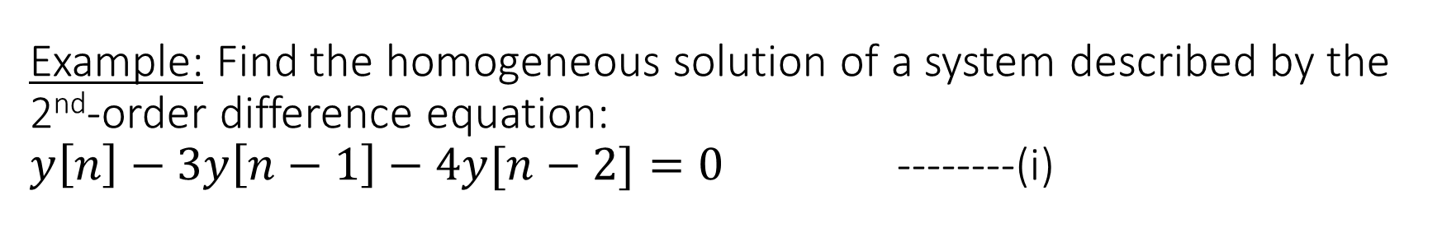
Example: Find the homogeneous solution of a system described by the 2nd-order difference equation:
$y\left[n\right]−3y\left[n−1\right]−4y[n−2]=0$ --------(i)
We know, $y_{h}\left[n\right]=C_{1}{λ_{1}}^{n}+C_{2}{λ_{2}}^{n}+…+C_{N}{λ_{N}}^{n}$ [for order N]
Now, for eqn (i), $y_{h}\left[n\right]=C_{1}{λ_{1}}^{n}+C_{2}{λ_{2}}^{n}$ [because it is 2nd order]
Then, we substitute an assumed solution in eqn (i).
$$λ^{n}−3λ^{n−1}−4λ^{n−2}=0$$
$$⟹λ^{n−2}\left(λ^{2}−3λ−4\right)=0$$
$$⟹λ^{2}−3λ−4=0$$
$$⟹λ=−1, 4$$
So, the solution becomes $y_{h}\left[n\right]=C_{1}{\left(−1\right)}^{n}+C_{2}{\left(4\right)}^{n}$ -----(ii)
From eqn (i), $y\left[n\right]=3y\left[n−1\right]+4y[n−2]$
$$∴y\left[0\right]=3y\left[−1\right]+4y[−2]$$
$$and, y\left[1\right]=3y\left[0\right]+4y[−1]$$

Slide 43
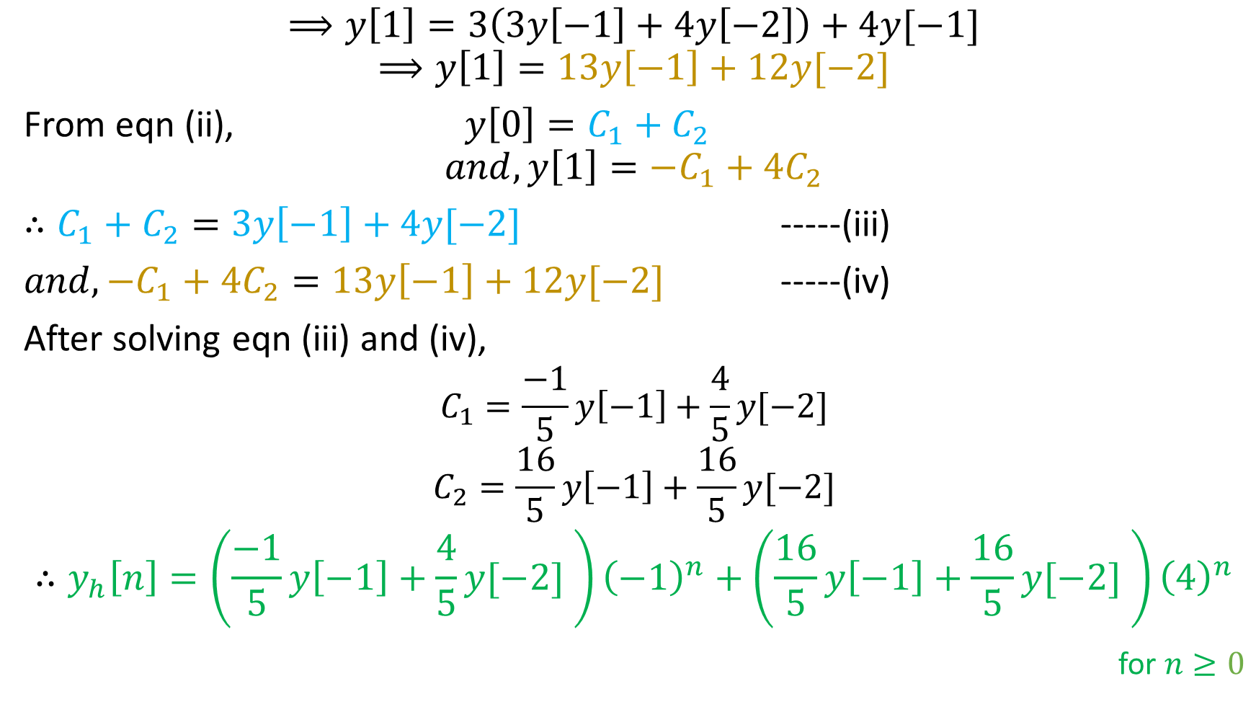
continued…
$$⟹y\left[1\right]=3\left(3y\left[−1\right]+4y\left[−2\right]\right)+4y[−1]$$
$$⟹y\left[1\right]=13y\left[−1\right]+12y[−2]$$
From eqn (ii), $y\left[0\right]=C_{1}+C_{2}$
$$and, y\left[1\right]=−C_{1}+4C_{2}$$
$∴C_{1}+C_{2}=3y\left[−1\right]+4y[−2]$ -----(iii)
$and, −C_{1}+4C_{2}=13y\left[−1\right]+12y[−2]$ -----(iv)
After solving eqn (iii) and (iv),
$$C_{1}=\frac{−1}{5}y\left[−1\right]+\frac{4}{5}y[−2]$$
$$C_{2}=\frac{16}{5}y\left[−1\right]+\frac{16}{5}y[−2]$$
$$∴y_{h}\left[n\right]=\left(\frac{−1}{5}y\left[−1\right]+\frac{4}{5}y[−2] \right){\left(−1\right)}^{n}+\left(\frac{16}{5}y\left[−1\right]+\frac{16}{5}y[−2] \right){\left(4\right)}^{n}$$
for $n≥0$

Slide 44


Correlation
Crosscorrelation:
$$r_{xy}\left(l\right)=\sum_{n=−∞}^{n=∞}{x\left[n\right] y[n−l]}$$
Autocorrelation:
$$r_{xx}\left(l\right)=\sum_{n=−∞}^{n=∞}{x\left[n\right] x[n−l]}$$
“Measure of similarity between signals”
Use: radar, sonar, GPS etc.

Slide 45

Convolution vs Crosscorrelation vs Autocorrelation
r_{fg}
r_{ff}
r_{gf}
r_{gg}

Slide 46
Question: Find r_{xy}[n] and r_{yx}[n] for the following: x[n]=[ 7 4 6 1 ], y[n]=[ 1 0 1 9 ].
 | 7 | 4 | 6 | 1 |  |  |  |  |  |  |  | 7 | 4 | 6 | 1
1 | 0 | 1 | 9 |  |  |  |  |  |  | 1 | 0 | 1 | 9
 | 7 | 4 | 6 | 1 |  |  |  |  |  |  |  | 7 | 4 | 6 | 1
 | 1 | 0 | 1 | 9 |  |  |  |  | 1 | 0 | 1 | 9
 | 7 | 4 | 6 | 1
 |  | 1 | 0 | 1 | 9
 | 7 | 4 | 6 | 1
 |  |  | 1 | 0 | 1 | 9
 | 7 | 4 | 6 | 1
 |  |  |  | 1 | 0 | 1 | 9
r_{xy}[0] = 0+4+54 = 58
r_{xy}[1] = 7+0+6+9 = 22
r_{xy}[2] = 4+0+1 = 5
r_{xy}[3] = 6+0 = 6
r_{xy}[4] = 1
r_{xy}[-1] = 7+36 = 43
r_{xy}[-2] = 63
So, r_{xy}[n] = [ 63 43 58 22 5 6 1 ]
And, r_{yx}[n] = [ 1 6 5 22 58 43 63 ]

Slide 47
Question: Find autocorrelation for the following: x[n]=[ 7 4 6 ]
 |  | 7 | 4 | 6
 |  | 7 | 4 | 6
 |  | 7 | 4 | 6
 |  |  | 7 | 4 | 6
 |  | 7 | 4 | 6
 |  |  |  | 7 | 4 | 6
 |  | 7 | 4 | 6
 | 7 | 4 | 6
 |  | 7 | 4 | 6
7 | 4 | 6
r_{xx}[0] = 49+16+36 = 101
r_{xx}[1] = 28+24 = 52
r_{xx}[2] = 42
r_{xx}[-1] = 28+24 = 52
r_{xx}[-2] = 42
So, r_{xx}[n] = [ 42 52 101 52 42 ]

Slide 48

continued…
Normalized Correlation Sequence
$$ρ_{xx}[n]=\frac{r_{xx}[n]}{r_{xx}[0]}$$
$$ρ_{xy}\left[n\right]=\frac{r_{xy}[n]}{\sqrt{r_{xx}\left[0\right]∙r_{yy}[0]}}$$
For example, if $r_{xx}\left[n\right]=[5 10 \underline{20} 10 5]$
then $ρ_{xx}\left[n\right]=[0.25 0.5 \underline{1} 0.5 0.25]$

Slide 49

Discrete Time Fourier Transform (DTFT)
$$X\left(e^{jω}\right)=\sum_{n=−∞}^{n=∞}{x\left[n\right]e^{−jωn}}$$
$X\left(e^{jω}\right)$ is a continuous function of ω, where ω = ΩT_{s}.
$X\left(e^{jω}\right)$ is periodic with period of 2π.
$$X\left(e^{jω}\right)=X\left(e^{j(ω+2πk)}\right)$$
To convert $X\left(e^{jω}\right)$ to x[n], inverse DTFT (IDTFT) is applied:
$$x\left[n\right]=\frac{1}{2π}\int_{−π}^{π}{X\left(e^{jω}\right)}e^{jωn}dω$$
where k is any integer

Slide 50



continued…
Discrete & Aperiodic
Continuous & Periodic
$$x\left[n\right]=\frac{1}{2π}\int_{−π}^{π}{X\left(e^{jω}\right)}e^{jωn}dω$$
$$X\left(e^{jω}\right)=\sum_{n=−∞}^{n=∞}{x\left[n\right]e^{−jωn}}$$

Slide 51


continued…
Existence of DTFT
Spectra
Sufficient condition:
$$\left|X\left(e^{jω}\right)\right|≤\sum_{n=−∞}^{n=∞}{\left|x\left[n\right]\right|}<∞$$
x[n] must be absolutely summable.
Then, DTFT converges to a finite result for all ω.
$X\left(e^{jω}\right)$ is generally complex.
Magnitude spectrum:
$$\left|X\left(e^{jω}\right)\right|=\sqrt{{\left(ℜ\left\{X\left(e^{jω}\right)\right\}\right)}^{2}+{\left(ℑ\left\{X\left(e^{jω}\right)\right\}\right)}^{2}}$$
Phase spectrum:
$$∡\left(X\left(e^{jω}\right)\right)=\tan^{−1}\left(\frac{ℑ\left(X\left(e^{jω}\right)\right)}{ℜ\left(X\left(e^{jω}\right)\right)}\right)$$
Note: Both are continuous & periodic.

Slide 52




continued…
Unit Impulse
$$δ\left[n\right]=\left\{\begin{aligned}1, n=0 \\ &0, n≠0\end{aligned}\right.$$
Unit Step
$$u\left[n\right]=\left\{\begin{aligned}1, n≥0 \\ &0, n<0\end{aligned}\right.$$
δ[n] = [ … 0 0 0 0 1 0 0 0 0 … ]
u[n] = [ … 0 0 0 0 1 1 1 1 1 … ]

Slide 53

Question: Find the DTFT of x[n] = u[n] – u[n-3]
u[n] = [… 0 0 0 0 0 1 1 1 1 1 1 1 1 …]
u[n-3] = [… 0 0 0 0 0 0 0 0 1 1 1 1 1 …]
x[n] = [… 0 0 0 0 0 1 1 1 0 0 0 0 0 …]
We know,
$$X\left(e^{jω}\right)=\sum_{n=−∞}^{n=∞}{x\left[n\right]e^{−jωn}}$$
$$=\sum_{n=0}^{n=2}{x\left[n\right]e^{−jωn}} \\ =x\left[0\right]e^{−jω0}+x\left[1\right]e^{−jω1}+x\left[2\right]e^{−jω2} \\ =1+e^{−jω}+e^{−2jω}$$

Slide 54




Question: Find the DTFT of $x\left[n\right]={\left(1/2\right)}^{n}u[n]$
We know,
$$X\left(e^{jω}\right)=\sum_{n=−∞}^{n=∞}{x\left[n\right]e^{−jωn}} \\ =\sum_{n=−∞}^{n=∞}{{\left(1/2\right)}^{n}u[n]e^{−jωn}}$$
But, u[n] = 0 when n < 0.
So,
$$X\left(e^{jω}\right)=\sum_{n=0}^{n=∞}{{\left(1/2\right)}^{n}e^{−jωn}}$$
$$⟹X\left(e^{jω}\right)=\sum_{n=0}^{n=∞}{{\left(\frac{1}{2}e^{−jω}\right)}^{n}}$$
$$={\left(\frac{1}{2}e^{−jω}\right)}^{0}+{\left(\frac{1}{2}e^{−jω}\right)}^{1}+{\left(\frac{1}{2}e^{−jω}\right)}^{2}+…$$
$$=1+{\left(\frac{1}{2}e^{−jω}\right)}^{1}+{\left(\frac{1}{2}e^{−jω}\right)}^{2}+…$$
This is a convergent geometric series (because the |ratio| is < 1)
$$∴X\left(e^{jω}\right)=\frac{1}{1−\frac{1}{2}e^{−jω}}$$
u[n]
[ using formula $S_{∞}=\frac{a}{1−r}$ ]

Slide 55




Question: Find the IDTFT of
$$X\left(e^{jω}\right)=\left\{\begin{aligned}1, −π/4≤ω≤π/4 \\ 0, otherwise\end{aligned}\right.$$
We know,
$$x\left[n\right]=\frac{1}{2π}\int_{−π}^{π}{X\left(e^{jω}\right)}e^{jωn}dω$$
$$⟹x\left[n\right]=\frac{1}{2π}\int_{{−π}/4}^{π/4}{e^{jωn}}dω$$
$$=\frac{1}{2π}∙\frac{1}{jn}{\left[e^{jωn}\right]}_{{−π}/4}^{π/4}$$
$$=\frac{1}{πn}∙\frac{1}{2j}\left(e^{\left(j\frac{π}{4}n\right)}−e^{\left(−j\frac{π}{4}n\right)}\right)$$
$$=\frac{1}{πn}\sin\left(\frac{π}{4}n\right)$$
[ We know, $\sin{θ}=\frac{e^{jθ}−e^{−jθ}}{2j}$ ]
$$⟹x\left[n\right]=\frac{1}{4}∙\frac{1}{\frac{π}{4}n}\sin\left(\frac{π}{4}n\right)$$
$$⟹x\left[n\right]=\frac{1}{4}sinc\left(\frac{π}{4}n\right)$$

Slide 56


continued…
$$x\left[n\right]=\frac{1}{4}sinc\left(\frac{π}{4}n\right)$$

Slide 57

Some Properties of DTFT
Linearity
$$x\left[n\right]=ax_{1}\left[n\right]+bx_{2}\left[n\right]\underset{↔}{DTFT}X\left(e^{jω}\right)=aX_{1}\left(e^{jω}\right)+bX_{2}\left(e^{jω}\right)$$
Time Delay
$$y\left[n\right]=x\left[n−k\right]\underset{↔}{DTFT}Y\left(e^{jω}\right)=X\left(e^{jω}\right)e^{−jωk}$$
Frequency Shift
$$y\left[n\right]=e^{jω_{c}n}x\left[n\right]\underset{↔}{DTFT}Y\left(e^{jω}\right)=X\left(e^{j\left(ω−ω_{c}\right)}\right)$$
Convolution
$$y\left[n\right]=x\left[n\right]∗h\left[n\right]\underset{↔}{DTFT}Y\left(e^{jω}\right)=X\left(e^{jω}\right)H\left(e^{jω}\right)$$
Differentiation
$$y\left[n\right]=nx\left[n\right]\underset{↔}{DTFT}Y\left(e^{jω}\right)=j\frac{d}{dω}\left(X\left(e^{jω}\right)\right)$$

Slide 58

continued…
Time Reversal
$$y\left[n\right]=x\left[−n\right]\underset{↔}{DTFT}Y\left(e^{jω}\right)=X\left(e^{−jω}\right)$$
Conjugation
$$y\left[n\right]=x^{∗}\left[n\right]\underset{↔}{DTFT}Y\left(e^{jω}\right)=X^{∗}\left(e^{−jω}\right)$$
Modulation
$$y\left[n\right]=x\left[n\right]\cos\left(ω_{0}n\right)\underset{↔}{DTFT}Y\left(e^{jω}\right)=\frac{1}{2}X\left(e^{j\left(ω−ω_{0}\right)}\right)+\frac{1}{2}X\left(e^{j\left(ω+ω_{0}\right)}\right)$$
Multiplication
$$x\left[n\right]=x_{1}\left[n\right]∙x_{2}\left[n\right]\underset{↔}{DTFT}X\left(e^{jω}\right)=\frac{1}{2π}\int_{−π}^{π}{X_{1}}\left(e^{jτ}\right)X_{2}\left(e^{j\left(ω−τ\right)}\right)ⅆτ$$
Parseval’s Theorem
$$\sum_{n=−∞}^{n=∞}{{\left|x[n]\right|}^{2}}=\frac{1}{2π}\int_{−π}^{π}{{\left|X\left(e^{jω}\right)\right|}^{2}}dω$$

Slide 59



Discrete Fourier Transform
(DFT)
Recall the DTFT of x[n],
$$X\left(ω\right)=\sum_{n=−∞}^{n=∞}{x\left[n\right]e^{−jωn}}$$
Let’s sample X(ω) periodically in frequency at a spacing of $δω$.
Since X(ω) is periodic with period 2π, only samples in the fundamental frequency range are necessary.
We take N equidistant samples in the interval $0≤ω<2π$with spacing $δω=\frac{2π}{N}$
$$X\left(\frac{2π}{N}k\right)=\sum_{n=−∞}^{n=∞}{x\left[n\right]e^{−j2πkn/N}}$$
where k = 0,1,2,…,N–1

Slide 60


continued…
But, the equally spaced frequency samples $X\left(\frac{2π}{N}k\right)$ do not uniquely represent the original sequence x[n] when x[n] has infinite duration.
Instead, the frequency samples correspond to a periodic sequence of period N, that is an aliased version of x[n].
So, a finite-duration sequence x[n] of length L has a DTFT:
$$X\left(ω\right)=\sum_{n=0}^{n=L−1}{x\left[n\right]e^{−jωn}};\text{0}≤ω≤2π$$
After equidistant sampling of X(ω) for N ≥ L,
$$X(k)≡X\left(\frac{2π}{N}k\right)=\sum_{n=0}^{n=L−1}{x\left[n\right]e^{−j2πkn/N}}$$
$$⟹X(k)=\sum_{n=0}^{n=N−1}{x\left[n\right]e^{−j2πkn/N}}$$
where k = 0,1,2,…,N–1
The N-point inverse DFT (IDFT):
$$x\left[n\right]=\frac{1}{N}\sum_{k=0}^{k=N−1}{X(k)e^{j2πkn/N}}$$
where n = 0,1,2,…,N–1

Slide 61



continued…
Let’s see the DTFT and DFT of $x\left[n\right]=\left\{\begin{aligned}1, 0≤n≤L−1 \\ &0, otherwise \end{aligned}\right.;L=10$

Slide 62

Example: Find the 4-point DFT of x[n]=[ 2 1 7 5 ]
$$X\left(k\right)=\sum_{n=0}^{n=3}{x[n]e^{−j2πnk/4}}$$
where k = 0, 1, 2, 3
$$⟹X\left(k\right)=x\left[0\right]e^{0}+x\left[1\right]e^{−{j2πk}/4}+x\left[2\right]e^{−{j2π2k}/4}+x[3]e^{−{j2π3k}/4}$$
$$⟹X\left(k\right)=2+e^{−{jπk}/2}+7e^{−jπk}+5e^{−{j3πk}/2}$$
$X(0)=2+1+7+5=15$
$X\left(1\right)=2+e^{−{jπ}/2}+7e^{−jπ}+5e^{−{j3π}/2}=−5+4j$
$X\left(2\right)=2+e^{−jπ}+7e^{−jπ2}+5e^{−j3π}=3$
$X\left(3\right)=2+e^{−{jπ3}/2}+7e^{−jπ3}+5e^{−{j3π3}/2}=−5−4j$
Magnitude, $\left|X(k)\right|=\left[ \underline{15} 6.403 3 6.403 \right]$
Angle, $∡X\left(k\right)=[ \underline{0} 2.467 0 −2.467 ]$

Slide 63

z-Transform
$$X\left(z\right)=\sum_{n=−∞}^{n=∞}{x\left[n\right]z^{−n}}$$
where z is a complex variable.
$$x[n]\underset{↔}{z}X(z)$$
The Region of Convergence (ROC) of X(z) is the set of values of z for which X(z) attains a finite value.
Example: Determine the z-transforms of the following finite-duration signals:
x₁[n]=[ 9 2 4 6 3 1 ]
X₁(z)=9z²+2z+4+6z^{–1}+3z^{–2}+z^{–3},
ROC: entire z-plane except z=0 and z=∞
x₂[n]=[ 1 0 7 9 5 ]
X₂(z)=1+7z^{–2}+9z^{–3}+5z^{–4},
ROC: entire z-plane except z=0

Slide 64

More example: Determine the z-transforms of the following finite-duration signals:
x₃[n]=δ[n]
X₃(z)=1 ; ROC: entire z-plane
x₄[n]=δ[n–6]
X₄(z)=z^{–6} ; ROC: entire z-plane except $z=0$
x₅[n]=δ[n+7]
X₅(z)=z⁷ ; ROC: entire z-plane except $z=∞$
x₆[n]=[ 4 6 0 7 ]
X₆(z)=4z³+6z²+7; ROC: entire z-plane except $z=∞$

Slide 65


Example: Determine the z-transform of the signal:
$$x\left[n\right]={\left(1/3\right)}^{n}u[n]$$
We get, $x\left[n\right]=\left[ \underline{1} \frac{1}{3} {\left(\frac{1}{3}\right)}^{2} {\left(\frac{1}{3}\right)}^{3} {\left(\frac{1}{3}\right)}^{4} …\right]$
Thus, $X\left(z\right)=1+\frac{1}{3}z^{−1}+{\left(\frac{1}{3}\right)}^{2}z^{−2}+{\left(\frac{1}{3}\right)}^{3}z^{−3}+{\left(\frac{1}{3}\right)}^{4}z^{−4}+…$
$$=1+\left(\frac{1}{3}z^{−1}\right)+{\left(\frac{1}{3}z^{−1}\right)}^{2}+{\left(\frac{1}{3}z^{−1}\right)}^{3}+{\left(\frac{1}{3}z^{−1}\right)}^{4}+…$$
Recall for infinite geometric series, $S_{∞}=\frac{a}{1−r}$ , where $|r|<1$
So, $\left|\frac{1}{3}z^{−1}\right|<1⟹\left|z\right|>\frac{1}{3}$
$$∴X\left(z\right)=\frac{1}{1−\frac{1}{3}z^{−1}};ROC:\left|z\right|>\frac{1}{3}$$

Slide 66

Existence of X(z)
Let, $z=re^{jθ}$, where $r=\left|z\right|$ , and $θ=∡z$
$$X\left(z\right)=\sum_{n=−∞}^{n=∞}{x[n]z^{−n}}=\sum_{n=−∞}^{n=∞}{x[n]r^{−n}e^{−jθn}}$$
In the ROC of X(z), $\left|X(z)\right|<∞$
$$\left|X(z)\right|=\left|\sum_{n=−∞}^{n=∞}{x[n]r^{−n}e^{−jθn}}\right|≤\sum_{n=−∞}^{n=∞}{\left|x[n]r^{−n}\right|}$$
So, $\left|X(z)\right|$ is finite if $x[n]r^{−n}$ is absolutely summable.
$$\left|X(z)\right|≤\sum_{n=−∞}^{n=−1}{\left|x\left[n\right]r^{−n}\right|}+\sum_{n=0}^{n=∞}{\left|x[n]r^{−n}\right|}$$

Slide 67




continued…
$$\left|X(z)\right|≤\sum_{n=1}^{n=∞}{\left|x\left[−n\right]r^{n}\right|}+\sum_{n=0}^{n=∞}{\left|x[n]r^{−n}\right|}$$
ROC for 1st sum consists of all points inside a circle of radius $r_{1}$
ROC for 2nd sum consists of all points outside a circle of radius $r_{2}$
Thus, X(z) exists if $r_{2}<r<r_{1}$
If $r_{2}>r_{1}$ , there is no common ROC,
and X(z) doesn’t exist.

Slide 68


continued…
Recall the example:
$$x\left[n\right]={\left(\frac{1}{3}\right)}^{n}u\left[n\right]\underset{↔}{z}X\left(z\right)=\frac{1}{1−\frac{1}{3}z^{−1}};ROC:\left|z\right|>\frac{1}{3}$$
Similarly,
$$x\left[n\right]={\left(a\right)}^{n}u\left[n\right]\underset{↔}{z}X\left(z\right)=\frac{1}{1−az^{−1}};ROC:\left|z\right|>\left|a\right|$$
where $a$ can be real or complex.

Slide 69



Example: Determine the z-transform of the signal:
$$x\left[n\right]={−5}^{n}u[−n−1]$$
We get, $x\left[n\right]=\left[… {−5}^{−4} {−5}^{−3} {−5}^{−2} {−5}^{−1}\right]=[… \frac{−1}{5^{4}} \frac{−1}{5^{3}} \frac{−1}{5^{2}} \frac{−1}{5}]$
Thus, $X\left(z\right)=…+\left(\frac{−1}{5^{4}}\right)z^{4}+\left(\frac{−1}{5^{3}}\right)z^{3}+\left(\frac{−1}{5^{2}}\right)z^{2}+\left(\frac{−1}{5}\right)z^{1}$
$$=−\left(…+{\left(\frac{1}{5}z\right)}^{4}+{\left(\frac{1}{5}z\right)}^{3}+{\left(\frac{1}{5}z\right)}^{2}+{\left(\frac{1}{5}z\right)}^{1}\right)$$
Recall for infinite geometric series, $S_{∞}=\frac{a}{1−r}$ , where $|r|<1$
So, $\left|\frac{1}{5}z\right|<1⟹\left|z\right|<5$
$$∴X\left(z\right)=−\frac{\frac{1}{5}z}{1−\frac{1}{5}z}=\frac{1}{1−5z^{−1}};ROC:\left|z\right|<5$$

Slide 70


continued…
Recall the previous example:
$$x\left[n\right]={−5}^{n}u\left[−n−1\right]\underset{↔}{z}X\left(z\right)=\frac{1}{1−5z^{−1}};ROC:\left|z\right|<5$$
Similarly,
$$x\left[n\right]={−a}^{n}u\left[−n−1\right]\underset{↔}{z}X\left(z\right)=\frac{1}{1−az^{−1}};ROC:\left|z\right|<\left|a\right|$$
where $a$ can be real or complex.

Slide 71




Example: Determine the z-transform of the signal:
$$x\left[n\right]=a^{n}u\left[n\right]+b^{n}u[−n−1]$$
For the 1st term, $ROC:\left|z\right|>\left|a\right|$
For the 2nd term, $ROC: \left|z\right|<\left|b\right|$
If $\left|a\right|>\left|b\right|$, two ROC don’t overlap.
So, X(z) doesn’t exist.
If $\left|a\right|<\left|b\right|$, the ROC is ring-shaped.
X(z) exists. $ROC: \left|a\right|<\left|z\right|<\left|b\right|$
For 2nd case,
$$X\left(z\right)=\frac{1}{1−{az}^{−1}}−\frac{1}{1−{bz}^{−1}}$$

Slide 72


ROC Characteristic
Finite-Duration Signal
Infinite-Duration Signal
(Causal)
(Anti-Causal)
(Two-Sided)

Slide 73

Some Properties of z-Transform
Linearity: $x\left[n\right]=ax_{1}\left[n\right]+bx_{2}\left[n\right]\underset{↔}{z}X\left(z\right)=aX_{1}\left(z\right)+bX_{2}(z)$
Example: Find the z-transform for $x\left[n\right]=\left(10\left(4^{n}\right)−17\left(9^{n}\right)\right)u[n]$
We get, $x\left[n\right]=10\left(4^{n}\right)u\left[n\right]−17\left(9^{n}\right)u\left[n\right]$
$$=10x_{1}\left[n\right]−17x_{2}[n]$$
$x_{1}\left[n\right]=4^{n}u\left[n\right]\underset{↔}{z}X_{1}\left(z\right)=\frac{1}{1−{4z}^{−1}};ROC:\left|z\right|>4$
$x_{2}\left[n\right]=9^{n}u\left[n\right]\underset{↔}{z}X_{2}\left(z\right)=\frac{1}{1−{9z}^{−1}};ROC:\left|z\right|>9$
$$∴X\left(z\right)=\frac{10}{1−{4z}^{−1}}−\frac{17}{1−{9z}^{−1}};ROC:\left|z\right|>9$$

Slide 74

continued…
Time-Shifting: $y\left[n\right]=x\left[n−k\right]\underset{↔}{z}Y\left(z\right)=z^{−k}X(z)$
Example: Using time-shifting, find z-transform for y₁[n]=x[n+3] and y₂[n]=x[n-2]; where x[n]=[ 2 0 5 4 6 3 ].
We get, $X\left(z\right)=2+5z^{−2}+4z^{−3}+6z^{−4}+3z^{−5};ROC:\left|z\right|>0$
$Y_{1}\left(z\right)=z^{3}X(z)$
$$=2z^{3}+5z+4+6z^{−1}+3z^{−2};ROC:0<\left|z\right|<∞$$
$Y_{2}\left(z\right)=z^{−2}X(z)$
$$=2z^{−2}+5z^{−4}+4z^{−5}+6z^{−6}+3z^{−7};ROC:\left|z\right|>0$$

Slide 75

continued…
Scaling: If $x\left[n\right]\underset{↔}{z}X\left(z\right);ROC:r_{1}<\left|z\right|<r_{2}$
Then $a^{n}x\left[n\right]\underset{↔}{z}X\left(a^{−1}z\right);ROC:\left|a\right|r_{1}<\left|z\right|<\left|a\right|r_{2}$
Time Reversal: If $x\left[n\right]\underset{↔}{z}X\left(z\right);ROC:r_{1}<\left|z\right|<r_{2}$
Then $x\left[−n\right]\underset{↔}{z}X\left(z^{−1}\right);ROC:\frac{1}{r_{2}}<\left|z\right|<\frac{1}{r_{1}}$
Example: Determine the z-transform for x[n]=u[-n].
Recall that, $u\left[n\right]\underset{↔}{z}\frac{1}{1−z^{−1}};ROC:\left|z\right|>1$
$$∴u\left[−n\right]\underset{↔}{z}\frac{1}{1−z};ROC:\left|z\right|<1$$

Slide 76

continued…
Differentiation: $y\left[n\right]=nx\left[n\right]\underset{↔}{z}Y\left(z\right)=−z\frac{dX\left(z\right)}{dz};ROC unchanged$
Example: Determine the z-transform for $y\left[n\right]=n\left(6^{n}\right)u[n]$
We recall,
$$x\left[n\right]=a^{n}u\left[n\right]\underset{↔}{z}X\left(z\right)=\frac{1}{1−{az}^{−1}};ROC:\left|z\right|>\left|a\right|$$
$$x\left[n\right]=6^{n}u\left[n\right]\underset{↔}{z}X\left(z\right)=\frac{1}{1−{6z}^{−1}};ROC:\left|z\right|>\left|6\right|$$
$$∴y\left[n\right]=nx\left[n\right]\underset{↔}{z}Y\left(z\right)=−z\frac{dX(z)}{dz};ROC:\left|z\right|>6$$
$$⟹Y\left(z\right)=−z\frac{d}{dz}\left(\frac{1}{1−{6z}^{−1}}\right)=\frac{{6z}^{−1}}{{\left(1−{6z}^{−1}\right)}^{2}};ROC:\left|z\right|>6$$

Slide 77

continued…
Convolution: $x\left[n\right]=x_{1}\left[n\right]∗x_{2}\left[n\right]\underset{↔}{z}X\left(z\right)=X_{1}(z)X_{2}(z)$
Example: Using convolution property of z-transform, find
$x[n]=x_{1}[n]∗x_{2}[n]$, where x₁=[ 5 0 7 ], x₂=[ 2 4 ]
$X_{1}\left(z\right)=5+{7z}^{−2};ROC:\left|z\right|>0$
$X_{2}\left(z\right)=2+{4z}^{−1};ROC:\left|z\right|>0$
$$∴X\left(z\right)=X_{1}(z)X_{2}(z)$$
$$⟹X\left(z\right)=\left(5+{7z}^{−2}\right)\left(2+{4z}^{−1}\right)$$
$$=10+{20z}^{−1}+{14z}^{−2}+{28z}^{−3};ROC:\left|z\right|>0$$
$$∴x\left[n\right]=[ \underline{10} 20 14 28 ]$$

Slide 78

Poles & Zeros for Rational X(z)
$$X\left(z\right)=z^{N−M}∙\frac{b_{0}\left(z−z_{1}\right)\left(z−z_{2}\right)…\left(z−z_{M}\right)}{a_{0}\left(z−p_{1}\right)\left(z−p_{2}\right)…\left(z−p_{N}\right)}$$
The zeros of X(z) are the values of z for which $X(z)=0$
The poles of X(z) are the values of z for which $X(z)=∞$
Note:
ROC of X(z) should not contain any poles.
If N > M, then X(z) has (N–M) zeros at origin.
If M > N, then X(z) has (M–N) poles at origin.
Poles or zeros may also occur at $z=∞$

Slide 79



Example: Determine the pole-zero plot for the signal:
$$x\left[n\right]=4^{n}u[n]$$
We recall,
$$X\left(z\right)=\frac{1}{1−4z^{−1}};ROC:\left|z\right|>4$$
$$⟹X\left(z\right)=\frac{z}{z−4};ROC:\left|z\right|>4$$
X(z) has one zero at z=0
X(z) has one pole at z=4

Slide 80









Time-Domain Behavior with Pole Location
“Causal Sequence $x\left[n\right]=a^{n}u[n]$ ”
Single Real Pole (Positive)
Single Real Pole (Negative)
$$0<a<1$$
$$−1<a<0$$
$$a=1$$
$$a=−1$$
$$a>1$$
$$a<−1$$

Slide 81







Time-Domain Behavior with Pole Location
“Causal Sequence $x\left[n\right]=na^{n}u[n]$ ”
Double Real Pole (Positive)
Double Real Pole (Negative)
$$0<a<1$$
$$−1<a<0$$
$$a=1$$
$$a=−1$$
$$a<−1$$
$$a>1$$

Slide 82

continued…
Causal real signals with simple real poles or simple complex conjugate pairs of poles, which are inside or on the unit circle, are always bounded in amplitude.
Time behavior of a signal depends strongly on the location of its poles relative to the unit circle.
Zeros also affect the behavior of a signal but not as strongly as poles.

Slide 83

Some Common z-Transform Pairs
x[n] | X(z) | ROC
$$δ[n]$$ | 1 | Entire z-plane
$$u[n]$$ | $$\frac{1}{1−z^{−1}}$$ | $$\left|z\right|>1$$
$$a^{n}u[n]$$ | $$\frac{1}{1−az^{−1}}$$ | $$\left|z\right|>\left|a\right|$$
$$na^{n}u[n]$$ | $$\frac{az^{−1}}{{\left(1−az^{−1}\right)}^{2}}$$ | $$\left|z\right|>\left|a\right|$$
$$−a^{n}u[−n−1]$$ | $$\frac{1}{1−az^{−1}}$$ | $$\left|z\right|<\left|a\right|$$
$$−na^{n}u[−n−1]$$ | $$\frac{az^{−1}}{{\left(1−az^{−1}\right)}^{2}}$$ | $$\left|z\right|<\left|a\right|$$
$$a^{n}\cos\left(ω_{0}n\right)u[n]$$ | $$\frac{1−az^{−1}\cos{ω_{0}}}{1−2az^{−1}\cos{ω_{0}}+a^{2}z^{−2}}$$ | $$\left|z\right|>\left|a\right|$$
$$a^{n}\sin\left(ω_{0}n\right)u[n]$$ | $$\frac{az^{−1}\sin{ω_{0}}}{1−2az^{−1}\cos{ω_{0}}+a^{2}z^{−2}}$$ | $$\left|z\right|>\left|a\right|$$

Slide 84

Inverse z-Transform
$$x\left[n\right]=\frac{1}{2πj}\oint_{C}^{ }{X(z)z^{n−1}dz}$$
where C is a counterclockwise closed path encircling the origin and entirely in ROC.
Methods:
Direct evaluation by contour integration
Expansion into a series of terms, in the variables $z$
Partial-fraction expansion and table lookup

Slide 85



Example: Find the inverse z-transform for
$$X\left(z\right)=\frac{1}{1−2z^{−1}+\frac{8}{9}z^{−2}};ROC: \left|z\right|>\frac{4}{3}$$
We get,
$$X\left(z\right)=\frac{z^{2}}{z^{2}−2z+\frac{8}{9}}$$
$$⟹X\left(z\right)=\frac{z^{2}}{\left(z−\frac{4}{3}\right)\left(z−\frac{2}{3}\right)}$$
$$⟹\frac{X\left(z\right)}{z}=\frac{z}{\left(z−\frac{4}{3}\right)\left(z−\frac{2}{3}\right)}$$
$$⟹\frac{X\left(z\right)}{z}=\frac{A}{z−\frac{4}{3}}+\frac{B}{z−\frac{2}{3}}$$
$$∴\frac{z}{\left(z−\frac{4}{3}\right)\left(z−\frac{2}{3}\right)}=\frac{A}{z−\frac{4}{3}}+\frac{B}{z−\frac{2}{3}}$$
$$⟹z=A\left(z−\frac{2}{3}\right)+B\left(z−\frac{4}{3}\right)$$
Putting $z=2/3$ , we get $B=−1$
Putting $z=4/3$ , we get $A=2$
$$∴\frac{X\left(z\right)}{z}=\frac{2}{z−\frac{4}{3}}+\frac{−1}{z−\frac{2}{3}}$$
$$⟹X\left(z\right)=\frac{2}{1−\frac{4}{3}z^{−1}}−\frac{1}{1−\frac{2}{3}z^{−1}}$$

Slide 86

continued…
$X\left(z\right)=\frac{2}{1−\frac{4}{3}z^{−1}}−\frac{1}{1−\frac{2}{3}z^{−1}};ROC:\left|z\right|>\frac{4}{3}$ ----------------(i)
So, x[n] is causal, and both terms in eqn (i) are causal terms.
$$∴x\left[n\right]=2{\left(\frac{4}{3}\right)}^{n}u\left[n\right]−{\left(\frac{2}{3}\right)}^{n}u[n]$$
What if $ROC:\left|z\right|<\frac{2}{3}$ ?
So, x[n] is anti-causal, and both terms in eqn (i) are anti-causal terms.
$$∴x\left[n\right]=−2{\left(\frac{4}{3}\right)}^{n}u\left[−n−1\right]+{\left(\frac{2}{3}\right)}^{n}u[−n−1]$$

Slide 87

continued…
$X\left(z\right)=\frac{2}{1−\frac{4}{3}z^{−1}}−\frac{1}{1−\frac{2}{3}z^{−1}}$ ----------------(i)
What if $ROC:\frac{2}{3}<\left|z\right|<\frac{4}{3}$ ?
So, x[n] is two-sided, and one term in eqn (i) is causal, another is anti-causal.
For ROC to exist (overlap):
$\left|z\right|>\frac{2}{3}$ provides causal part.
$\left|z\right|<\frac{4}{3}$ provides anti-causal part.
$$∴x\left[n\right]=−2{\left(\frac{4}{3}\right)}^{n}u\left[−n−1\right]−{\left(\frac{2}{3}\right)}^{n}u[n]$$

Slide 88



Example: Find the inverse z-transform for
$$X\left(z\right)=\frac{1}{\left(1+z^{−1}\right){\left(1−z^{−1}\right)}^{2}};x\left[n\right] is causal$$
We get,
$$X\left(z\right)=\frac{z^{3}}{\left(z+1\right){\left(z−1\right)}^{2}}$$
$$⟹\frac{X\left(z\right)}{z}=\frac{z^{2}}{\left(z+1\right){\left(z−1\right)}^{2}}$$
$$⟹\frac{X\left(z\right)}{z}=\frac{A}{z+1}+\frac{B}{z−1}+\frac{C}{{\left(z−1\right)}^{2}}$$
$$∴\frac{z^{2}}{\left(z+1\right){\left(z−1\right)}^{2}}=\frac{A}{z+1}+\frac{B}{z−1}+\frac{C}{{\left(z−1\right)}^{2}}$$
$$⟹z^{2}=A{\left(z−1\right)}^{2}+B\left(z+1\right)\left(z−1\right)+C\left(z+1\right)$$
After solving, $A=1/4;B=3/4;C=1/2$
$$∴\frac{X\left(z\right)}{z}=\frac{1/4}{z+1}+\frac{3/4}{z−1}+\frac{1/2}{{\left(z−1\right)}^{2}}$$
$$⟹X\left(z\right)=\frac{1/4}{1+z^{−1}}+\frac{3/4}{1−z^{−1}}+\frac{\left(1/2\right)z^{−1}}{{\left(1−z^{−1}\right)}^{2}}$$
$$∴x\left[n\right]=\frac{1}{4}{\left(−1\right)}^{n}u\left[n\right]+\frac{3}{4}{\left(1\right)}^{n}u\left[n\right]+\frac{1}{2}n{\left(1\right)}^{n}u[n]$$
$$⟹x\left[n\right]=\left(\frac{1}{4}{\left(−1\right)}^{n}+\frac{3}{4}+\frac{1}{2}n\right)u[n]$$

Slide 89




Example: Find the inverse z-transform for
$$X\left(z\right)=\frac{2z^{−1}}{1−2z^{−1}+2z^{−2}};x\left[n\right] is causal$$
We get, $X\left(z\right)=\frac{2z}{z^{2}−2z+2}$
$$⟹\frac{X\left(z\right)}{z}=\frac{2}{\left(z−\left(1+j\right)\right)\left(z−\left(1−j\right)\right)}$$
$$⟹\frac{X\left(z\right)}{z}=\frac{A}{z−\left(1+j\right)}+\frac{A^{∗}}{z−\left(1−j\right)}$$
After solving, $A=−j;A^{∗}=j$
$$∴\frac{X\left(z\right)}{z}=\frac{−j}{z−(1+j)}+\frac{j}{z−(1−j)}$$
$$⟹X\left(z\right)=\frac{−j}{1−(1+j)z^{−1}}+\frac{j}{1−(1−j)z^{−1}}$$
$$∴x\left[n\right]=\left(−j{\left(1+j\right)}^{n}+j{\left(1−j\right)}^{n}\right)u\left[n\right]$$
Formula: $Ap^{n}+A^{∗}{\left(p^{∗}\right)}^{n}=2\left|A\right|∙{\left|p\right|}^{n}\cos\left(ωn+θ\right)$
where $A=\left|A\right|e^{jθ}$and $p=\left|p\right|e^{jω}$
$$⟹x\left[n\right]=\left(2{\left(\sqrt{2}\right)}^{n}\cos\left(\frac{π}{4}n−\frac{π}{2}\right)\right)u[n]$$
$$∴x\left[n\right]=\left(2{\left(\sqrt{2}\right)}^{n}\sin\left(\frac{π}{4}n\right)\right)u[n]$$
Note: Here, $A=−j=1e^{{−jπ}/2}$
$$p=1+j=\sqrt{2}e^{{jπ}/4}$$

Slide 90




System Function $H(z)$
H(z) represents the z-domain characterization of a system, whereas h[n] is the corresponding time-domain characterization of the system.
$$y\left[n\right]=x\left[n\right]∗h\left[n\right]\underset{↔}{z}Y\left(z\right)=X\left(z\right)H(z)$$
$$H\left(z\right)=\frac{Y(z)}{X(z)}$$
Example: Determine the system function and the impulse response of the causal system described by the difference equation: $y[n]=\frac{1}{5}y[n−1]+7x[n]$
Computing the z-transform of this difference equation,
$$Y\left(z\right)=\frac{1}{5}z^{−1}Y\left(z\right)+7X\left(z\right)$$
$$⟹Y\left(z\right)\left(1−\frac{1}{5}z^{−1}\right)=7X\left(z\right)$$
$$⟹H\left(z\right)=\frac{Y\left(z\right)}{X\left(z\right)}=\frac{7}{1−\frac{1}{5}z^{−1}};ROC:\left|z\right|>\frac{1}{5}$$
$$∴h\left[n\right]=7{\left(\frac{1}{5}\right)}^{n}u[n]$$
Note: This system has pole at $1/5$ and zero at origin.

Slide 91


Example: An LTI system has $h\left[n\right]=δ\left[n\right]+0.5δ\left[n−1\right]$.
Find the system’s unit step response.
We get, $H\left(z\right)=1+0.5z^{−1};ROC:\left|z\right|>0$
And, $x\left[n\right]=u\left[n\right]\underset{↔}{z}X\left(z\right)=\frac{1}{1−z^{−1}};ROC:\left|z\right|>1$
$$∴Y\left(z\right)=H\left(z\right)X\left(z\right)=\frac{1+0.5z^{−1}}{1−z^{−1}}$$
$$⟹Y\left(z\right)=\frac{1}{1−z^{−1}}+\frac{0.5z^{−1}}{1−z^{−1}};ROC:\left|z\right|>1$$
$$∴y\left[n\right]=u\left[n\right]+0.5u[n−1]$$

Slide 92

Example: Compute the step response of a causal LTI system with zero at 1, pole at 3, and H(0) = 4. Also find the LCCDE.
Let, $H\left(z\right)=k∙\frac{z−1}{z−3}⟹H\left(0\right)=4=k∙\frac{0−1}{0−3}⟹k=12$
$$∴H\left(z\right)=12∙\frac{z−1}{z−3}=12∙\frac{1−z^{−1}}{1−3z^{−1}};ROC:\left|z\right|>3$$
And, $x\left[n\right]=u\left[n\right]\underset{↔}{z}X\left(z\right)=\frac{1}{1−z^{−1}};ROC:\left|z\right|>1$
$$∴Y\left(z\right)=H\left(z\right)X\left(z\right)=12∙\frac{1−z^{−1}}{1−3z^{−1}}∙\frac{1}{1−z^{−1}}=\frac{12}{1−3z^{−1}};ROC:\left|z\right|>3$$
$$∴y\left[n\right]=12{\left(3\right)}^{n}u[n]$$
$$\frac{Y(z)}{X(z)}=H\left(z\right)=12∙\frac{1−z^{−1}}{1−3z^{−1}}=\frac{12−12z^{−1}}{1−3z^{−1}}$$
$$∴y\left[n\right]−3y\left[n−1\right]=12x\left[n\right]−12x[n−1]$$

Slide 93

Causality & Stability with z-Transform
An LTI system is causal if and only if the ROC of H(z) is the exterior of a circle of radius $r<∞$, including the point $z=∞$.
An LTI system is BIBO stable if and only if the ROC of H(z) includes the unit circle.
A causal LTI system is BIBO stable if and only if all the poles of H(z) are inside the unit circle.

Slide 94


Example: An LTI system is characterized by the following system function:
$$H\left(z\right)=\frac{1}{1−3.5z^{−1}+1.5z^{−2}}$$
System is non-causal. Specify ROC of H(z). Determine h[n]. Find stability.
After partial-fraction expansion, we get:
$$H\left(z\right)=\frac{{−1}/5}{1−\frac{1}{2}z^{−1}}+\frac{6/5}{1−3z^{−1}}$$
Since the system is non-causal (given), $ROC:\frac{1}{2}<\left|z\right|<3$
$$∴h\left[n\right]=−\frac{1}{5}{\left(\frac{1}{2}\right)}^{n}u\left[n\right]−\frac{6}{5}{\left(3\right)}^{n}u[−n−1]$$
ROC contains “unit circle”, so the system is stable.

Slide 95



$$H\left(z\right)=\frac{{−1}/5}{1−\frac{1}{2}z^{−1}}+\frac{6/5}{1−3z^{−1}}$$
continued…
What if the system is causal?
What if the system is anti-causal?
$$ROC:\left|z\right|>3$$
$$∴h\left[n\right]=−\frac{1}{5}{\left(\frac{1}{2}\right)}^{n}u\left[n\right]+\frac{6}{5}{\left(3\right)}^{n}u[n]$$
ROC doesn’t contain “unit circle”, so the system is unstable.
$$ROC:\left|z\right|<\frac{1}{2}$$
$$∴h\left[n\right]=\frac{1}{5}{\left(\frac{1}{2}\right)}^{n}u\left[−n−1\right]−\frac{6}{5}{\left(3\right)}^{n}u[−n−1]$$
ROC doesn’t contain “unit circle”, so the system is unstable.

Slide 96
Pole-Zero Cancellation
When a z-transform has a pole that is at the same location as a zero, the pole is cancelled by the zero.
H(z) itself → order of the system reduced by one.
Product of H(z) and X(z) → pole of the system suppressed by zero in x[n], or vice versa.
By proper selection of the zeros of x[n], it is possible to suppress one or more system modes in the response of the system.
By proper selection of the zeros of H(z), it is possible to suppress one or more modes of x[n] from the response of the system.

Slide 97

Example: Find h[n] for a causal system is described by the following LCCDE:
$$y\left[n\right]=2.5y\left[n−1\right]−y\left[n−2\right]+x\left[n\right]−5x\left[n−1\right]+6x[n−2]$$
We get, $y\left[n\right]−2.5y\left[n−1\right]+y\left[n−2\right]=x\left[n\right]−5x\left[n−1\right]+6x[n−2]$
Applying z-transform,
$$Y\left(z\right)−2.5z^{−1}Y\left(z\right)+z^{−2}Y\left(z\right)=X\left(z\right)−5z^{−1}X\left(z\right)+6z^{−2}X(z)$$
$$⟹Y\left(z\right)\left(1−2.5z^{−1}+z^{−2}\right)=X(z)\left(1−5z^{−1}+6z^{−2}\right)$$
$$⟹H\left(z\right)=\frac{Y\left(z\right)}{X\left(z\right)}=\frac{1−5z^{−1}+6z^{−2}}{1−2.5z^{−1}+z^{−2}}$$
$$⟹H(z)=\frac{z^{2}−5z+6}{z^{2}−2.5z+1}=\frac{\left(z−2\right)\left(z−3\right)}{\left(z−2\right)\left(z−0.5\right)}$$
$$⟹H\left(z\right)=\frac{z−3}{z−0.5}=\frac{z−0.5−2.5}{z−0.5}=1−\frac{2.5}{z−0.5}$$
$$⟹H\left(z\right)=1−\frac{2.5z^{−1}}{1−0.5z^{−1}};ROC:\left|z\right|>\frac{1}{2}$$
$$∴h\left[n\right]=δ\left[n\right]−2.5{\left(0.5\right)}^{n−1}u[n−1]$$

Slide 98



Example: A causal LTI system is described by:
$$y\left[n\right]=\frac{5}{6}y\left[n−1\right]−\frac{1}{6}y\left[n−2\right]+x[n]$$
Find the input signal that will cancel the nearest pole to the origin. Also find system response for that input.
$$Y\left(z\right)\left(1−\frac{5}{6}z^{−1}+\frac{1}{6}z^{−2}\right)=X(z)$$
$$∴H\left(z\right)=\frac{Y(z)}{X(z)}=\frac{1}{1−\frac{5}{6}z^{−1}+\frac{1}{6}z^{−2}}$$
$$⟹H\left(z\right)=\frac{1}{\left(1−\frac{1}{2}z^{−1}\right)\left(1−\frac{1}{3}z^{−1}\right)}$$
This system has two real poles at $1/2$ and $1/3$
System $ROC:\left|z\right|>\frac{1}{2}$
The nearest pole is at $1/3$ (to be cancelled).
So, X(z) must be $\left(1−\frac{1}{3}z^{−1}\right);ROC:\left|z\right|>0$
$$∴x\left[n\right]=δ\left[n\right]−\frac{1}{3}δ[n−1]$$
Now, $Y\left(z\right)=H\left(z\right)X\left(z\right)=\frac{1}{1−\frac{1}{2}z^{−1}};ROC:\left|z\right|>\frac{1}{2}$
$$∴y\left[n\right]={\left(\frac{1}{2}\right)}^{n}u[n]$$

Slide 99

continued…
What if you want to cancel the farthest pole from the origin?
$$H\left(z\right)=\frac{1}{\left(1−\frac{1}{2}z^{−1}\right)\left(1−\frac{1}{3}z^{−1}\right)}$$
The farthest pole is at $1/2$ (to be cancelled).
So, X(z) must be $\left(1−\frac{1}{2}z^{−1}\right);ROC:\left|z\right|>0$
$$∴x\left[n\right]=δ\left[n\right]−\frac{1}{2}δ[n−1]$$
Now, $Y\left(z\right)=H\left(z\right)X\left(z\right)=\frac{1}{1−\frac{1}{3}z^{−1}};ROC:\left|z\right|>\frac{1}{3}$
$$∴y\left[n\right]={\left(\frac{1}{3}\right)}^{n}u[n]$$

Slide 100




Example: A cell phone signal $x[n]$ is distorted by multipath reflections off of city buildings. What your cell phone receives is not $x[n]$ but $y[n]$, where $y\left[n\right]=x\left[n\right]−0.75x\left[n−1\right]+0.125x\left[n−2\right]$. Can you find a filter that recovers $x[n]$ from $y[n]$?
We need to compute the inverse filter $g[n]$ that can undo the effect of $h[n]$.
$$H\left(z\right)=\frac{Y(z)}{X(z)}=1−0.75z^{−1}+0.125z^{−2}$$
$$⟹H\left(z\right)=\frac{z^{2}−0.75z+0.125}{z^{2}}$$
We want $h[n]∗g[n]=δ[n]$, which implies $H(z)G(z)=1$.
$$G\left(z\right)=\frac{1}{H(z)}=\frac{z^{2}}{z^{2}−0.75z+0.125}$$

Slide 101

continued…
$$⟹G\left(z\right)=\frac{z^{2}}{\left(z−0.5\right)\left(z−0.25\right)}$$
$$⟹\frac{G\left(z\right)}{z}=\frac{z}{\left(z−0.5\right)\left(z−0.25\right)}$$
$$⟹\frac{G\left(z\right)}{z}=\frac{2}{z−0.5}+\frac{−1}{z−0.25}$$
$$⟹G\left(z\right)=\frac{2z}{z−0.5}−\frac{z}{z−0.25}$$
$$⟹G\left(z\right)=\frac{2}{1−0.5z^{−1}}−\frac{1}{1−0.25z^{−1}}$$
$$∴g\left[n\right]=2{\left(0.5\right)}^{n}u\left[n\right]−{\left(0.25\right)}^{n}u[n]$$

Slide 102
Digital Filter
Analog vs Digital
Analog filters are cheap, fast, and have a large dynamic range.
Digital filters are vastly superior in the level of performance.
Digital Filter Type
FIR Filter: has Finite Impulse Response
[carried out by convolution]
IIR Filter: has Infinite Impulse Response
[carried out by recursion]
Use:
Signal separation (e.g. EKG contaminated with noise)
Signal restoration (e.g. image captured with shaky camera)

Slide 103

Filter Parameters
Every linear filter has
impulse response
step response
frequency response
Some info about dB:
Every 20 dB means that the amplitude has changed by a factor of 10.
-3 dB means that the amplitude is reduced to 0.707, and the power is reduced to 0.5.

Slide 104
Information is Represented in Signals
Step response describes how information represented in the time domain is being modified by the system.
Frequency response shows how information represented in the frequency domain is being changed.
Good performance in the time domain results in poor performance in the frequency domain, and vice versa.
Example:
Filter for noise removal from an EKG: step response is the important parameter, and frequency response is of little concern.
Filter for a hearing aid: frequency response is all important, while step response doesn't matter.

Slide 105



Time Domain Parameters of Digital Filter
Better:
Fast step response
No overshoot
Linear Phase

Slide 106




Frequency Domain Parameters of Digital Filter
Better:
Fast roll-off
Flat passband
Good stopband attenuation

Slide 107



Low-Pass Filter to High-Pass Filter

Slide 108



Band-Pass & Band-Reject Filter from LPF & HPF

Slide 109

Moving Average Filter
$$y\left[i\right]=\frac{1}{M}\sum_{j=0}^{M−1}{x\left[i+j\right]}$$
For example, a 5-point MA filter:
$$y\left[80\right]=\frac{x\left[80\right]+x\left[81\right]+x\left[82\right]+x\left[83\right]+x[84]}{5}$$
$$y\left[80\right]=\frac{x\left[78\right]+x\left[79\right]+x\left[80\right]+x\left[81\right]+x[82]}{5}$$
A 5-point filter has the filter kernel: $[…0 0 \frac{1}{5} \frac{1}{5} \frac{1}{5} \frac{1}{5} \frac{1}{5} 0 0…]$
That is, MA filter is a convolution of the input signal with a rectangular pulse having an area of unity.
Remember: MA filter is an FIR filter.
Alternatively,

Slide 110



continued…
The amount of noise reduction is equal to the square-root of the number of points in the average.
For example, a 100 point moving average filter reduces the noise by a factor of 10.

Slide 111


Frequency Response of MA Filter
MA is an exceptionally good smoothing filter.
But, MA is an exceptionally bad low-pass filter.
Frequency response of an M-point MA filter:
$$H\left[f\right]=\frac{1}{M}\frac{\sin\left(πfM\right)}{\sin\left(πf\right)}$$

Slide 112

Windowed-Sinc Filter
While this infinite length (in time domain) is not a problem for mathematics, it is a show stopper for computers.
Now there is excessive ripple in the passband and poor attenuation in the stopband.
Increasing the length of the filter kernel does not reduce these problems.

Slide 113

continued…
Windowing comes to the rescue!
Multiplying the truncated-sinc (c), by the Blackman or Hamming window (e), results in the windowed-sinc filter kernel shown in (f).
The passband is now flat, and the stopband attenuation is so good it cannot be seen in this graph.

Slide 114


Window: Hamming vs Blackman
Hamming Window:
$$w\left[n\right]=0.54−0.46\cos\left(\frac{2πn}{M}\right)$$
Blackman Window:
$$w\left[n\right]=0.42−0.5\cos\left(\frac{2πn}{M}\right)+0.08\cos\left(\frac{4πn}{M}\right)$$
Comparison:
Hamming has about a 20% faster roll-off than Blackman.
Blackman has a better stopband attenuation ($−74$ dB) than Hamming ($−53$ dB).
Blackman has a passband ripple of about 0.02%, while Hamming is typically 0.2%.
Conclusion:
In general, Blackman should be your first choice; a slow roll-off is easier to handle than poor stopband attenuation.

Slide 115



Designing the Windowed-Sinc Filter
Parameters:
Cutoff frequency, $f_{C}$
Length of the filter kernel, $M+1$
Value for $M$ sets the roll-off:
$${BW}_{tran}≈\frac{4}{M}$$
Both $f_{C}$ and ${BW}_{tran}$ are expressed as fraction of the sampling rate. Thus, they must be between $0$ and $0.5$.
$f_{C}$ is measured at the one-half amplitude point.
M=60

Slide 116



continued…
Filter Kernel: (Blackman LPF)
$$h\left[n\right]=K\operatorname{sinc}\left(2πf_{C}\left(n−\frac{M}{2}\right)\right)∙\left(0.42−0.5\cos\left(\frac{2πn}{M}\right)+0.08\cos\left(\frac{4πn}{M}\right)\right)$$
for $0≤n≤M$
$K$ is chosen to provide unity gain at zero frequency (normalizing coefficient).
$M$ must be an even integer.

Slide 117


Example: EEG pattern containing alpha rhythm occurs between 7 and 12 Hz, and beta rhythm occurs between 17 and 20 Hz. Design a Blackman LPF that can separate alpha from beta rhythms. The EEG signal was digitized at a sampling rate of 100 sample/second. Set your transition bandwidth at 4 Hz.
Let, $f_{C}=14$ Hz $=0.14$ of sampling rate.
Given, ${BW}_{tran}=4$ Hz $=0.04$ of sampling rate.
$$∴M=\frac{4}{{BW}_{tran}}=\frac{4}{0.04}=100$$
$$h\left[n\right]=K\operatorname{sinc}\left(2πf_{C}\left(n−\frac{M}{2}\right)\right)∙\left(0.42−0.5\cos\left(\frac{2πn}{M}\right)+0.08\cos\left(\frac{4πn}{M}\right)\right)$$
$$=K\operatorname{sinc}\left(0.28π\left(n−50\right)\right)∙\left(0.42−0.5\cos\left(\frac{2πn}{100}\right)+0.08\cos\left(\frac{4πn}{100}\right)\right)$$
for $0≤n≤100$

Slide 118



Kaiser Window
$$δ=min\left\{δ_{p},δ_{s}\right\}$$
$$A=−20\log_{10}{δ}$$
$$β=\left\{\begin{aligned}0.1102\left(A−8.7\right), A>50 \\ 0.5842{\left(A−21\right)}^{0.4}+0.07886\left(A−21\right), 21≤A≤50 \\ &0, A<21\end{aligned}\right.$$
$$M=even\left\lceil \frac{A−8}{2.285\left(ω_{s}−ω_{p}\right)}\right\rceil$$
$M+1$ is the length of the window.
$β$ is the shape parameter.
Large values of $β$ result in reduced ripple.

Slide 119


continued…
$$w\left[n\right]=\left\{\begin{aligned}\frac{I_{0}\left(β\sqrt{1−{\left(\frac{n−0.5M}{0.5M}\right)}^{2}}\right)}{I_{0}(β)}, 0≤n≤M \\ &0, otherwise\end{aligned}\right.$$
where $I_{0}\left(∙\right)$ is the 0th-order modified Bessel function of the 1st kind, that can be easily generated using:
$$I_{0}\left(x\right)=1+\sum_{k=1}^{k=∞}{{\left(\frac{{\left(0.5x\right)}^{k}}{k!}\right)}^{2}}$$
A Kaiser Window is nearly optimum in the sense of having the most energy in its main-lobe for a given side-lobe amplitude.
James Frederick Kaiser

Slide 120


Example: Design an FIR LPF using Kaiser window according to the following specifications
$$\begin{matrix}0.99≤\left|H\left(e^{jω}\right)\right|≤1.01 & 0≤\left|ω\right|≤0.19π \\ \left|H\left(e^{jω}\right)\right|≤0.01 & 0.21π≤\left|ω\right|≤π\end{matrix}$$
Solve:
$$δ=min\left\{δ_{p},δ_{s}\right\}=min\left\{0.01,0.01\right\}=0.01$$
$$A=−20\log_{10}{δ}=−20\log_{10}{0.01}=40$$
$$β=0.5842{\left(A−21\right)}^{0.4}+0.07886\left(A−21\right)=0.5842{\left(19\right)}^{0.4}+0.07886\left(19\right)$$
$$⟹β=3.395$$
$$M=even\left\lceil \frac{A−8}{2.285\left(ω_{s}−ω_{p}\right)}\right\rceil =even\left\lceil \frac{40−8}{2.285\left(0.21π−0.19π\right)}\right\rceil$$
$$=even\left\lceil 222.8\right\rceil =224$$

Slide 121


continued…
$$∴w\left[n\right]=\left\{\begin{aligned}\frac{I_{0}\left(β\sqrt{1−{\left(\frac{n−0.5M}{0.5M}\right)}^{2}}\right)}{I_{0}(β)}, 0≤n≤M \\ &0, otherwise\end{aligned}\right.$$
$$⟹w\left[n\right]=\left\{\begin{aligned}\frac{I_{0}\left(0.0304\sqrt{224n−n^{2}}\right)}{I_{0}(3.395)}, 0≤n≤224 \\ &0, otherwise\end{aligned}\right.$$
$$∴h\left[n\right]=h_{d}\left[n\right]∙w[n]$$
where $h_{d}[n]=K\operatorname{sinc}\left(0.2π\left(n−112\right)\right)$
$$ω_{C}=\frac{ω_{p}+ω_{s}}{2}=\frac{0.19π+0.21π}{2}$$
$$⟹ω_{C}=0.2π$$

Slide 122


IIR (Recursive) Filter
$$y\left[n\right]=b_{0}x\left[n\right]+b_{1}x\left[n−1\right]+b_{2}x\left[n−2\right]+b_{3}x\left[n−3\right]+… \\ +a_{1}y\left[n−1\right]+a_{2}y\left[n−2\right]+a_{3}y\left[n−3\right]+…$$
$a_{1},a_{2},a_{3},…,b_{0},b_{1},b_{2},b_{3},…$ are called Recursion Coefficients.
IIR filters execute very rapidly, but have less performance and flexibility than other digital filters.
In theory, recursive filter convolves the input signal with a very long filter kernel; although only a few coefficients are involved.
3-stage Recursive Filter

Slide 123


Single Pole Recursive Filter
LPF
HPF
Proper coefficient selection can also make the digital recursive filter mimic an analog RC HPF or LPF.

Slide 124


continued…
Coefficient Selection:
(Single Pole IIR Filter)
LPF:
$$b_{0}=1−K$$
$$a_{1}=K$$
HPF:
$$b_{0}=\frac{1+K}{2}$$
$$b_{1}=−\frac{1+K}{2}$$
$$a_{1}=K$$
Physically, $K$ is the amount of decay between adjacent samples.
For example, $K=0.87$ means that the value of each sample in the output signal is $0.87$ the value of the sample before it.
The higher the value of $K$, the slower the decay.
$0<K<1$
$K=e^{−2πf_{C}}$, where $f_{C}=−3$ dB cutoff frequency.

Slide 125


continued…
Single Pole Recursive Filter in action:
$K=0.95$ (for LPF), $K=0.86$ (for HPF)
Remember: Single Pole Recursive Filter performs well in the time-domain, and poorly in the frequency-domain. Performance at higher $f_{C}$ (with respect to sampling rate) is terrible!

Slide 126

Special: 4-stage Recursive LPF
[comparable to the Blackman, but faster]
Coefficient Selection:
$$b_{0}={\left(1−K\right)}^{4}$$
$$a_{1}=4K$$
$$a_{2}=−6K^{2}$$
$$a_{3}=4K^{3}$$
$$a_{4}=−K^{4}$$
where $K=e^{−14.445f_{C}}$

Slide 127






Narrow-band Filters
Band-Pass Filter
$$b_{0}=1−K_{1}$$
$$b_{1}=2\left(K_{1}−K_{2}\right)\cos\left(2πf\right)$$
$$b_{2}={K_{2}}^{2}−K_{1}$$
$$a_{1}=2K_{2}\cos\left(2πf\right)$$
$$a_{2}=−{K_{2}}^{2}$$
Band-Reject Filter
$$b_{0}=K_{1}$$
$$b_{1}=−2K_{1}\cos\left(2πf\right)$$
$$b_{2}=K_{1}$$
$$a_{1}=2K_{2}\cos\left(2πf\right)$$
$$a_{2}=−{K_{2}}^{2}$$
where $K_{2}=1−3\left(BW\right)$ ;
$$K_{1}=\frac{1−2K_{2}\cos\left(2πf\right)+{K_{2}}^{2}}{2−2\cos\left(2πf\right)}$$
$f=$center frequency
$BW=$bandwidth measured at 0.707 amplitude
[both expressed as fraction of sampling frequency]

Slide 128




Phase Response
What is so wrong with nonlinear phase? Many applications cannot tolerate the left and right edges looking different. This can be misinterpreted as a feature (terrible)!!!
$h[n]$ of recursive filter is not symmetrical between left and right, therefore has a nonlinear phase.

